Slide 1
One algorithm from The Book:
A tribute to Ira Pohl
Alexander Stepanov
A9.com
http://www.stepanovpapers.com/IraPohlFest.pdf

Slide 2
The highest compliment [Erdős] could pay to a colleague's work was to say, “That's straight from The Book.”
Encyclopedia Britannica

Slide 3
CS needs its Book
The Book contains algorithms that are:
Beautiful
Optimal
Useful

Slide 4
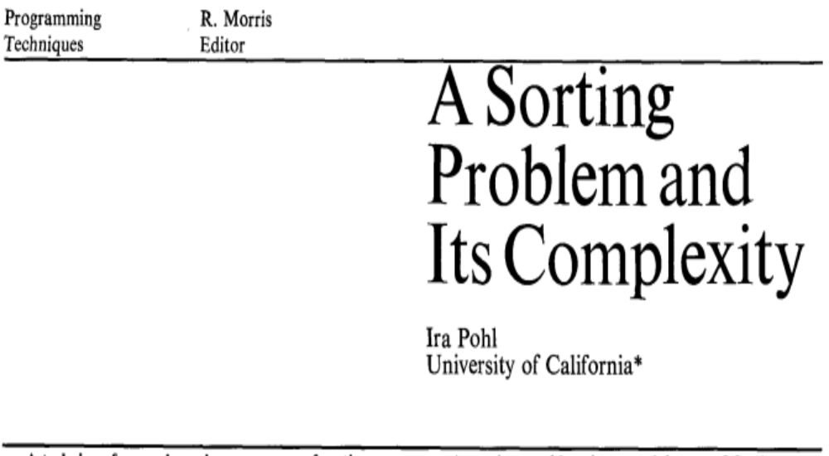
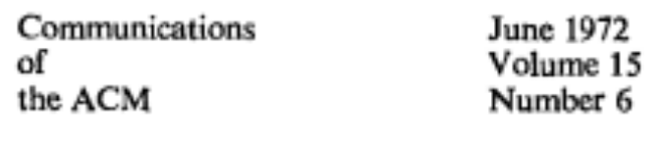

Slide 5
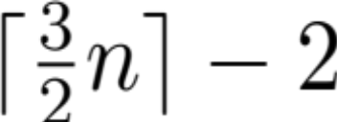
Finding both min and max
To find minimum (or maximum) of n elements
we need n – 1 comparisons
Don’t we need 2n – 2 (or 3?) comparisons to find both?
Ira showed that we need at most comparisons
And he showed that his algorithm is optimal

Slide 6
maybe min or maybe max
not max not min
not min and not max

Slide 7

Strict Weak Ordering
Weak trichotomy
Transitivity
Irreflexivity, or strictness

Slide 8
template <StrictWeakOrdering R>
struct min_max
{
R r;
template <Regular T> // T == Domain<R>
const T& min(const T& x,
const T& y) const {
if (r(y, x)) return y;
else return x;
}

Slide 9

Weak Commutativity
Is min commutative?
Not for StrictWeakOrdering
Weak Commutativity!
Set with min defined is
  semigroup
  (weak Abelian) semigroup
Weak theories
  equivalence axioms (instead of equational)

Slide 10
template <Regular T> // T == Domain<R>
const T& max(const T& x,
const T& y) const {
if (r(y, x)) return x;
else return y;
}

Slide 11
// the idiot who designed STL wrote:
template <Regular T> // T == Domain<R>
const T& max(const T& x,
const T& y) const {
if (r(x, y)) return y;
else return x;
}
// why is it wrong?

Slide 12
template <Regular T> // T == Domain<R>
pair<T, T> construct(const T& x,
const T& y) const {
if (r(y, x)) return {y, x};
else return {x, y};
}

Slide 13
template <Regular T> // T == Domain<R>
pair<T, T>
combine(const pair<T, T>& x,
const pair<T, T>& y) const {
return { min(x.first, y.first),
max(x.second, y.second) };
}
};

Slide 14
Iterators
Input
Forward
Bidirectional
RandomAccess

Slide 15
template <StrictWeakOrdering R>
struct compare_dereference
{
R r;
template <InputIterator I>
// Domain<R> == ValueType<I>
bool operator()(const I& i,
const I& j) const {
return r(*i, *j);
}
};

Slide 16
template <ForwardIterator I,
StrictWeakOrdering R>
pair<I, I>
min_max_element_even_length(I first,
I last,
R r) {
// assert(distance(first, last) % 2 == 0)
min_max<compare_dereference<R>> op{r};
if (first == last) return {last, last};

Slide 17
I prev = first;
pair<I, I> result =
op.construct(prev, ++first);
while (++first != last) {
prev = first;
result = op.combine(
result,
op.construct(prev, ++first));
}
return result;
}

Slide 18
template <ForwardIterator I,
StrictWeakOrdering R>
pair<I, I>
min_max_element(I first, I last, R r) {
min_max<compare_dereference<R>> op{r};
I prev = first;
if (first == last || ++first == last)
return {prev, prev};

Slide 19
pair<I, I> result =
op.construct(prev, first);
while (++first != last) {
prev = first;
if (++first == last)
return op.combine(result,
{prev, prev});
result = op.combine(
result,
op.construct(prev, first));
}
return result;
}

Slide 20
Type Functions
template <InputIterator I>
using ValueType = typename
std::iterator_traits<I>::value_type;

Slide 21
template <InputIterator I,
StrictWeakOrdering R>
pair<ValueType<I>, ValueType<I>> min_max_value_nonempty(I first,
I last,
R r) {
typedef ValueType<I> T;
min_max<R> op{r};
T val = *first;
if (++first == last) return {val, val};

Slide 22
pair<T, T> result =
op.construct(val, *first);
while (++first != last) {
val = *first;
if (++first == last)
return op.combine(result,
{val, val});
result = op.combine(
result,
op.construct(val, *first));
}
return result;
}

Slide 23
template <InputIterator I,
StrictWeakOrdering R>
pair<ValueType<I>, ValueType<I>> min_max_value(I first, I last, R r) {
typedef ValueType<I> T;
if (first == last)
return {supremum(r), infimum(r)}
return min_max_value_nonempty(first,
last,
r);
}

Slide 24
I have been teaching this algorithm every 2 – 3 years for the last 30 years
When I teach it, I implement it anew
Writing the code and teaching it gives me joy every time

Slide 25
THANK YOU, IRA!

Slide 26
Getting rid of an extra compare
// Add to min_max:
template <Regular T> // T == Domain<R>
pair<T, T> combine(const pair<T, T>& x,
const T& val) const {
if (r(val, x.first)) return { val, x.second};
if (r(val, x.second)) return x;
return {x.first, val};
}

Slide 27
Getting rid of an extra compare (2)
// In min_max_element and
// min_max_value_nonempty, replace:
if (++first == last)
return op.combine(result, {val, val});
// with
if (++first == last)
return op.combine(result, val);

