Slide 1
Journey Three:
Successors of Peano
The axioms of natural numbers and their relation to iterators and the nonlinear traversal of binary trees.

Slide 2
Successors of Peano
Lecture 1

Slide 3
Axioms and Computers
Formalization of Mathematics led to work of Gödel and Turing.
Specifying software is based on axioms.
Concepts are a way of grouping axioms together.

Slide 4
Euclid’s Axiomatic Method
Euclid is the founder of the axiomatic method:
Definitions
Postulates
Common notions

Slide 5
23 Definitions
1. A point is that which has not parts.
…
23. Parallel straight lines are straight lines which, being in the same plane and being produced indefinitely in both directions, do not meet one another in either direction.

Slide 6
Common Notions
Things which are equal to the same thing are also equal to one another.
If equals be added to equals, the whole are equal.
If equals be subtracted from equals, the remainders are equal.
Things which coincide with one another are equal to one another.
The whole is greater than the part.

Slide 7
Modern Restatement of
Common Notions
Notes:
\begin{enumerate}
\item
$a = c \wedge b = c \implies a = b$
\item
$a = b \wedge c = d \implies a + c = b + d$
\item
$a = b \wedge c = d \implies a - c = b - d$
\item
$a \equiv b \implies a = b$
\item
$a < a + b$
\end{enumerate}

Slide 8
Postulates
To draw a straight line from any point to any point.
To produce a finite straight line continuously in a straight line.
To describe a circle with any centre and distance.
That all right angles are equal to one another.
That, if a straight line falling on two straight lines make the interior angles on the same side less than two right angles, the two straight lines, if produced indefinitely, meet on that side on which are the angles less than the two right angles.

Slide 9
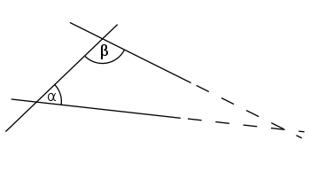
α + β < 180°

Slide 10
Equivalent Formulations
Given a line and a point not on it, at most one parallel to the given line can be drawn through the point.
  Playfair’s axiom
There exists a triangle whose angles add up to 180°.
There exist two similar triangles that are not congruent.

Slide 11
Proving Vth postulate
Ptolemy (90 – 168)
Omar Khayyam (1050–1123)
Girolamo Saccheri (1667-1733)

Slide 12
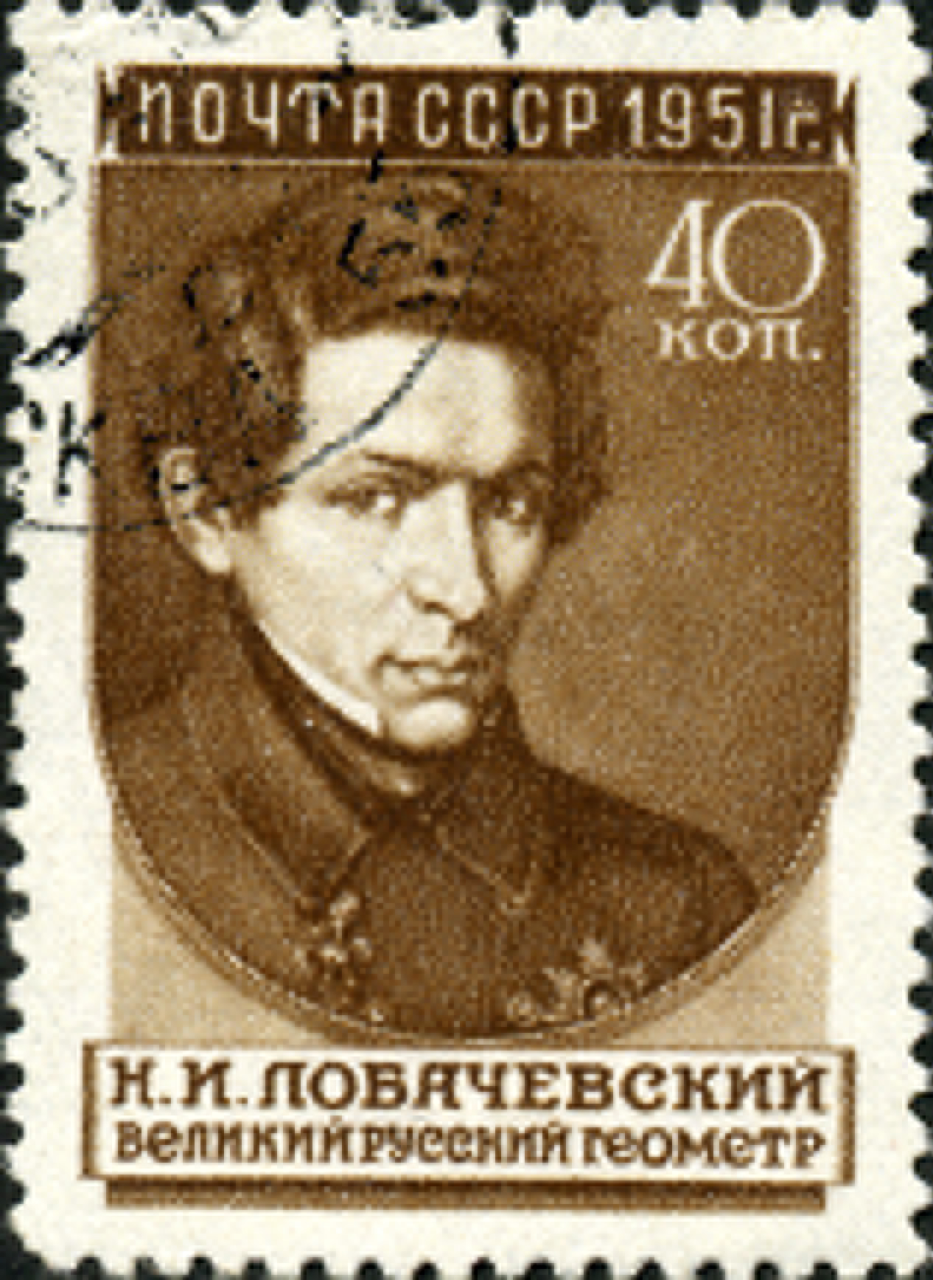
Nikolai Ivanovich Lobachevsky
(1792 -1856)

Slide 13
Lobachevsky’s Work
Taught by Johann Bartels
  Professor of Gauss
Kazan University
  Professor, rector (president)
Non-Euclidean Geometry
  First reported in 1826
  Rejected by Philistines (1832 – 1834)
  Elected to Göttingen Academy of Sciences (1842)
  Last major book (Pangeometry) in 1855

Slide 14
Lobachevsky’s Impact
“It is no exaggeration to call Lobatchewsky the Copernicus of Geometry, for geometry is only a part of the vaster domain which he renovated; it might even be just to designate him as a Copernicus of all thought.”
E.T. Bell, Men of Mathematics, page 306

Slide 15
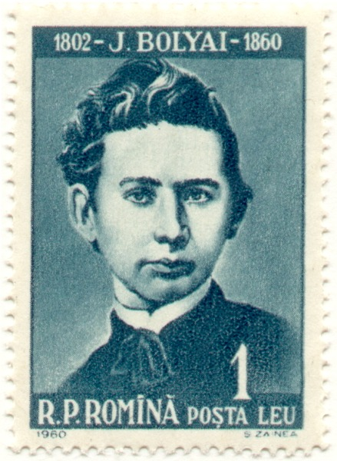
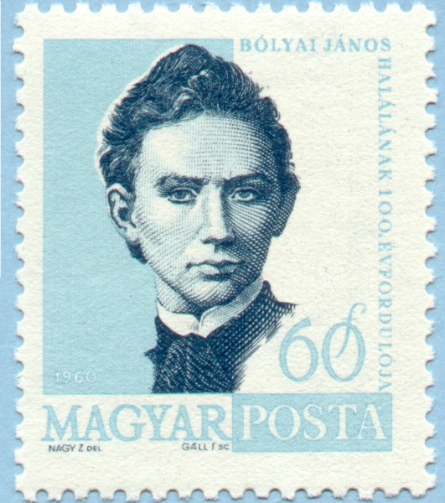
Janos Bolyai
(1802 – 1860)

Slide 16
Bolyai Tragedy
“If I commenced by saying that I am unable to praise this work, you would certainly be surprised for a moment. But I cannot say otherwise. To praise it would be to praise myself. Indeed the whole contents of the work, the path taken by your son, the results to which he is led, coincide almost entirely with my meditations, which have occupied my mind partly for the last thirty or thirty-five years.”
Letter from Carl Gauss to Farkas Bolyai

Slide 17
Geometry and Reality
Who is right, Euclid or Lobachevsky?
Gauss’s experiment
Independence of the V postulate
  Beltrami, Poincare and Klein
“It does not matter if we call the things chairs, tables and beer mugs or points, lines and planes.”
  David Hilbert

Slide 18
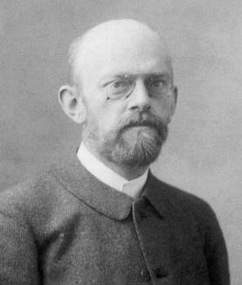
David Hilbert (1862 – 1943)

Slide 19
Hilbert’s Work
Invariant theory
Theory of algebraic integers
Foundations of geometry
Hilbert Spaces
Mathematical Physics
  General Relativity Theory
Foundations of Mathematics

Slide 20
Hilbert’s Axioms
7 axioms of connection
  If two points lie on a plane, all points on the line going through these points are on this plane.
4 axioms of order
  There is a point between any two points on a line.
1 axiom of parallels
6 axioms of congruence
  Two triangles are congruent if side-angle-side…
1 Archimedes' axiom
(6.) 1 Completeness axiom
Notes:
(But see the work of Laura Meikle and Jacques Fleuriot…)

Slide 21
Hilbert’s 23 Problems
1. Continuum hypothesis
2. Consistency of arithmetic
…
10. Existence of a solution to Diophantine equation
…

Slide 22
Hilbert’s Program
To formalize mathematics:
  every proposition is written in a formal language
  complete: every true proposition is provable
  consistent: no contradiction can be derived

Slide 23
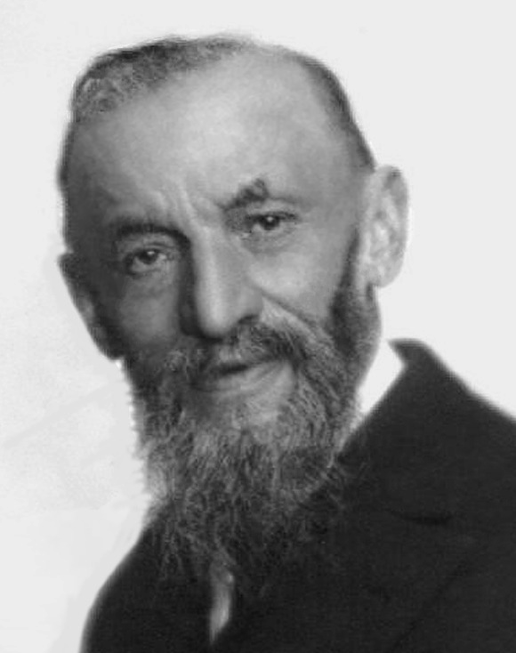
Giuseppe Peano (1858 -1932)

Slide 24
Peano Work
Space filling curve (Peano curve) – 1890
Formulario Mathematico – 1891 till 1908
Latine sine flexione – 1903 till about 1930

Slide 25
Peano on
“tables, chairs and beer mugs”
“Certainly it is permitted to anyone to put forward whatever hypotheses he wishes, and to develop the logical consequences contained in those hypotheses. But in order that this work merit the name of Geometry, it is necessary that these hypotheses or postulates express the result of the more simple and elementary observations of physical figures.”
Notes:
Hubert Kennedy
The Mathematical Philosophy of Giuseppe Peano
Philosophy of Science 30 (1963): 262–266
http://hubertkennedy.angelfire.com/TwelveArticles.pdf

Slide 26
Peano Axioms
Notes:
~~\\
There is a set $\mathbb{N}$ called the \emph{natural numbers}:
\begin{enumerate}
\item
$ \exists 0 \in \mathbb{N} $
\item
$\forall n \in \mathbb{N} ~:~\exists n' \in \mathbb{N}$ -- ~called its \emph{successor}
\item
$\forall \mathbb{S} \subset \mathbb{N} ~:~
(0 \in \mathbb{S} \wedge \forall n ~:~ n \in \mathbb{S} \implies n' \in \mathbb{S}) \implies \mathbb{S} = \mathbb{N}$
\item
$\forall n, m\in \mathbb{N} ~:~n'= m' \implies n = m$
\item
$\forall n \in \mathbb{N} ~:~ n' \neq 0$
\end{enumerate}

Slide 27
Axioms in Interlingua
0. N₀ es classe, vel “numero” es nomen commune.
Zero es numero.
Si a es numero, tunc suo successivo es numero.
3. N₀ es classe minimo, que satisfac ad conditione
0, 1, 2; […]
Duo numero, que habe successivo aequale, es aequale inter se.
5. 0 non seque ullo numero.

Slide 28
Modern Variations
Many modern texts start natural numbers with 1 and not 0.
They often put the induction axiom last.
Sometimes they replace second order induction axiom with a first order induction axiom schema.

Slide 29
Predecessors of Peano
Hermann Grassmann (1809 – 1877)
  Lehrbuch der Arithmetik (1861)
Richard Dedekind
  Was sind und was sollen die Zahlen? (1888)

Slide 30
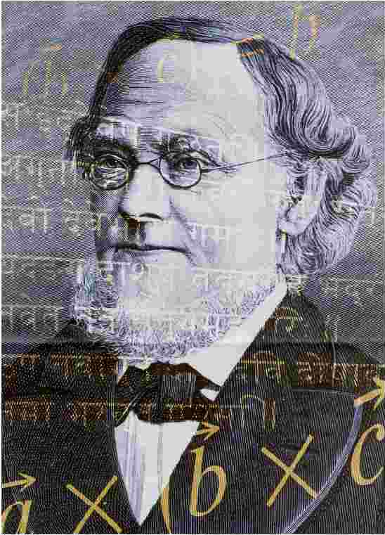
Hermann Grassmann

Slide 31
Independence of Peano Axioms
To prove that every axiom is needed, we need to remove each one from the set of axioms and demonstrate that the remaining set has models that do not meet our intent. (In other words, they are not isomorphic to our natural numbers.)

Slide 32
Removing
Existence of 0 Axiom
Notes:
\begin{enumerate}
%\item
%$ \exists 0 \in \mathbb{N} $
\item
$\forall n \in \mathbb{N} ~:~\exists n' \in \mathbb{N}$ -- ~called its \emph{successor}
\item
$\forall \mathbb{S} \subset \mathbb{N} ~:~
(
%0 \in \mathbb{S} \wedge
\forall n ~:~ n \in \mathbb{S} \implies n' \in \mathbb{S}) \implies \mathbb{S} = \mathbb{N}$
\item
$\forall n, m\in \mathbb{N} ~:~n'= m' \implies n = m$
%\item
%$\forall n \in \mathbb{N} ~:~ n' \neq 0$
\end{enumerate}

Slide 33
Trivial model
Notes:
\varnothing

Slide 34
Removing
Totality of Successor Axiom
Notes:
\begin{enumerate}
\item
$ \exists 0 \in \mathbb{N} $
%\item
%$\forall n \in \mathbb{N} ~:~\exists n' \in \mathbb{N}$ -- ~called its \emph{successor}
\item
$\forall \mathbb{S} \subset \mathbb{N} ~:~
(
0 \in \mathbb{S} \wedge
\forall n ~:~ n \in \mathbb{S} \implies n' \in \mathbb{S}) \implies \mathbb{S} = \mathbb{N}$
\item
$\forall n, m\in \mathbb{N} ~:~n'= m' \implies n = m$
\item
$\forall n \in \mathbb{N} ~:~ n' \neq 0$
\end{enumerate}

Slide 35
Finite linear models
{0}
{0, 1}
{0, 1, 2}
…

Slide 36
Removing Induction Axiom
Notes:
\begin{enumerate}
\item
$ \exists 0 \in \mathbb{N} $
\item
$\forall n \in \mathbb{N} ~:~\exists n' \in \mathbb{N}$ -- ~called its \emph{successor}
%\item
%$\forall \mathbb{S} \subset \mathbb{N} ~:~
%(
%0 \in \mathbb{S} \wedge
%\forall n ~:~ n \in \mathbb{S} \implies n' \in \mathbb{S}) \implies \mathbb{S} = \mathbb{N}$
\item
$\forall n, m\in \mathbb{N} ~:~n'= m' \implies n = m$
\item
$\forall n \in \mathbb{N} ~:~ n' \neq 0$
\end{enumerate}

Slide 37
Transfinite ordinals
{0, 1, 2, 3, …, ω, ω+1, ω+2, …}
{0, 1, 2, 3, …, ω₁, ω₁+1, ω₁+2, …, ω₂, ω₂+1, ω₂+2, …}
…

Slide 38
Removing
Invertibility of Successor Axiom
Notes:
\begin{enumerate}
\item
$ \exists 0 \in \mathbb{N} $
\item
$\forall n \in \mathbb{N} ~:~\exists n' \in \mathbb{N}$ -- ~called its \emph{successor}
\item
$\forall \mathbb{S} \subset \mathbb{N} ~:~
(
0 \in \mathbb{S} \wedge
\forall n ~:~ n \in \mathbb{S} \implies n' \in \mathbb{S}) \implies \mathbb{S} = \mathbb{N}$
%\item
%$\forall n, m\in \mathbb{N} ~:~n'= m' \implies n = m$
\item
$\forall n \in \mathbb{N} ~:~ n' \neq 0$
\end{enumerate}

Slide 39
ρ-shaped structures
{0, 1, 1, 1, …}
{0, 1, 2, 1, 2, …}
{0, 1, 2, 3, 4, 5, 3, 4, 5, …}
…

Slide 40
Removing
Nothing has 0 as its Successor Axiom
Notes:
\begin{enumerate}
\item
$ \exists 0 \in \mathbb{N} $
\item
$\forall n \in \mathbb{N} ~:~\exists n' \in \mathbb{N}$ -- ~called its \emph{successor}
\item
$\forall \mathbb{S} \subset \mathbb{N} ~:~
(
0 \in \mathbb{S} \wedge
\forall n ~:~ n \in \mathbb{S} \implies n' \in \mathbb{S}) \implies \mathbb{S} = \mathbb{N}$
\item
$\forall n, m\in \mathbb{N} ~:~n'= m' \implies n = m$
%\item
%$\forall n \in \mathbb{N} ~:~ n' \neq 0$
\end{enumerate}

Slide 41
Circular structures
{0, 0, …}
{0, 1, 0, 1, …}

Slide 42
Definition of addition
Notes:
a + 0 &= a\\
a+b' &= (a+b)'

Slide 43
0 is left additive identity
Notes:
\rm{base~step}:\\ ~0 + 0 &= 0 \\
\rm{induction~step}:\\ 0 + a &= a \implies 0 + a' = (0 + a)' = a'

Slide 44
Definition of Multiplication
Notes:
a \cdot 0 &= 0\\
a \cdot b' &= (a \cdot b) + a

Slide 45
Notes:
\rm{base~step}:\\ ~0\cdot 0 &= 0 \\
\rm{induction~step}:\\ 0 \cdot a &= 0 \implies 0 \cdot a' = 0 \cdot a + 0 = 0

Slide 46
Definition of 1
Notes:
a + 0 &= a\\
a+b' &= (a+b)'

Slide 47
Adding 1
Notes:
a + 1 = a + 0' = (a + 0)' = a'

Slide 48
Multiplying by 1
Notes:
a \cdot 1 = a \cdot 0' = a \cdot 0 + a = 0 + a = a

Slide 49
Associativity of addition
Notes:
\rm{base~step}:\\ ~(a + b) + 0 &= a + b = a + (b + 0)\\
\rm{induction~step}:\\ (a + b) + c &= a + (b+ c) \implies \\
(a +b) + c' &= ((a + b) + c)' =\\ (a + (b + c))' &=
a + (b + c)' = a + (b + c')

Slide 50
a + 1 = 1 + a
Notes:
\rm{base~step}:\\ ~1 + 0 &= 1 + 0 = 1\\
\rm{induction~step}:\\ a + 1 &= 1 + a \implies \\
a' + 1 &= a' + 0' =\\
(a' + 0)' &= ((a + 1) + 0)' = \\
(a + 1)' &= (1 + a)' = 1 + a'

Slide 51
Commutativity of addition
Notes:
\rm{base~step}:\\ ~a + 0 &= a = 0 + a\\
\rm{induction~step}:\\ a + b &= b + a \implies \\
a + b' &= a + (b + 1) =\\
(a + b) + 1 &= (b + a) + 1 = \\
b + (a + 1) &= b + (1 + a) = \\
(b + 1) + a & = b' + a

Slide 52
Problem 52
Using induction prove
  associativity and commutativity of multiplication
  distributivity of multiplication over addition

Slide 53
Problem 53
Using induction define total ordering between natural numbers.

Slide 54
Problem 54
Using induction define the following partial functions on natural numbers.
  predecessor
  subtraction

Slide 55
Limitation of Peano Axioms
“…the answer is that number (positive integer) cannot be defined (seeing that the ideas of order, succession, aggregate, etc., are as complex as that of number).”
Giuseppe Peano

Slide 56
Utility of Axioms
Axioms explain, not define.
Explanation could be really slow
  defining + from successor
Or not constructive at all
  there is an inverse element

Slide 57
Successors of Peano
Lecture 2

Slide 58
Sets
Peano axioms referred to the set of natural numbers.
What are sets?
Does a set of natural numbers exist?

Slide 59
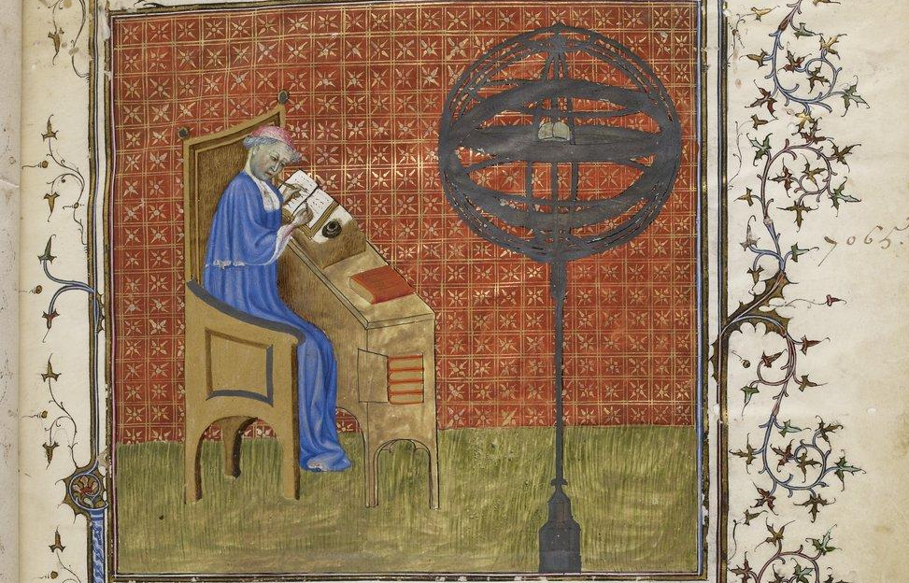
Nicole Oresme (1320 – 1382)

Slide 60
Oresme Accomplishments
Cartesian coordinates
Translation of Aristotle into French
Proof of Merton theorem
  The distance traveled in any given period by a body moving under uniform acceleration is the same as if the body moved at a uniform speed equal to its speed at the midpoint of the period
  Thomas Bradwardine and Oxford Calculators
Economics
  Monetary policy

Slide 61
Convergent infinite series
Notes:
\sum_{i=1}^{\infty}\frac{i}{2^{i-1}} = 1 + 2 \cdot \frac{1}{2} + 3 \cdot \frac{1}{4}+ \dots + n \cdot\frac{1}{2^{n-1}} + \dots = 4

Slide 62
step 1
Notes:
~\\
~~~1 + 2 \cdot \frac{1}{2} + 3 \cdot \frac{1}{4}+ \dots + n \cdot\frac{1}{2^{n-1}}

Slide 63
step 2
Notes:
~\\
(1 + \frac{1}{2} + \frac{1}{4}+ \dots + \frac{1}{2^{n-1}} + \dots) +\\
~~~~~~~~(\frac{1}{2} + \frac{1}{4}+ \dots + \frac{1}{2^{n-1}} + \dots) +\\
~~~~~~~~~~~~~~~~(\frac{1}{4}+ \dots + \frac{1}{2^{n-1}} + \dots) + \dots =\\

Slide 64
step 3
Notes:
~\\
1 \cdot (1 + \frac{1}{2} + \frac{1}{4}+ \dots + \frac{1}{2^{n-1}} + \dots) +\\
\frac{1}{2} \cdot (1 + \frac{1}{2} + \frac{1}{4}+ \dots + \frac{1}{2^{n-1}} + \dots) +\\
\frac{1}{4} \cdot (1 + \frac{1}{2} + \frac{1}{4}+ \dots + \frac{1}{2^{n-1}} + \dots) + \dots =\\

Slide 65
step 4
Notes:
~\\
(1 + \frac{1}{2} + \frac{1}{4}+ \dots)\cdot(1 + \frac{1}{2} + \frac{1}{4}+ \dots) = 2\cdot2 = 4

Slide 66
Divergence of Harmonic series
Notes:
\sum_{i=1}^{2^n}\frac{1}{i} = 1 &+ \frac{1}{2}
\\ &+ (\frac{1}{3} + \frac{1}{4})
\\ &+ (\frac{1}{5} + \frac{1}{6} + \frac{1}{7}+ \frac{1}{8})
\\ &+ \dots
\\ &+ (\frac{1}{2^{n-1}+1} + \dots + \frac{1}{2^{n}}) \geq \frac{n}{2}

Slide 67
One-to-one Correspondence
“Oresme shows by the principle of one-to-one correspondence that the collection of odd natural numbers is not smaller than the collection of natural numbers, because it is possible to count the odd natural numbers by the natural numbers.”
Stanford Encyclopedia of Philosophy

Slide 68
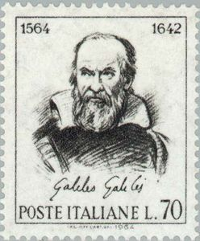
Galileo Galilei

Slide 69
Main Books
(20 volumes total)
[1632] Dialogue Concerning the Two Chief
World Systems.
[1638] Dialogues Concerning Two New
Sciences.

Slide 70
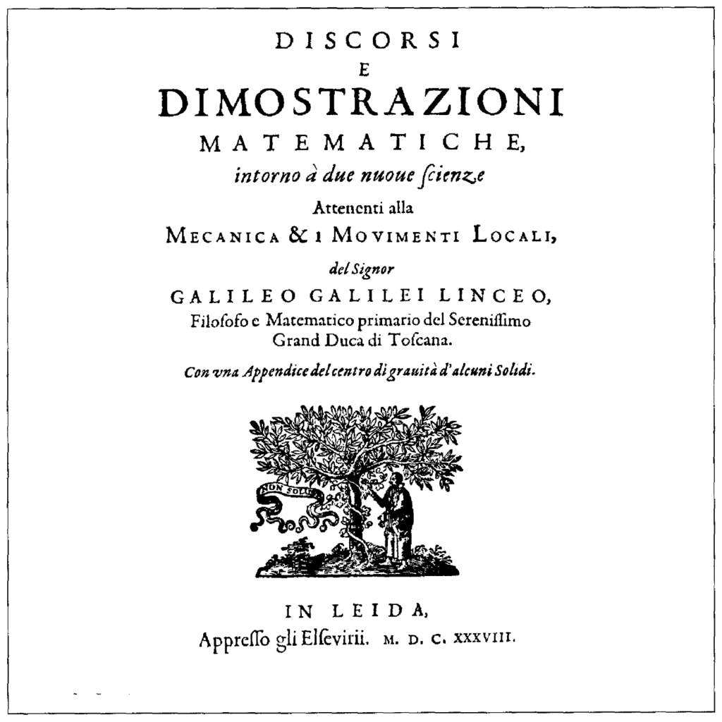
Two New Sciences (1638)

Slide 71
Two Sciences
Strength of materials
  Square-cube law
Laws of motion
  Uniform acceleration of falling bodies
  Trajectory of projectiles

Slide 72
Galileo on infinity
“This is one of the difficulties which arise when we attempt, with our finite minds, to discuss the infinite, assigning to it those properties which we give to the finite and limited; but this I think is wrong, for we cannot speak of infinite quantities as being the one greater or less than or equal to another.”

Slide 73
Mapping from numbers to squares
Notes:
n &\longleftrightarrow n^2\\
\{1, 2, 3, \dots\} &\longleftrightarrow \{1, 4, 9, \dots\}

Slide 74
Paradox
“The proportionate number of squares diminishes as we pass to larger numbers, Thus up to 100 we have 10 squares, that is, the squares constitute 1/10 part of all the numbers; up to 10000, we find only 1/100 part to be squares; and up to a million only 1/1000 part; on the other hand in an infinite number, if one could conceive of such a thing, he would be forced to admit that there are as many squares as there are numbers taken all together.”

Slide 75
Littlewood’s Paradox
Notes:
http://archive.org/stream/mathematiciansmi033496mbp#page/n15/mode/2up
(5) \emph{An infinity paradox.} Balls numbered 1, 2, … (or for\\
a mathematician the numbers themselves) are put into a\\
box as follows. At 1 minute to noon the
numbers 1 to 10 \\are put in, and the number 1 is taken out.
At $\frac{1}{2}$ minute to\\ noon numbers 11 to 20 are put in and the
number 2 is taken\\ out. At $\frac{1}{3}$ minute 21 to 30 in and 3 out;$~$ and so on. How\\ many are in the box at noon?
\\$~~~~~~~~~~~~~~~~~~~~~~~~~~~~~$\emph{A Mathematician's Miscellany}, page 5

Slide 76
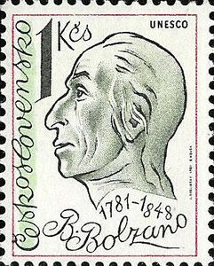
Bernard Bolzano

Slide 77
Contributions
ε-δ definition of continuity
Bolzano-Weierstrass Theorem
  every bounded sequence has a convergent subsequence.
Intermediate value theorem
Uniform convergence
Paradoxien des Unendlichen
Wissenschaftslehre

Slide 78
Paradoxes of the infinite
§19 Not all infinite sets are equal with respect to their
multiplicity
  One could say that all infinite sets are infinite and thus one cannot compare them, but most people will agree that an interval in the real line is certainly a part and thus agree to a comparison of infinite sets.
§20 There are distinct infinite sets between which there is
1-1 correspondence. It is possible to have a 1-1
correspondence between an infinite set and a proper
subset of it.
  y=12/5x and y=5/12x gives a 1-1 correspondence between [0,5] and [0,12].
§21 If two sets A and B are infinite, one can not conclude
anything about the equality of the sets even if there is a
1-1 correspondence.
  If A and B are finite and A is a subset of B such that there is a 1-1 correspondence, then indeed A=B
  The above property is thus characteristic of infinite sets.

Slide 79
“There are truths, at least one”
“That no proposition has truth disproves itself because it is itself a proposition and we should have to call it false in order to call it true. For, if all propositions were false, then this proposition itself, namely that all propositions are false, would be false. Thus, not all propositions are false, but there also true propositions.”
Notes:
Theory of Science, paragraph 31, page 39

Slide 80
There is at least one true proposition
Consider the following propositions:
  There are no true propositions.
  If 1 is true then 1 is false.
  1 is false.
  3 is true.
  There is at least one true proposition.

Slide 81
Problem 81
Using Bolzano method, prove that there are infinitely many true propositions.

Slide 82
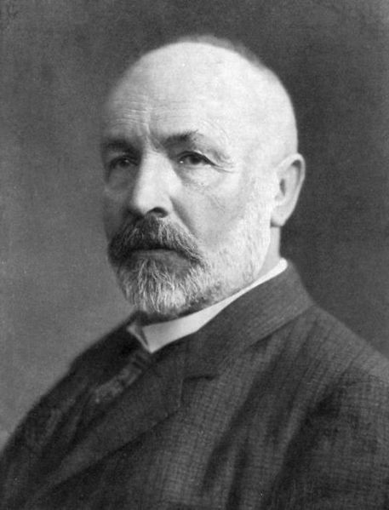
Georg Cantor
(1845 – 1918)

Slide 83
Cantor-Dedekind Correspondence
(November - December 1873)
[Cantor] Could we enumerate positive real numbers?
[Dedekind] It is not an interesting question… But here is the proof that we can enumerate the algebraic numbers.
[Cantor] Then if the answer to my question is no, it would prove the existence of transcendental numbers…
[Cantor] The answer is NO!

Slide 84
Countable Sets
Hilbert’s hotel

Slide 85
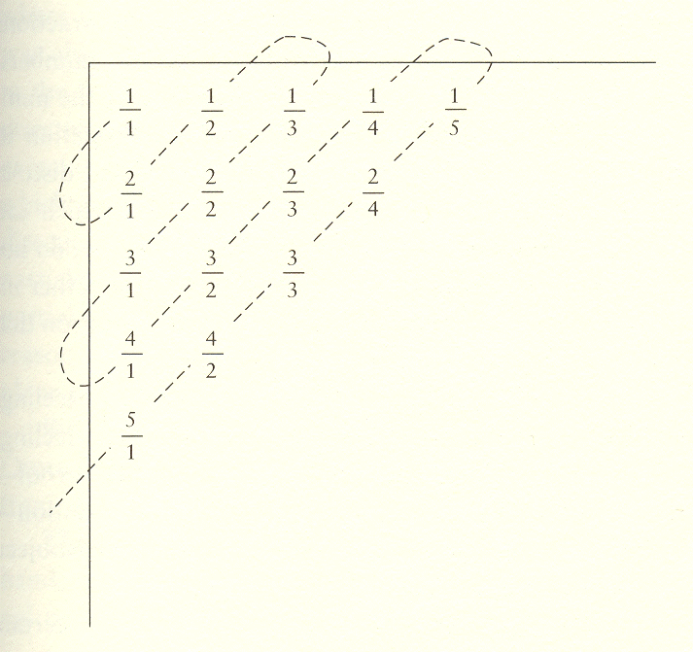
Counting Rational Numbers
Notes:
http://mindfire.ca/Mathematics,%20Physics%20&%20%20Reality/Part%20Three%20-%20Cantor's%20Infinities.htm

Slide 86
Counting Algebraic Numbers
An real number is called algebraic if it is a root of a polynomial with integer coefficients.
A polynomial has weight k if k is the maximum of absolute values of its coefficients and exponents.
There is a finite number of polynomials of a given weight and every one of them has finitely many roots.

Slide 87
Cantor’s 1874 Theorem
Notes:
{\color[rgb]{0.000000,0.000000,0.000000}~\\
Given a closed interval of real numbers and \\a sequence of real
numbers, the interval contains\\
a number that is not in the sequence.\\\\
Formally:\\
If $a_0, b_0 \in \mathbb{R} \wedge a_0 < b_0$ and $\{r_i\}_{i =
0}^\infty \subseteq \mathbb{R}$\\
then $\exists c \in [a_0, b_0]$ such that $c \notin \{r_i\}$.\\\\
Informally:\\
You cannot enumerate every point in a line segment.}

Slide 88
1874 proof of uncountability of continuum
Notes:
\begin{enumerate}
\item Find the first pair of distinct elements in the sequence $\{r_i\}$ that is in the interval $[a_0, b_0]$. (If there is no such pair, then, obviously there is an element in $[a_0, b_0]$ such that it is not in the sequence; therefore; we are done with the proof.)
\item Designate the smaller element of the pair $a_1$ and the larger one $b_1$, and repeat steps 1 and 2 with the interval $[a_0, b_0]$ being replaced with the $[a_1, b_1]$ and the sequence $\{r_i\}$ with the "unused" elements in the sequence $\{r_i\}$.
\item Observe that $r_i$ does not belong to the inside of the interval $[a_{2i}, b_{2i}]$.
\item So if the sequence of intervals $[a_i, b_i]$ is finite, the middle of the last interval is not in the sequence
$\{r_i\}$.
\item If the sequence of intervals $\{[a_i, b_i]\}$ is infinite, no element $r_i$ could belong to its intersection
$\bigcap[a_i, b_i]$. And since we know that the intersection is not empty, an element from it will not be in $\{r_i\}$.
\end{enumerate}

Slide 89
Problem 89
Prove that the intersection of nested, closed intervals is not empty.

Slide 90
Two Kinds of Infinity
Notes:
\begin{enumerate}
\item Sets equipotent to $\mathbb{N}$ have cardinality $\aleph_0$.
\item Sets equipotent to $\mathbb{R}$ have cardinality $\mathfrak{C}$.
\end{enumerate}

Slide 91
Transcendental Numbers
Since there are “more” real numbers than algebraic numbers, most real numbers are transcendental.

Slide 92
There are very few algebraic numbers.
Notes:
Every countable set $\{a_i\}$ of reals is of measure 0.\\
Take the union of open intervals
$$\bigcup_{i=0}^\infty(a_i - \frac{\epsilon}{2^{i+2}},~ a_i + \frac{\epsilon}{2^{i+2}})~~~~~~~~~~~~~~~~~~~~~~~~~~$$
The size of the union is $\epsilon$.
\\Since we can make $\epsilon$ however small, the measure of the set is 0.

Slide 93
Notes:
Power set: $2^S$ or $\mathcal{P}(S)$
x \in 2^S \iff x \subseteq S

Slide 94
Problem 94
Prove that a power set of a finite set with n elements contains 2^{n} elements.

Slide 95
Notes:
|2^{\aleph_0}| = |\mathfrak{C}|
\begin{enumerate}
\item $|\mathbb{R}| = |\mathbb{R}^+|$ through $f(x) = \ln(x)$
\item $|(0, 1) | = |\mathbb{R}^+|$ through $f(x) = \frac{1}{x} - 1$
\item $|(0, 1)| = |\rm{Seq}\{0, 1\}|$ through binary (?)
\item $|2^{\aleph_0}| = |\rm{Seq}\{0, 1\}|$ through the characteristic function
\end{enumerate}

Slide 96
Continuum Hypothesis (CH)
Notes:
~\\
There are no cardinalities between $\aleph_0$ and $\mathfrak{C}$.\\\\
In other words, $\mathfrak{C} = 2^{\aleph_0} = \aleph_1$

Slide 97
History of CH
Georg Cantor (1878) states it.
David Hilbert (1900) makes it famous.
Kurt Gödel (1940) shows that it cannot be disproved in ZF or ZFC.
Paul Cohen (1963) shows that it cannot be proved in ZF or ZFC.
  but Cohen believed it to be false!

Slide 98
Onto or Surjective Functions
Notes:
~~~~~~~~~~~~~~~~~~~~~~~~~~~~~~~~~~~~A function $f:X \rightarrow Y$ is called \emph{onto} if
$$ \forall y \in Y ~\exists x \in X~ : ~ f(x) = y$$

Slide 99
Cantor’s Theorem (1891)
There is no onto function from a set to its power set.

Slide 100
Diagonalization Proof
Notes:
~\\
Assume the contrary:\\
$~~~~~~$there exist a set $\mathbb{S}$ and
a surjection $f: \mathbb{S} \rightarrow 2^\mathbb{S}$.\\
Take $\mathbb{D} = \{x \in \mathbb{S} | x \notin f(x) \}$.\\
$\mathbb{D} \subset \mathbb{S} \implies \mathbb{D} \in 2^\mathbb{S}$.\\
$f$ is surjective $\implies \exists d \in \mathbb{S} ~:~ f(d) = \mathbb{D}$.\\
$d \in \mathbb{D} \vee d \notin \mathbb{D}$.\\
$d \in \mathbb{D} \implies d \notin \mathbb{D} \implies \neg (d \in \mathbb{D})$.\\
$d \notin \mathbb{D} \implies d \in \mathbb{D} \implies \neg (d \notin \mathbb{D})$.\\
Contradiction.

Slide 101
Infinity of Infinities
Notes:
~\\
Power set sequence: $\aleph_0, 2^{\aleph_0}, 2^{2^{\aleph_0}}, \dots$.\\\\
Designate the $i$th element of the power set sequence as $\beth_i$.\\\\
Use a \emph{limit} operation: $\bigcup_{i=0}^\infty \beth_i$ to go beyond the first sequence.\\\\
Combining power set and limit operations gets into really big sets...

Slide 102
Russell’s Paradox (1903)
Notes:
~\\
Consider the set $S = \{x ~|~ x \notin x\}$ of all sets\\ that
do not contain themselves.\\\\
Is $S \in S$?\\\\
If it is, it is not; if it is not, it is.
~\\

Slide 103
Successors of Peano
Lecture 3

Slide 104
Zermelo’s Axioms (1907)
Notes:
~\\
I. Axiom of extensionality.
If every element of set $M$ is also an element of $N$ and the other way around, then $M=N$. \\
II. Axiom of elementary sets.
There is a set, the \emph{empty set} $\varnothing$, that contains no element.
If $a$ is an object of the domain, there exists a set $\{a\}$, that contains $a$ and only $a$ as an element.
If $a$ and $b$ are two objects of the domain, there always exists a set $\{a, b\}$ containing as elements $a$ and $b$ but no object x distinct from them both.\\
III. Axiom of separation.
Whenever the propositional function $E(x)$ is defined for all elements of a set $M$, $M$ possesses a subset
containing all the elements $x$ of $M$ for which $E(x)$ is true and no other elements.\\
IV. Axiom of the power set.
To every set $T$ there corresponds a set or $\mathcal{P}(T)$
, the power set of $T$, that contains all the subsets of $T$ and no other elements.\\
V. Axiom of the union.
To every set $T$ there corresponds a set $\cup_T$, the union of $T$, that contains all the elements of the elements of $T$ and no other elements.\\
VI. Axiom of choice.\\
VII. Axiom of infinity.\\

Slide 105
Axiom of Choice (AC)
Notes:
If $T$ is a set whose elements all are sets that are\\ different from $\varnothing$, and mutually disjoint, its union $\cup_T$ \\ includes at least one subset $C_T$ having one and only\\ one element in common with each element of $T$.
\\

Slide 106
Banach-Tarski Paradox
Using the axiom of choice, one can cut a sphere into a finite number of pieces that can be so rearranged that one obtains two spheres of the same size as the original sphere.

Slide 107
Axiom of Infinity
Notes:
There exists in the domain at least one set $Z$\\ that contains
the empty set as an element and is\\ so constituted
that to each of its elements $a$ there\\ corresponds
a further element of
the form $\{a\}$.

Slide 108
Problem 108
Notes:
Prove the following theorem (Zermelo):\\\\
Every set M possesses at least one subset $M_0$ \\that is not an element of $M$.\\\

Slide 109
Zermelo-Fraenkel (ZF)
In addition to Zermelo axioms
  Axiom of regularity
    Every non-empty set contains an element disjoint from it.
  Axiom of replacement
    An image of every set is a set.

Slide 110
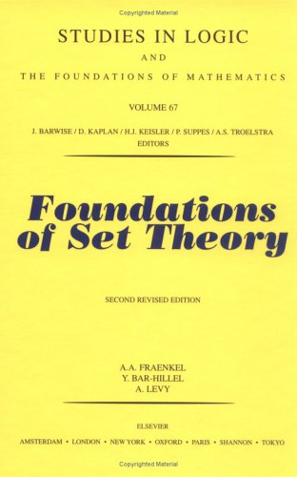
Fraenkel, Bar-Hillel, Levy

Slide 111
Emile Borel
(1871 – 1956)
Les Nombres Inaccessibles (1952)
  There are countably many accessible numbers.

Slide 112
Mathematical Paradise
“No one shall expel us from the Paradise that Cantor has created.”
David Hilbert, Über das Unendliche Mathematische Annalen 95 (1925)

Slide 113
Hilbert’s Program
Formalization of mathematics
Complete
  if a proposition is true it is provable
    either a proposition or its negation is provable
Consistent
  it is impossible to prove both a proposition and its negation
Completeness and consistency should be proven with finitary methods

Slide 114
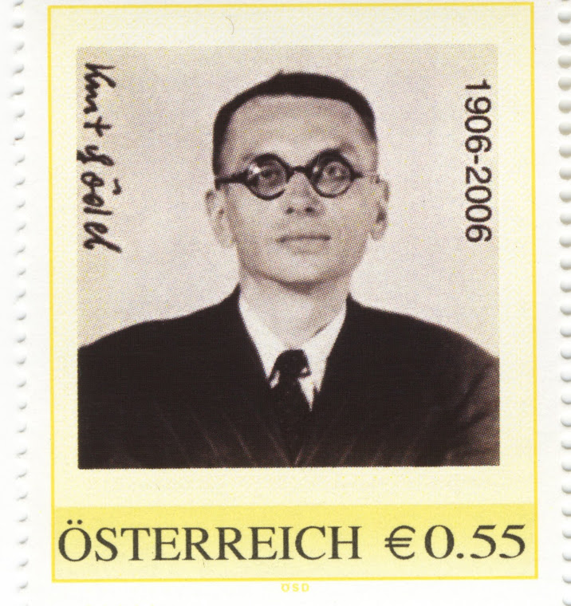
Kurt Gödel (1906 – 1978)

Slide 115
Gödel’s results
Completeness of first-order predicate calculus
Incompleteness theorems (2)
  Gödel numbering
Recursive functions
Length of proofs
Consistency of axiom of choice and continuum hypothesis with ZF

Slide 116
Incompleteness Theorems
Any consistent theory containing Peano arithmetic contains a proposition that is true, but not provable.
Any consistent theory containing Peano arithmetic cannot prove its own consistency.

Slide 117
Magic Proposition
This proposition is not provable.

Slide 118
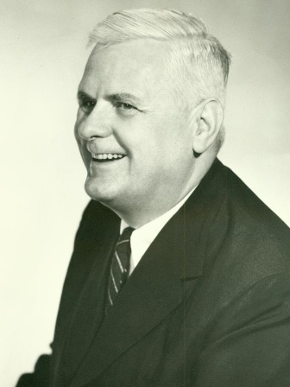
Alonzo Church (1903 – 1995)

Slide 119
Field of Symbolic Logic
A Bibliography of Symbolic Logic (1936)
Founding of the Association of Symbolic Logic
Journal of Symbolic Logic
Introduction to Mathematical Logic. Part 1. (1944, 1956)

Slide 120
Church’s Students
31 students including:
Stephen Kleene
John Rosser
Alan Turing
Leon Henkin
Martin Davis
Hartley Rogers
Michael Rabin
Dana Scott

Slide 121
Church’s Thesis
Whatever can be computed by a modern computer (or a Turing machine) includes everything that can ever be computed.

Slide 122
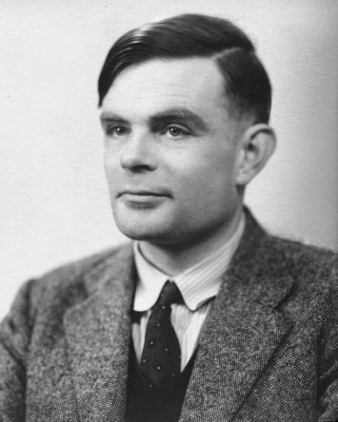
Alan Turing (1912 – 1954)

Slide 123
Turing’s Contributions
Turing machine
Halting problem
Turing-completeness
Enigma code
Turing test
Biology

Slide 124
Diagonalization
Cantor’s proof of the eponymous theorem led to multiple similar proofs in mathematical logic and computer science.
Self-referential propositions have a long history.

Slide 125
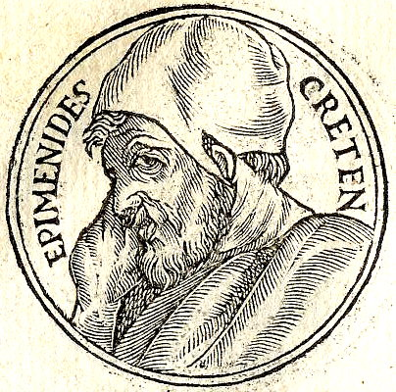
Liar’s Paradox

Slide 126
Insolubilia
What I am saying is false.
Thomas Bradwardine of Merton
Jean Buridan of Paris

Slide 127
Abstracting Diagonalization
It is instructive to try to use the method of abstraction that we learned in the Journey 2 to find a generic form of Cantor’s proof.

Slide 128
Unary-binary Family
Notes:
A set $\mathbb{F}$ of (possibly partial) functions of one ($\mathbb{F}_1$)\\
and two ($\mathbb{F}_2$) variables from domain $T$ to codomain $T’$\\ is called a
\emph{unary-binary family}.
unary and binary has nothing to do with numbers, but with arity of functions.

Slide 129
Examples of
Unary-binary Families
Notes:
\begin{itemize}
\item total functions from $\mathbb{N}$ to $\mathbb{N}$ and from $\mathbb{N}\times \mathbb{N}$ to $\mathbb{N}$
\item continuous functions from $\mathbb{R}$ to $\mathbb{R}$ and from $\mathbb{R}\times \mathbb{R}$ to $\mathbb{R}$
\item computable functions from $\mathbb{N}$ to $\mathbb{N}$ and from $\mathbb{N}\times \mathbb{N}$ to $\mathbb{N}$
\end{itemize}

Slide 130
Interpreter
Notes:
~\\In a unary-binary family $\mathbb{F}$ with the domain $T$\\ a binary function $\mathfrak{I} \in \mathbb{F}_2$
is called an \emph{interpreter} if
\\
\\$~~~~~~~~\forall f \in \mathbb{F}_1 ~~\exists c \in T ~:~\forall x \in T ~~ \mathfrak{I}(c, x) = f(x) $

Slide 131
Example of an interpreter
eval1 in Lisp:
(defun eval1(x y)
(eval (cons x y)))
takes two S-expressions
treats first as code, the second as data

Slide 132
Another interpreter
Notes:
Let us take a unary-binary family $L$ containing \\
unary functions $f_k(x) = x + k$ and binary functions\\
$w_k(x, y) = x + y + k$.
\\\\Then, $w_0(x, y) = x + y$ is an interpreter in $L$, \\since
$f_k(x) = w(k, x)$.

Slide 133
Anti-interpreter
Notes:
~~\\In a unary-binary family $\mathbb{F}$ with the domain $T$, \\a function $\mathfrak{A} \in \mathbb{F}_2$
is called an \emph{anti-interpreter} if
\\
\\$~~~~~~~~\forall f \in \mathbb{F}_1 ~~\exists c \in T ~:~\forall x \in T ~~ f(x) \neq \mathfrak{A}(c, x) $

Slide 134
An example of an anti-interpreter
Notes:
As before, $L$ is a unary-binary family containing \\
unary functions $f_k(x) = x + k$ and binary functions\\
$w_k(x, y) = x + y + k$.
\\\\Then, $w_1(x, y) = x + y + 1$ is an anti-interpreter in $L$, \\since
$w_1(k, x) = x + k + 1 = f_k(x) + 1 \ne f_k(x)$.

Slide 135
eval
Could we make an analogous anti-interpreter for Lisp based on eval?

Slide 136
Diagonalizable Families
Notes:
A unary-binary family $\mathbb{D}$ from $T$ to $T’$ \\is called a
\emph{diagonalizable family} if
\\\\$~~~~~~~~~\forall g \in \mathbb{D}_2 ~~\exists f \in \mathbb{D}_1 ~:~ \forall x \in T ~~ g(x, x) = f(x)$

Slide 137
Example of diagonalizable family
Lisp functions are diagonalizable.
For any function foo we can define a function bar:
(defun bar (x) (foo x x))

Slide 138
Anti-interpreter Theorem
A diagonalizable family does not have an anti-interpreter.
Notes:
A diagonalizable family does not have an anti-interpreter.

Slide 139
Proof of the
Anti-interpreter Theorem
Notes:
Let us assume that there is an anti-interpreter $\mathfrak{A}$.\\
Then let $\mathfrak{a}(x) = \mathfrak{A}(x, x)$. Since $\mathfrak{A}$ is an anti-interpreter
\\$~~~~~~~~~~~\exists c \in T ~:~ \forall x ~~ \mathfrak{a}(x) \neq \mathfrak{A}(c, x)$
\\But then
\\$~~~~~~~~~~~\mathfrak{a}(c) = \mathfrak{A}(c, c) \wedge \mathfrak{a}(c) \neq \mathfrak{A}(c, c)$
\\Contradiction.

Slide 140
How about L ?
Notes:
~~\\$L$ has an interpreter and an anti-interpreter.\\\\
It is not diagonalizable because a function\\
$w_k(x, x) = 2x + k$ is not in the family.

Slide 141
Composable-diagonalizable (C-D) family
Notes:
~~\\
A diagonalizable family $C$ with domain $T$\\and co-domain $T'$
is \emph{composable} if:\\\\
$\exists (\mathfrak{f}:T'\rightarrow T') ~\forall (w \in C) ~:\\~~~~~~~~~\mathfrak{f}(x)
\ne x ~~\wedge~~ \mathfrak{f}(w(x, y)) \in C$

Slide 142
Non-existence of interpreter theorem
A C-D family does not contain an interpreter.

Slide 143
Proof of non-existence of interpreter
Notes:
~~\\
Let us assume that an interpreter $\mathfrak{I}$ exists.\\
We now can compose it with our function $\mathfrak{f}$.\\
Then $\mathfrak{A}(x, y) = \mathfrak{f}(\mathfrak{I}(x, y))$ is an anti-interpreter.\\\\
Indeed, for any unary function $g$ in the family,\\
there is a $c\in T$ such that $\mathfrak{I}(c, x) = g(x)$.\\
But $\mathfrak{A}(c, x) = \mathfrak{f}(\mathfrak{I}(c, x)) = \mathfrak{f}(g(x)) \ne g(x)$.

Slide 144
Interpreter for any
Turing-complete system
Turing constructed a universal Turing machine: a Turing machine which is an interpreter for Turing machines.
If we accept Church’s thesis, such an interpreter exists in any equivalent formulation.

Slide 145
Interpreter Thesis
Any non-trivial set of computable functions that contains an interpreter is Turing-complete.

Slide 146
Examples of C-D families
Total computable functions over integers
Polynomial time functions over integers
Continuous functions over real numbers
Differentiable functions over real numbers

Slide 147
Halting problem
There is no computable function halt(c, x) that returns true if code c terminates on input x and false otherwise.
Indeed, if such a function existed we would be able to construct an anti-interpreter:

Slide 148
Anti-interpreter Code
integer anti_interpreter(integer c,
integer x) {
if (halts(c, x)) {
return interpreter(c, x) + 1;
} else {
return 0;
}
}

Slide 149
Successors of Peano
Lecture 4

Slide 150
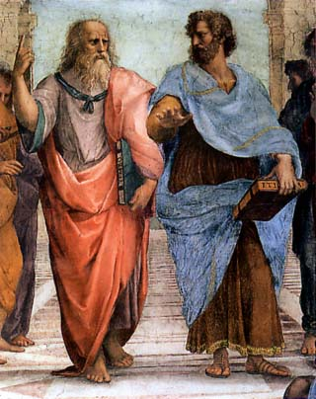
The School of Athens

Slide 151
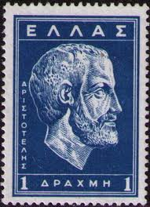
Aristotle (384 BC – 322 BC)

Slide 152
The Summary
πάντες ἄνθρωποι τοῦ εἰδέναι ὀρέγονται φύσει.
All humans naturally desire to know.

Slide 153
Works
Organon
Physics
Metaphysics
Ethics
Poetics
Politics
…

Slide 154
Organon
Categories
On Interpretation
Prior Analytics
Posterior Analytics
Topics
Sophistical Refutations

Slide 155
Individual, Species, Genus
individual
species
genus - differentia
definition
proprium
accident

Slide 156
Theories
A theory is a set of true propositions.
A theory could be generated by a set of axioms plus the set of inference rules.
A theory is finitely-axiomatizable if it can be generated from a finite set of axioms.
A set of axioms is independent if removing one will decrease the set of true propositions.
A theory is complete is for any proposition, either it or its negation is in the theory.
A theory is consistent if for no proposition it contains it and its negation.

Slide 157
Theory of Groups
Notes:
~~\\
operations: $x \circ y, ~~x^{-1}$\\
constant: ~~~~$e$ ~(identity)\\
axioms:
\\$~~~~~x\circ (y\circ z) = (x \circ y) \circ z
\\~~~~~x\circ e = e \circ x = x
\\~~~~~x\circ x^{-1} = x^{-1} \circ x = e$
\\theorems:
\\$~~~~~\forall y ~\forall x ~:~ x\circ y = x \implies y = e
\\~~~~~ (x \circ y)^{-1} = y^{-1} \circ x^{-1}$
\\ $~~~~~$\dots

Slide 158
Model of a theory
A set of elements that satisfies all the propositions in the theory is called its model.

Slide 159
Categorical Theories
A (consistent) theory is categorical or univalent if all of its models are isomorphic.
(This is an original definition of Oswald Veblen. Modern logicians talk about κ-categorical theories: all models of the cardinality κ are isomorphic.)

Slide 160
Groups of order < 13
order | abelian | non-abelian
1 | 1 | 0
2 | 1 | 0
3 | 1 | 0
4 | 2 | 0
5 | 1 | 0
6 | 1 | 1
7 | 1 | 0
8 | 3 | 2
9 | 2 | 0
10 | 1 | 1
11 | 1 | 0
12 | 2 | 3

Slide 161
Non-isomorphic groups of order 4
 | e | a | b | c
e | e | a | b | c
a | a | b | c | e
b | b | c | e | a
c | c | e | a | b
 | e | a | b | c
e | e | a | b | c
a | a | e | c | b
b | b | c | e | a
c | c | b | a | e
Cyclic group Z₄
Klein group

Slide 162
Distinguishing proposition (differentia) for groups of order 4
Notes:
$\forall x \in G ~:~ x^2 = e$\\\\
is true for Klein group but false for $\mathbb{Z}_4$

Slide 163
Different models of Z₄
Additive group of remainders modulo 4
  0, 1, 2, 3
Multiplicative group of non-zero remainders modulo 5
  1, 2, 3, 4
What are possible mappings between them?

Slide 164
Different models of Klein group
Multiplicative group of units modulo 8
  1, 3, 5, 7
Group of isometries transforming a rectangle into itself
What are possible mappings between them?

Slide 165
Propositions vs. models
The more propositions there are in a theory, the fewer different models there are.
  More propositions imply more axioms
The more models there are in a theory, the fewer propositions there are.

Slide 166
Value and its type
A datum is a sequence of bits.
  101
A value is a datum together with its interpretation.
  it is 5.
  it is -1 (how?)
A value-type is a set of values sharing a common interpretation.

Slide 167
Value-types in Programming Languages
C++, Java, etc, do not provide mechanisms for defining value-type.
Every type resides in memory and is an object type.

Slide 168
Object
An object is collection of bits in memory that contain a value of a given type.
An object is immutable if the value never changes.
An object is mutable otherwise.
An object is unrestricted if it can contain any value of its value type.

Slide 169
Object type
An object type is a uniform method of storing and retrieving values of a given value type from a particular object when given its address.
In programming languages, types are object types.

Slide 170
Concepts and their types
Concept is a way of describing a family of related object types.

Slide 171
Integer Concepts and Their Types
Integral
  int8_t, uint8_t, int16_t,…
UnsignedIntegral
  uint8_t, uint16_t, …
SignedIntegral
  int8_t, int16_t, …

Slide 172
Concepts as predicates on types
Concept is a predicate on type that assures that a given type satisfies a set of requirements
  operations
  semantics
  time/space complexity

Slide 173
Type-functions
A function that given a type, returns an affiliated type.
  value_type(Sequence)
  coefficient_type(Polynomial)
  ith_element_type(Tuple, size_t)

Slide 174
Type-attribute
A function that given a type, returns one of its numerical attributes
  sizeof
  alignment_of
  number of members in a struct

Slide 175
Regular
copy-constructor
  default constructor
    T a(b) equivalent to T a; a = b;
assignment
equality
destructor

Slide 176
Semantics of Regular
Notes:
~~\\
$\forall a ~\forall b~\forall c~: T~ a(b) \implies (b = c \implies a = c)$\\
$\forall a ~\forall b~\forall c~: a\leftarrow b \implies (b = c \implies a = c)$\\
$\forall f \in {\rm RegularFunction} ~:~ a = b \implies f(a) = f(b)$
\\ \dots axioms of destructors

Slide 177
Semiregular
Semiregular is like Regular except that equality is not explicitly defined.
It is assumed to be implicitly defined so that axioms that control copying and assignment are still valid.

Slide 178
Swap
template <Semiregular T>
void swap(T& x, T& y) {
T tmp(x);
x = y;
y = tmp;
}

Slide 179
Iterator Concepts
  Fundamental operations
    regular type operations
    successor
    dereferencing

Slide 180
Dereferencing
Dereferencing is assumed to be “fast.”
  There is not faster way of getting to data than through the iterator.
  Iterators might be bigger in size than pointers to allow for navigation.
Past-the-end values
Singular values

Slide 181
Separating successor and dereferencing
  It is possible (as does EoP) to separate successor from dereferencing.
Another way of getting similar results is to assure that dereferencing is defined for all objects

Slide 182
Default dereferencing
(illegal in C++)
template <typename T>
T& operator*(T& x) {
return x;
}
template <typename T>
const T& operator*(const T& x) {
return x;
}

Slide 183
Connection of dereferencing and successor
Dereferencing is defined on an iterator if and only if successor is defined.
There are no non-empty ranges containing no values.
If you are not at the end of the range, you can dereference.

Slide 184
Forward Iterators
equality
dereferencing
successor
All operations are constant time
  algorithms written in terms of these operations are expected to be as fast as possible

Slide 185
Complexity is part of the interface!

Slide 186
Successors of Peano
Lecture 5

Slide 187
Three Fundamental Problems
swap
  copy, assignment, (implied) equality
minimum, maximum
  strict ordering
linear search
  successor

Slide 188
Three fundamental concepts
regular
  semi-regular
total ordering
  weak ordering
iterator concepts

Slide 189
Iterator Categories
Input iterators
  one directional traversal, single-pass algorithms
  model: input stream
Forward iterators
  one directional traversal, multi-pass algorithms
  model: singly-linked list
Bidirectional iterators
  bidirectional traversal, multi-pass algorithms
  model: doubly-linked list
Random access iterators
  random-access algorithms
  model: array

Slide 190
Output Iterators
No equality
dereferencing only as an l-value
alternating ++ and *

Slide 191
Other Categories of Iterators
Linked iterators
  successor function is mutable
Segmented iterators
  std::deque would immediately benefit

Slide 192
distance for input iterators
template <InputIterator I>
DifferenceType(I) distance(I f, I l,
std::input_iterator_tag) {
// precondition: valid_range(f, l)
DifferenceType(I) n(0);
while (f != l) {
++f;
++n;
}
return n;
}

Slide 193
distance for random access iterators
template <RandomAccessIterator I>
DifferenceType(I) distance(I f, I l,
std::random_access_iterator_tag) {
// precondition: valid_range(f, l)
return l - f;
}

Slide 194
difference type
difference type of iterator is an integral type that is large enough to encode the longest possible range

Slide 195
Iterator Traits
value_type
reference
pointer
difference_type
iterator_category

Slide 196
type functions in C++
#define DifferenceType(X) typename \ std::iterator_traits<X>::difference_type

Slide 197
Category dispatch
template <InputIterator I>
inline
DifferenceType(I) distance(I f, I l) {
return distance(f, l,
IteratorCategory(I)());
}

Slide 198
Un-implementability of valid_range
Linked data structures
Pointers

Slide 199
Laws of valid ranges
Notes:
~\\
${\rm container}( c) \implies {\rm valid}({ \rm begin}( c), {\rm end}( c))$\\
${\rm valid}(x, y) \wedge x \ne y \implies {\rm valid}({\rm successor}(x), y)$

Slide 200
advance
(input iterators)
template <InputIterator I>
inline
void advance(I& x, DifferenceType(I) n,
std::input_iterator_tag) {
while (n) {
--n;
++x;
}
}

Slide 201
advance
(random access iterators)
template <RandomAccessIterator I>
inline
void advance(I& x, DifferenceType(I) n,
std::random_access_iterator_tag) {
x += n;
}

Slide 202
advance
template <InputIterator I>
inline
void advance(I& x, DifferenceType(I) n) {
advance(x, n, IteratorCategory(I)());
}

Slide 203
Open, Semi-open and Closed Ranges
open: does not include either end
  (i, j)
semi-open: includes value at i but not at j
  [i, j)
closed: includes value at i and at j
  [i, j]
There are also semi-open ranges (i, j]

Slide 204
Semi-open Ranges
Algorithmically, semi-open ranges are superior
  search
  insert
  rotation
  partition

Slide 205
Positions in a sequence
A sequence of n elements has n + 1 (insertion, rotation, etc) positions.

Slide 206
Bounded and Counted Ranges
A range (open, semi-open, or closed) can be specified in two ways
  bounded: two iterators
  counted: an iterator and length

Slide 207
Ranges
semi-open closed
Bounded: two iterators [i, j) [i, j]
Counted: iterator and integer [i, n) [i, n]

Slide 208
Linear search
template <InputIterator I,
Predicate P>
I find_if(I f, I l, P p) {
while (f != l && !p(*f)) ++f;
return f;
}

Slide 209
Input iterators
Single-pass algorithms
  you cannot step into the same river twice
i == j does not imply ++i == ++j
modifying one copy invalidates the rest

Slide 210
Linear search (counted)
template <InputIterator I,
Predicate P>
std::pair<I, difference_type(I)>
find_if_n(I f, difference_type(I) n, P p) {
while (n && !p(*f)) { ++f; --n; }
return std::make_pair(f, n);
}
// Why do we return a pair?

Slide 211
Binary Search
John Mauchly (1946)
  discussion
D.H. Lehmer (1960)
  “correct” implementation

Slide 212
bsearch()
“The bsearch() function shall return a pointer to a matching member of the array, or a null pointer if no match is found. If two or more members compare equal, which member is returned is unspecified.”
http://www.unix.com/man-page/POSIX/3posix/bsearch/

Slide 213
Intermediate value theorem
Notes:
~\\
$f$ is a continuous function in an interval $[a, b]$\\
such that $f(a) < f(b)$.\\
Then $\forall u \in [f(a), f(b)]$ there is $c \in [a, b]$\\
such that $u = f(c)$.

Slide 214
Proof
Do the binary search!

Slide 215
History of IVT
Simon Stevin (1594)
  polynomials
Joseph Louis Lagrange (1795)
  polynomials
Bernard Bolzano (1817)
Augustin-Louis Cauchy (1821)

Slide 216
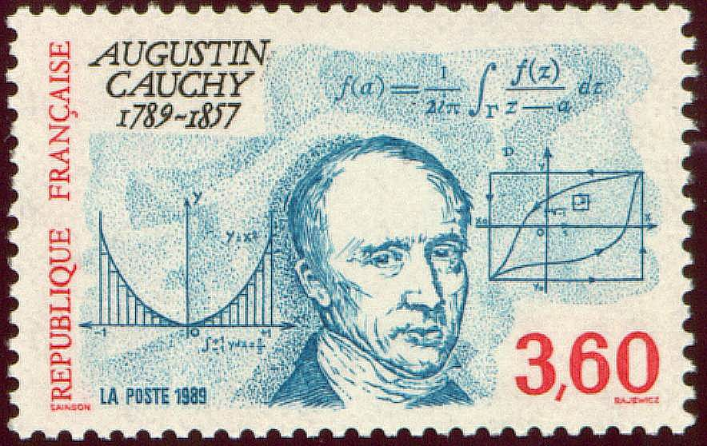
Augustin-Louis Cauchy
(1789 -1857)

Slide 217
partition_point_n
template <ForwardIterator I, Predicate P>
I partition_point_n(I f, DifferenceType(I) n, P p);

Slide 218
Partition point semantics
Notes:
~~\\precondition: \\
$ \exists m \in [f, n) ~:~ (\forall i \in [f, m) ~:~ p(i)) ~\wedge~ (\forall i \in [m, f + n) ~:~ \neg p(i))$\\
\\
postcondition: return value is $m$ from the precondition

Slide 219
The sad story of partition
Should elements that satisfy the predicate precede the elements that do not?

Slide 220
template <ForwardIterator I, Predicate P>
I partition_point_n(I f, DifferenceType(I) n, P p) {
while (n) {
I middle(f);
DifferenceType(I) half(n >> 1);
advance(middle, half);
if (!p(*middle)) {
n = half;
} else {
f = ++middle;
n = n - (half + 1);
}
}
return f;
}

Slide 221
partition_point
template <ForwardIterator I, Predicate P>
I partition_point(I f, I l, P p) {
return partition_point_n(f,
std::distance(f, l),
p);
}

Slide 222
Sorted ranges
Read section 6.5 of EoP

Slide 223
Binary Search Lemma
Notes:
~\\For any sorted range $[v_i, v_j)$ and a value $a$,
\\ there are two iterators, lower bound $b_l$
\\and upper bound $b_u$ such that\\
$
1. ~~\forall k \in [i, b_l) ~~~~:~ v_k < a\\
2. ~~\forall k \in [ b_l, b_u) ~:~ v_k = a\\
3. ~~\forall k \in [b_u, j) ~~~:~ v_k > a\
$

Slide 224
Problem 224
Prove the Binary Search Lemma.

Slide 225
lower_bound
template <ForwardIterator I>
I lower_bound(I f, I l, ValueType(I) a) {
std::less<ValueType(I)> cmp;
return std::partition_point(f, l,
std::bind2nd(cmp, a));
}

Slide 226
lower_bound (C++11)
template <ForwardIterator I>
I lower_bound(I f, I l, ValueType(I) a) {
return std::partition_point(f, l,
[=](ValueType(I) x) { return x < a; });
}

Slide 227
upper_bound
template <ForwardIterator I>
I upper_bound(I f, I l, ValueType(I) a) {
std::less_equal<ValueType(I)> comp;
return std::partition_point(f, l,
std::bind2nd(cmp, a));
}

Slide 228
upper_bound (C++11)
template <ForwardIterator I>
I lower_bound(I f, I l, ValueType(I) a) {
return std::partition_point(f, l,
[=](ValueType(I) x) { return x <= a; });
}

Slide 229
Practical theories
Iterator theories are as important to Computer Science as theories of groups and rings are to Algebra.
Knowing theories implies knowing their algorithms.

Slide 230
Lessons of the Journey
Investigations of foundational issues of arithmetic led to the design of modern computers.
Simple theories of successor allow us to express a large body of algorithms.
Concentrate on deep understanding of a few central things!

