Slide 1
Journey Two:
Heirs of Pythagoras
How division with remainder led to discovery of many fundamental abstractions.

Slide 2
Heirs of Pythagoras
Lecture 1

Slide 3
Mathematics
Science of numbers and space.
Numbers and space are our innate abilities.

Slide 4
Pythagorean School
Square, oblong, triangular numbers
Discrete structure of space
Arithmetization of geometry
A catastrophe
  the program cannot succeed

Slide 5
He discovered “the theory of irrationals...”
Proclus

Slide 6
Common Measure
A segment V is a measure of a segment A iff A can be represented as a finite concatenation of copies of V.
A segment V is a common measure of segments A and B iff it is a measure of both.
A segment V is the greatest common measure of A and B if it is greater than any other common measure of A and B.

Slide 7
Properties of gcm
Notes:
gcm(a, a) &= a\\
gcm(a,b) &= gcm(a, a+b)\\
b < a \implies gcm(a, b) &= gcm(a - b, b)\\
gcm(a, b) &= gcm(b, a)

Slide 8
Line segment gcm
line_segment gcm(line_segment a,
line_segment b) {
if (a == b) return a;
if (b < a) return gcm(a - b, b);
if (a < b) return gcm(a, b - a);
}

Slide 9
gcm(196in, 42in)
Notes:
~\\
196 ~~>~~&42\\
154 ~~>~~&42\\
112 ~~>~~&42\\
70 ~~>~~&42\\
28 ~~<~~&42\\
28 ~~>~~&14\\
14 ~~=~~&14 { \rm ~~~Done!}

Slide 10
Well-ordering Principle
Greeks found the principle that any set of natural numbers has a smallest element a very powerful proof technique.
  It is equivalent to induction axiom.
In order to prove that something does not exist, prove that if it exists, a smaller one also exists.

Slide 11
The Assumption
Let us assume that there is a segment that can measure both the side and the diagonal of some square. Let us take the smallest such square for this segment.

Slide 12
B
A
C
D

Slide 13
B
A
E
F
C
D
Notes:
\overline{AB} = \overline{AF} ~~\wedge~~ \overline{AC} \perp \overline{EF}

Slide 14
B
A
E
G
F
C
D
Notes:
\overline{AC} \perp \overline{CG} ~~\wedge~~ \overline{EG} \perp \overline{EF}

Slide 15
B
A
E
G
F
C
D
Notes:
\angle CEF &= 180^\circ - \angle CFE - \angle ECF = 45^\circ \\
\angle CEF &= \angle ECF \implies \overline{FC} = \overline{FE}

Slide 16
B
A
E
G
F
C
D
Notes:
\angle ABC &= \angle AFE \\
\angle ABF &= \angle AFB \\
\angle ABC - \angle ABF &= \angle AFE - \angle AFB\\
\angle EBF &= \angle EFB \implies \overline{BE} = \overline{EF}\\

Slide 17
B
A
E
G
F
C
D

Slide 18
B
A
E
G
F
C
D
Notes:
gcm(\overline{AC}, \overline{AB}) = gcm(\overline{AB}, \overline{CF}) = gcm(\overline{CE}, \overline{CF})

Slide 19
B
A
E
G
F
C
D
Notes:
\overline{EB} < \overline{EC} \implies \overline{EF} < \frac{\overline{AB}}{2}

Slide 20
Q.E.D.
We constructed a smaller square that could be measured by the segment. Contradiction!

Slide 21
Revolutionary Discovery
In modern terms,
Pythagoras discovered that √2 is irrational

Slide 22
Number-theoretic proof of irrationality of √2
Notes:
~\\Assume that $(m/n)^2 = 2$ and that $m/n$ is irreducible. \\$m^2 = 2n^2$. \\$m$ is even.\\ $m = 2u$. \\$(2u)^2 = 2n^2$.\\ $4u^2 = 2n^2$.\\ $2u^2 = n^2$.\\ $n$ is even. \\Contradiction.

Slide 23
Dilemma
To ground geometry in arithmetic we need a unit of measurement. The unit must be small enough to measure all the segments involved in a given problem.
The proof we just have seen demonstrates that such a unit cannot exist.

Slide 24
The Perpetual Conflict
The tension between continuous and discrete remains central even today and, in my opinion, will remain with mathematics forever.
The tension has been the source of progress and revolutionary insights for many ages.

Slide 25
Athens in V century BC
Marathon, Salamis, Themistocles, Aristides, Pericles, Aspasia, Aeschylus, Sophocles, Euripides, Aristophanes, Thucydides, Parthenon, Phidias…
“…we are the school of Hellas…”

Slide 26
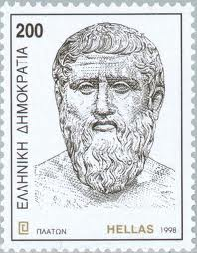
Plato (427BC - 347BC)

Slide 27
Significance of Plato
The safest general characterization of the
European philosophical tradition is that it consists of a series of footnotes to Plato.
Alfred North Whitehead
Process and Reality

Slide 28
Ariston, the Poet
You gaze at stars, my Aster.
O, that I were heaven
To look back at you
With innumerable eyes.

Slide 29
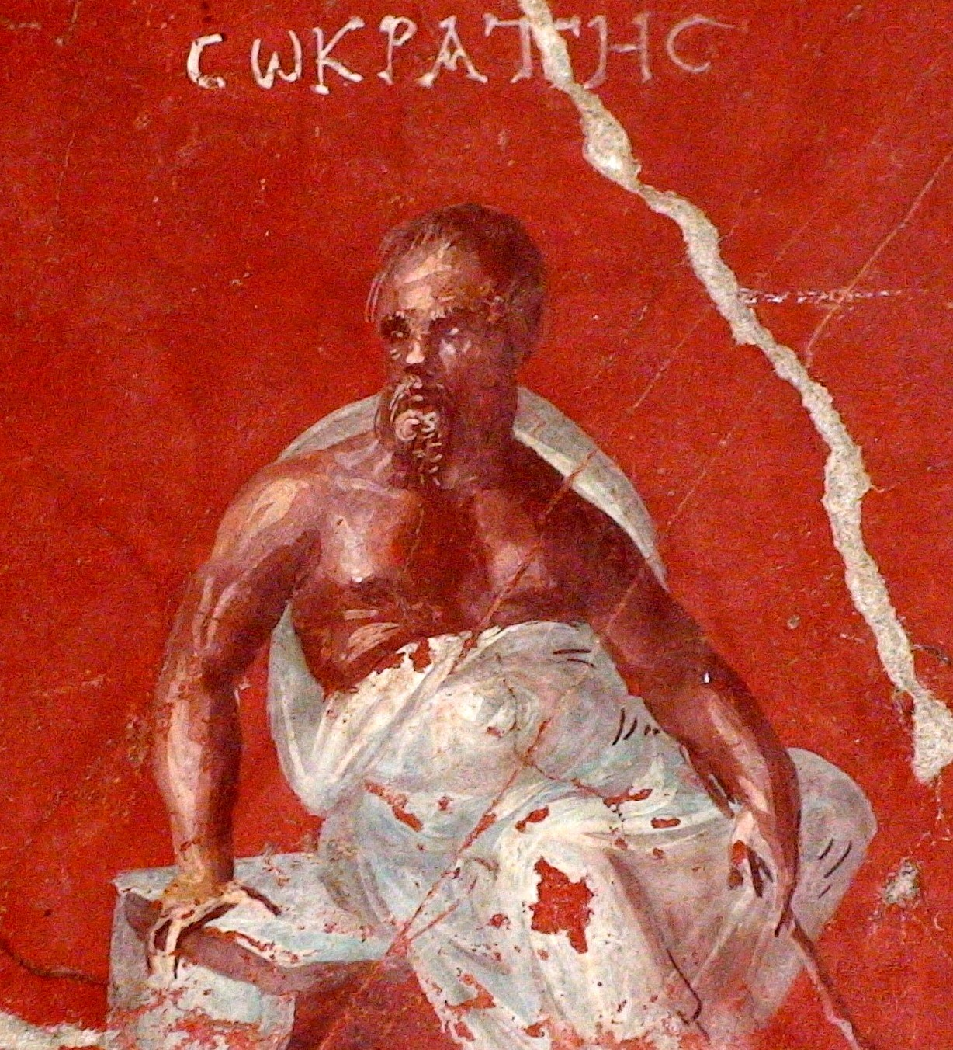
Socrates 470BC – 399BC

Slide 30
The Gadfly
I neither know nor think that I know.
The life which is unexamined is not worth living.
The hour of departure has arrived, and we go our ways - I to die, and you to live. Which is better God only knows.

Slide 31
Plato’s life after 399
Megara, Cyrene, Heliopolis, Tarentum, Syracuse (399BC – 387BC)
  sold into slavery by Dionysius I
Starts the Academy near Athens (385BC)
Syracuse (366BC)
  “the palace was filled with sawdust, as they say, owing to the multitude of geometricians there.”
Syracuse (361BC)
Death (347BC)

Slide 32
Academy
Μηδείς αγεωμέτρητος εισίτω
Let no one ignorant of geometry enter
10 out of 15 years of study were fully dedicated to mathematics

Slide 33
“The Century of Plato”
“At the center of scientific life stood the personality of Plato. He guided and inspired scientific work in his Academia and outside.”
B. L. van der Waerden
Science Awakening
Notes:
page 148

Slide 34
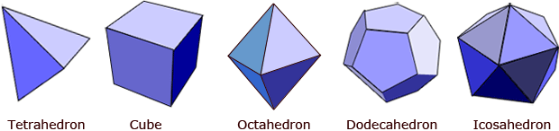
Platonic Solids

Slide 35
Delian Problem
Doubling the cube
Several mechanical solutions by Plato’s students
Fully solved in 1837 by Pierre Wantzel

Slide 36
Popular Reception
[Athenians] came to Plato’s lecture on the Good in the conviction that they would get some one or other of the things that the world calls good: riches, or health, or strength. But when they found that Plato’s reasonings were of mathematics their disenchantment was complete.
Aristoxenus

Slide 37
Alexandria
Founded in 331BC
Mouseion
  over 1000 scholars
  free room and board
Lasting influence
  canon
  texts

Slide 38
Bibliotheca
Patronage by Ptolemy (I, II, III, IV, V, VI, VII)
500000 scrolls
  manuscript acquisitions
  copying
  translating
  editing
Notes:
"If those books are in agreement with the Quran, we have no need of them; and if these are opposed to the Quran, destroy them."

Slide 39
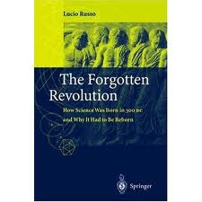
Hellenistic Science

Slide 40
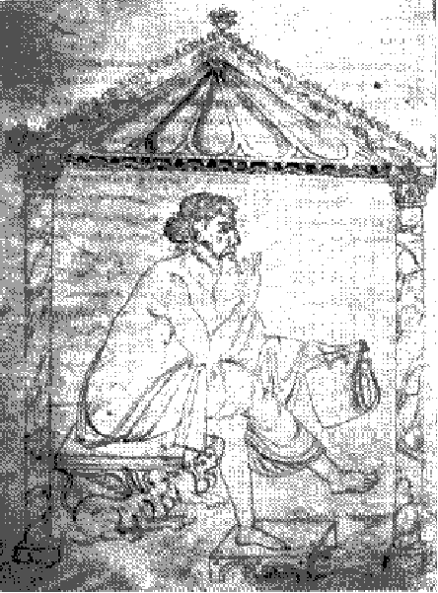
Euclid (325BC-265BC)

Slide 41
What do we gain from Euclid?
Some one who had begun to read geometry with Euclid, when he had learnt the first theorem, asked Euclid, “what shall I get by learning these things?” Euclid called his slave and said, “Give him three pence, since he must make gain out of what he learns.”
Strobaeus, Florilegium

Slide 42
Royal Road?
Ptolemy once asked Euclid whether there was any shorter way to a knowledge of geometry than by study of the Elements, whereupon Euclid answered that there was no royal road to geometry.
Proclus
Commentary on Elements

Slide 43
Poetic Insight
O blinding hour, O holy, terrible day,
When first the shaft into his vision shone
Of light anatomized! Euclid alone
Has looked on Beauty bare. Fortunate they
Who, though once only and then but far away,
Have heard her massive sandal set on stone.
Edna St Vincent Millay

Slide 44
Elements, Book X
Proposition 2. If, when the less of two unequal magnitudes is continually subtracted in turn from the greater that which is left never measures the one before it, then the two magnitudes are incommensurable.

Slide 45
gcm0
line_segment gcm0(line_segment a,
line_segment b) {
while (a != b) {
if (b < a) a = a - b;
else b = b - a;
}
return a;
}
a and b are incommensurable iff gcm0 does not terminate.

Slide 46
Problem 46
gcm0 is inefficient when one segment is much longer than the other. Come up with a more efficient implementation.

Slide 47
Problem 47
Prove that if a segment measures two other segments, then it measures their greatest common measure.

Slide 48
Heirs of Pythagoras
Lecture 2

Slide 49
gcm0 (repeat)
line_segment gcm0(line_segment a,
line_segment b) {
while (a != b) {
if (b < a) a = a - b;
else b = b - a;
}
return a;
}

Slide 50
gcm1
line_segment gcm1(line_segment a,
line_segment b) {
while (a != b) {
while (b < a) a = a – b;
std::swap(a, b);
}
return a;
}

Slide 51
segment_remainder
line_segment
segment_remainder(line_segment a,
line_segment b) {
while (b < a) a = a - b;
return a;
}

Slide 52
Why does this terminate?
while (b < a) a = a - b;
Axiom of Archimedes:
(For Greeks segments are never 0.)
Notes:
\forall a, b~ \exists n: a \le nb

Slide 53
segment_gcm
line_segment
segment_gcm(line_segment a,
line_segment b) {
while (a != b) {
a = segment_remainder(a, b);
std::swap(a, b);
}
return a;
}

Slide 54
Recursive Remainder Lemma
Notes:
~~\\If $r = {\rm segment\_remainder}(a, 2b)$ then\\
${\rm segment\_remainder}(a, b) = \begin{cases}
r & \text{if $r \leq b$} \\
r - b & \text{if $r > b$}
\end{cases}$

Slide 55
fast_segment_remainder
line_segment
fast_segment_remainder(line_segment a,
line_segment b)
{
if (a <= b) return a;
if (a - b <= b) return a - b;
a = fast_segment_remainder(a, b + b);
if (a <= b) return a;
return a - b;
}

Slide 56
fast_segment_gcm
line_segment
fast_segment_gcm(line_segment a,
line_segment b) {
while (a != b) {
a = fast_segment_remainder(a, b);
std::swap(a, b);
}
return a;
}

Slide 57
Discovery of 0
Babylonian astronomers used 0 with base 60 positional notation.
  The rest of their society used decimal non-positional notation.
Greek astronomers used base 60 positional notation for their trigonometric tables.

Slide 58
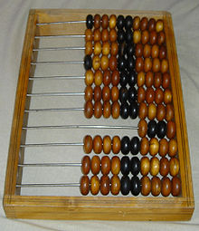
Abacus
Known throughout from ancient China to Rome
Positional decimal representation
Still, no written representation of 0 for 1000 years!

Slide 59
Decimal 0
Indian mathematicians combined “natural” decimal integers with positional notation and 0
  The notation spread through India to Persia from 6th to 9th century AD.
Arab scholars adopted it and it was taught from Bagdad to Cairo to Cordoba.

Slide 60
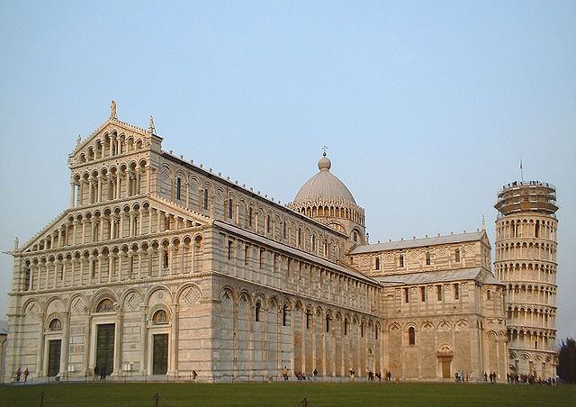
Pisa

Slide 61
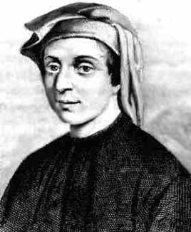
Leonardo Pisano (1170-1250)

Slide 62
Leonardo’s Journeys
“In his boyhood” visits his father in Bugia, Algiers where he studies “Hindu digits”.
Later, while on business, he studied further techniques in Egypt, Syria, Greece, Sicily, and Provence.
Leonardo and Frederick II (Michael Scott, John of Palermo.)
Given a salary by Pisa in recognition of his accomplishments.

Slide 63
Leonardo’s Books
Liber Abaci (1st edition, 1203)
  Book of Computations
Practica Geometriae (1223)
Flos (1225)
Liber Quadratorum (1226)
Liber Abaci (2nd edition, 1228)

Slide 64
Problem 64 (easy)
Prove that
Why was it difficult for the Greeks?
Notes:
\sqrt[3]{16} + \sqrt[3]{54} = \sqrt[3]{250}

Slide 65
Problem 65
For any odd square number x find an even square number y, such that x + y is a square number.
Liber Quadratorum

Slide 66
Problem 66 (hard)
If x and y are both sums of two squares, then so is their product xy.
Liber Quadratorum

Slide 67
Zero segments
We can view AA as a segment.
That forces the re-adjustment in our procedures.

Slide 68
fast_segment_remainder1
line_segment
fast_segment_remainder1(line_segment a,
line_segment b)
{
// precondition: b != 0
if (a < b) return a;
if (a - b < b) return a - b;
a = fast_segment_remainder1(a, b + b);
if (a < b) return a;
return a - b;
}

Slide 69
Halving
It is possible to divide a segment in two equal parts with ruler and compass.
That allows us to eliminate the recursion from the fast remainder algorithm.

Slide 70
largest_doubling
line_segment
largest_doubling(line_segment a,
line_segment b) {
// precondition: b ≠ 0
while (b <= a – b) b = b + b;
return b;
}

Slide 71
remainder
line_segment remainder(line_segment a,
line_segment b) {
// precondition: b ≠ 0
if (a < b) return a;
line_segment c = largest_doubling(a, b);
a = a – c;
while (c != b) {
c = half(c);
if (c <= a) a = a – c;
}
return a;
}

Slide 72
Computing quotient
integer quotient(line_segment a, line_segment b) {
// Precondition: b > 0
if (a < b) return integer(0);
line_segment c = largest_doubling(a, b);
integer n(1);
a = a – c;
while (c != b) {
c = half(c); n = n + n;
if (c <= a) { a = a – c; n = n + 1; }
}
return n;
}

Slide 73
Ahmes Knew It
A primitive version of quotient algorithm appears in the Rhind papyrus.
It is an “algorithmic inverse” of Egyptian multiplication.
It was known to the Greeks as Egyptian division.

Slide 74
Computing quotient and remainder
std::pair<integer, line_segment>
quotient_remainder(line_segment a, line_segment b) {
// Precondition: b > 0
if (a < b) return std::make_pair(integer(0), a);
line_segment c = largest_doubling(a, b);
integer n(1);
a = a – c;
while (c != b) {
c = half(c); n = n + n;
if (c <= a) { a = a – c; n = n + 1; }
}
return std::make_pair(n, a);
}
Computing both quotient and remainder is not more complex than just quotient.

Slide 75
Floyd-Knuth: no halving
line_segment remainder_fibonacci(
line_segment a, line_segment b) {
// Precondition: b > 0
if (a < b) return a;
line_segment c = b;
do {
line_segment tmp = c; c = b + c; b = tmp;
} while (a >= c);
do {
if (a >= b) a = a - b;
line_segment tmp = c – b; c = b; b = tmp;
} while (b < c);
return a;
}

Slide 76
Problem 76
Design quotient_fibonacci and quotient_remainder_fibonacci.

Slide 77
gcm_remainder
line_segment
gcm_remainder(line_segment a,
line_segment b) {
while (b != line_segment(0)) {
a = remainder(a, b);
std::swap(a, b);
}
return a;
}

Slide 78
Euclidean algorithm for integers
integer gcd(integer a, integer b) {
while (b != integer(0)) {
a = a % b;
std::swap(a, b);
}
return a;
}

Slide 79
General Treatment
Read EoP, chapter 5

Slide 80
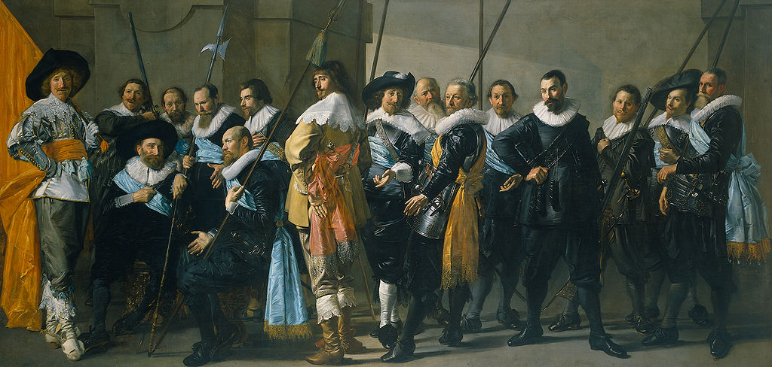
Dutch Golden Age (1568–1700)

Slide 81
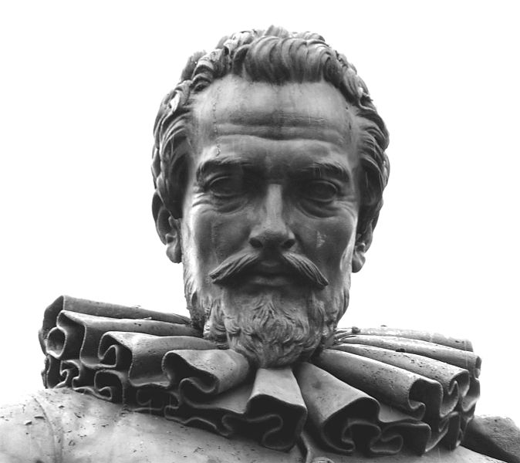
Simon Stevin (1548 – 1620)

Slide 82
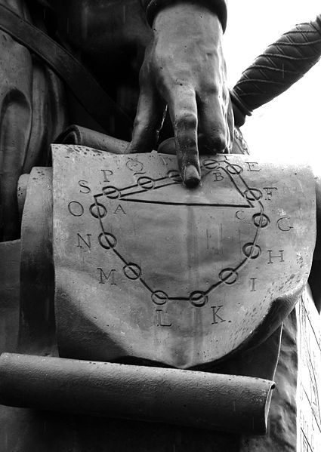

Slide 83
Stevin’s Contributions
Engineering
  use of sluices for military purposes
  wind-powered vehicle
Physics
  parallelogram of forces
    representation of forces by vectors
  hydrostatics
    pressure is independent of shape
  acceleration of falling bodies
Music
Notes:
\sqrt[12]{2}

Slide 84
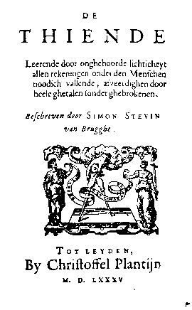
The Tithe (1585)

Slide 85
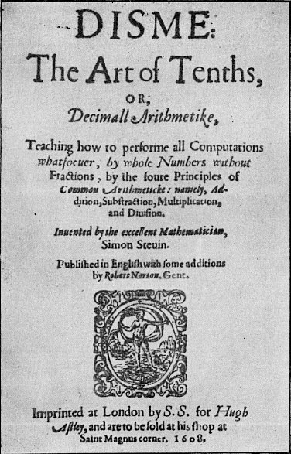

Slide 86
Numbers measure everything
“Number is that which expresseth the quantitie of each thing.”
Simon Stevin
Disme
“with one stroke, the classical restrictions of “numbers” to integers or to rational fractions was eliminated. His general notion of a real number was accepted by all later scientists.”
B. L. van der Waerden
History of Algebra

Slide 87
Stevin invented the number line
negative
irrational
inexplicable…
√2
-1
-0.5
0
0.5
1
1.5
2
Notes:
For slide 85

Slide 88
Swept under the rug
Replacement of finite with infinite representation
  1/7 vs. 0.142857142857142857142857142857…

Slide 89
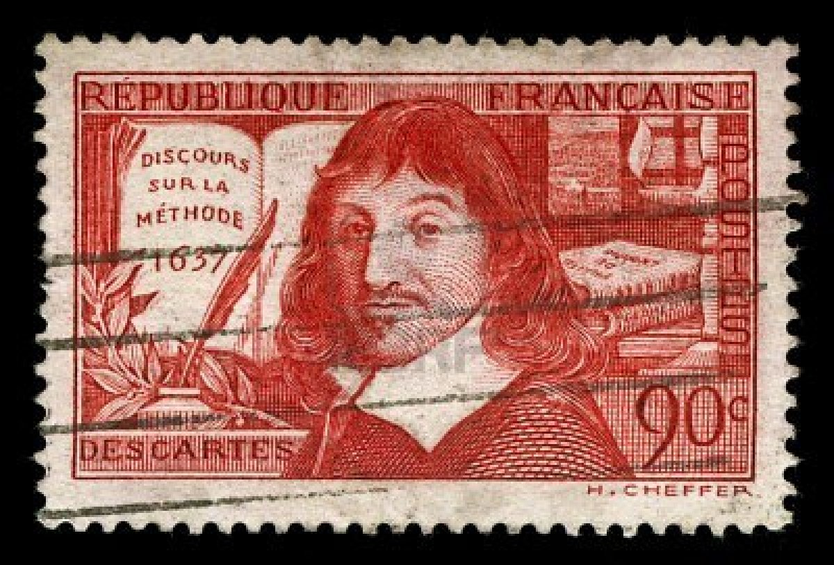
Rene Descartes (1596 – 1650)

Slide 90
Cartesian Geometry
“Any problem in geometry can easily be reduced to such terms that a knowledge of lengths of certain strait lines is sufficient for its construction.”
Renatus Cartesius, La Geometrie

Slide 91
Polynomials (Stevin 1585)
Till Stevin it was an algorithm
  take a number; raise it to 4th power; multiply it by 4 …
Polynomial is a finite sequence of numbers:
  4, 7, -1, 27, -3
Notes:
4x^4 + 7x^3 -x^2 + 27x -3

Slide 92
Intermediate Value Theorem
Appendice algébraique contenant règle générale de toutes équations (1594)
Stevin shows how the successive decimals of the root can be obtained.
“in some cases the true value cannot be reached though one can obtain as many decimals of it as one may wish and come indefinitely near to it.”
Notes:
Simon Stevin of Bruges, George Sarton, Isis, Vol.21,No.2.(Jul., 1934), pages 253 and 273 and(pp.241-303)

Slide 93
Horner’s rule
Notes:
&4x^4 + 7x^3 -x^2 + 27x -3 =\\
&(((4x + 7)x - 1)x + 27)x -3

Slide 94
Evaluating polynomials
template <InputIterator I, Semiring R>
R polynomial_value(I f, I l, R x) {
if (f == l) return R(0);
R sum(*f);
while (++f != l) {
sum = sum * x;
sum = sum + *f;
}
return sum;
}

Slide 95
The value type of iterator
The value type of the iterator (the type of the coefficients of the polynomial) does not have to be equal to the semiring R (the argument type of the polynomial and its result type).
  e.g., polynomial with real coefficients can be evaluated with a matrix with real coefficients.
    characteristic polynomial of a matrix can be applied to the matrix

Slide 96
Problem 96
What are the requirements on R and the value type of iterator? In other words, what are the requirements on coefficients of polynomials and on their values.

Slide 97
Operations on polynomials
addition, subtraction
  element by element
multiplication:
Notes:
c_0 &= a_0b_0\\
c_1 &= a_0b_1 + a_1b_0\\
c_2 &= a_0b_2 + a_1b_1 + a_2b_0\\
&~~\vdots\\
c_k &= \sum_{k = i + j}a_ib_j

Slide 98
Degree of polynomials
Degree of a polynomial is the index of the highest coefficient:
Notes:
{\rm deg}(5) &= 0\\
{\rm deg}(x+3) &= 1\\
{\rm deg}(x^3 + x - 7) &= 3

Slide 99
Division with remainder
Polynomial a is divisible by polynomial b with remainder if there are polynomials q and r such that
Notes:
a = bq + r ~~\wedge~~ {\rm deg}(r) < {\rm deg}(b)

Slide 100
Problem 100
Prove that for any two polynomials p(x) and q(x)
Notes:
&1.~~ p(x) = q(x)\cdot(x-x_0) + r \implies p(x_0) = r\\
&2.~~ p(x_0) = 0 \implies p(x) = q(x)\cdot(x - x_0)

Slide 101
Polynomial Division
3x² +2x -2
x-2 3x³ -4x² -6x +10
3x³ -6x²
2x² -6x
2x² -4x
-2x +10
-2x +4
6
Notes:
For slide 99

Slide 102
Stevin’s gcd algorithm (1585)
polynomial<real> gcd(polynomial<real> m,
polynomial<real> n) {
while (n != polynomial<real>(0)) {
polynomial<real> t = remainder(m, n);
m = n;
n = t;
}
return m;
}

Slide 103
Proof of correctness
gcd is preserved at every step and the number of steps is finite:
Notes:
&1. ~~a = qb + r \implies {\rm gcd}(a, b) = {\rm gcd}(b, r) \\
&2. ~~{\rm deg}(r) < {\rm deg(b)}

Slide 104
Problem 104 (Chrystal, Algebra)
Find gcd of:
Notes:
1.~~ &16x^4-56x^3-88x^2 +278x +105,\\
&16x^4 - 64x^3 - 44x^2 + 232x +70\\ \\
2.~~ &7x^4+6x^3-8x^2 -6x +1,\\
&11x^4 +15x^3 -2x^2 -5x +1\\ \\
3.~~ &nx^{n+1} -(n+1)x^n + 1,\\
&x^n - nx + (n-1)

Slide 105
Heirs of Pythagoras
Lecture 3

Slide 106
Die heilige deutsche Kunst
Music
  Bach, Händel, Haydn, Mozart, Beethoven, Schubert, Schumann, Brahms, Wagner, Mahler, Richard Strauss
Literature
  Goethe, Schiller
Philosophy
  Leibniz, Kant, Hegel, Schopenhauer, Marx, Nietzsche

Slide 107
German Professor
Commitment to the truth
A scientist as a professional civil servant
Collegial spirit
Professor-student bond
Continuity of research
Wir müssen wissen — wir werden wissen!
We must know — we will know!

Slide 108
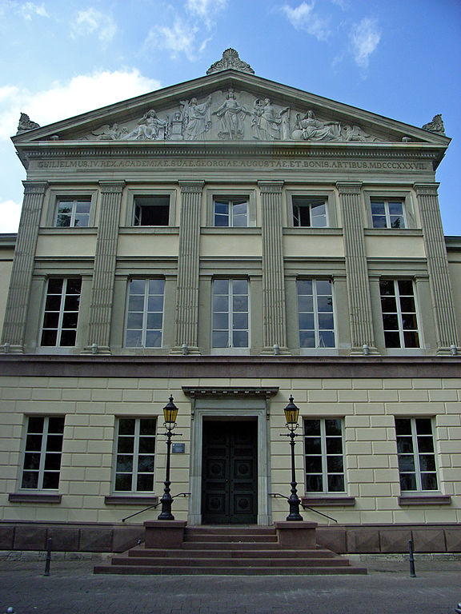
University of Göttingen (1734)
Gauss, Riemann, Dirichlet, Dedekind, Klein, Hilbert, Minkowski, Courant, Noether
Max Born, Heisenberg, Oppenheimer

Slide 109
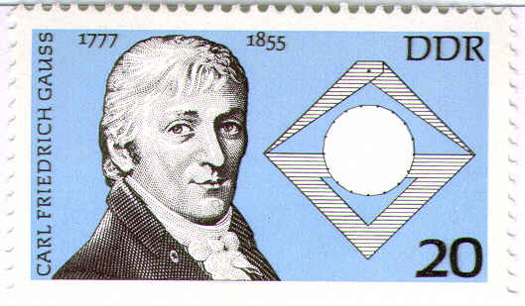
Carl Friedrich Gauss
Regular heptodecagon

Slide 110
Princeps mathematicorum
Fundamental Theorem of Algebra
Number Theory
(Non-Euclidean geometry)
Normal distribution and method of least squares
Celestial Mechanics
Differential Geometry
Electromagnetism

Slide 111
Disquisitiones Arithmeticae (1801)
Fundamental theorem of arithmetic
Modular arithmetic
Quadratic reciprocity law
Theory of integral quadratic forms
Cyclotomic equations and construction of regular polygons

Slide 112
Gauss gcd “algorithm”
Given many numbers A, B, C, etc. the greatest common divisor is found as follows. Let all the numbers be resolved into their prime factors, and from these extract the ones which are common to A, B, C, etc…
Moreover, we know from elementary consideration how to solve these problems when the resolution of the numbers A, B, C, etc. into factors is not given.
Disquisitiones Arithmeticae, art. 18

Slide 113
Complex Numbers
Imaginary numbers (xi where i² = -1) were used since XVI century, but never acquired legitimacy.
In 1831 Gauss introduced complex numbers z = a + bi as points (a,b) on Cartesian plane.
In the same paper he introduced complex integers (Gaussian integers) which became a major tool in number theory.

Slide 114
Notes:
~~\\
complex number: ~~~~~~$z = x + yi$\\
complex conjugate: ~~~$\overline{z} = x - yi$\\
real part: ~~~~~~~~~~~~~~~~~~~~~${\rm Re}(z) = \frac{1}{2}(z + \overline{z}) = x$\\
imaginary part: ~~~~~~~~~${\rm Im}(z) = \frac{1}{2i}(z - \overline{z}) = y$\\
norm: ~~~~~~~~~~~~~~~~~~~~~~~~~~$z\overline{z} = \|z\| = x^2+y^2 $\\
absolute value: ~~~~~~~~~~$|z|= \sqrt{\|z\|} = \sqrt{x^2+y^2}$\\
argument: ~~~~~~~~~~~~~~~~~~${\rm arg}(z) = \arccos(\frac{x}{|z|})$\\\\
addition: ~~~~~~~~~~~~~~~~~~~~$z_1 + z_2 = (x_1 + x_2) +(y_1 + y_2)i$\\
subtraction: ~~~~~~~~~~~~~~~$z_1 - z_2 = (x_1 - x_2) +(y_1 - y_2)i$\\
multiplication: ~~~~~~~~~~$z_1z_2 = (x_1 x_2 - y_1y_2) +(x_2y_1 + x_1y_2)i$\\
reciprocal: ~~~~~~~~~~~~~~~~~$\frac{1}{z} = \frac{\overline{z}}{\|z\|}= \frac{x}{x^2+y^2} - \frac{y}{x^2+y^2}i$\\

Slide 115
Gaussian Integers
Complex numbers of the form a + bi where a and b are integers.

Slide 116
Gaussian remainder z₁ % z₂
Construct a grid on complex plane generated by z₂, iz₂, -iz₂ and –z₂
Find a square in the grid containing z₁
Find a vertex w of the square closest to z₁
z₁ – w is the remainder

Slide 117
w
z₁
z₂
iz₂
-iz₂
-z₂

Slide 118
Gaussian integer gcd
complex<integer> gcd(complex<integer> m,
complex<integer> n) {
while (real(n) != 0 || imag(n) != 0) {
complex<integer> t = m % n;
m = n;
n = t;
}
return m;
}

Slide 119
Use of Gaussian Integers
The introduction of Gaussian integers lead to extraordinary simplification of several difficult proofs in number theory.

Slide 120
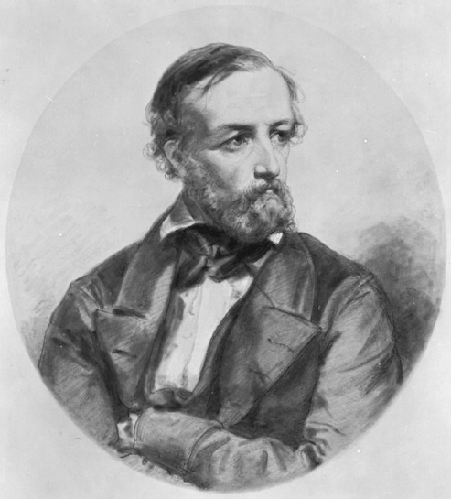
Johann Peter Gustav
Lejeune Dirichlet (1805-1859)

Slide 121
Dirichlet Life
Proof of Last Fermat Theorem for n = 5
Slept with Disquisitionae Arithmeticae under his pillow
In 1855 succeeded Gauss in Gottingen

Slide 122
Primes in arithmetic progressions
If gcd(a, b) = 1 then there are infinitely many primes of the form an + b

Slide 123
Vorlesungen über Zahlentheorie
(Lectures on Number Theory)
…the whole structure of number theory rests on a single foundation, namely the algorithm for finding the greatest common divisor of two numbers.
All the subsequent theorems … are still only simple consequences of the result of this initial investigation…
…any analogous theory, for which there is a similar algorithm for the greatest common divisor, must also have consequences analogous to those in our theory. In fact, such theories exist.

Slide 124
Lectures on Number Theory
If one considers all numbers of the form:
…it is only for certain values of , e.g. , that the greatest common divisor of two numbers could be found by an algorithm like the one for … integers…
However, it is otherwise when :
Notes:
t + n\sqrt {-a}
21 = 3\cdot7 = (1+2\sqrt{-5})\cdot(1-2\sqrt{-5})

Slide 125
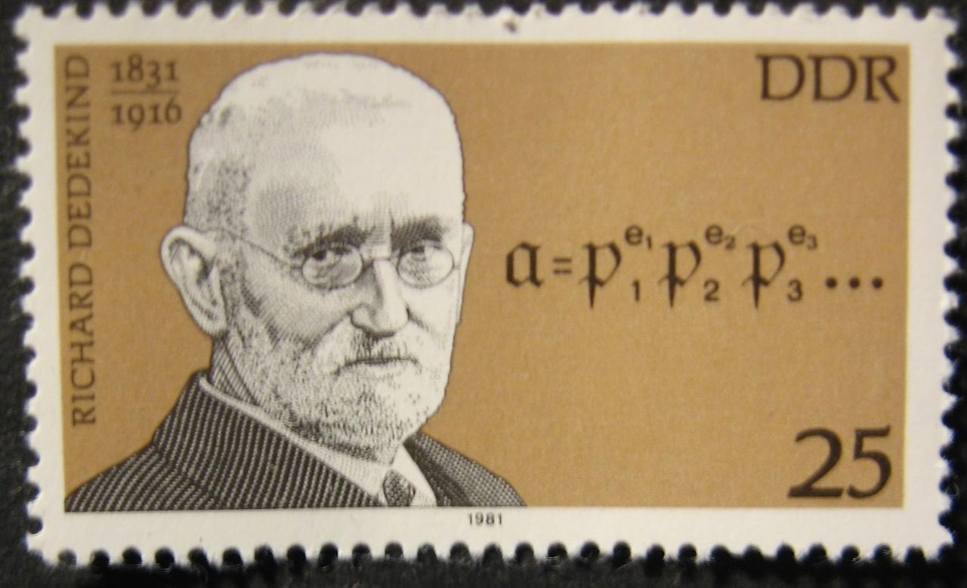
Richard Dedekind (1831 – 1916)

Slide 126
Dedekind’s Life
Last student of Gauss
Collaborator of Dirichlet
TU Braunschweig
Ring Theory
Algebraic Integers
Foundations of real numbers
  also integers and rationals

Slide 127
Algebraic integers
Algebraic integers are linear integral combinations of roots of a monic polynomial with integer coefficients:
Notes:
~~\\
$x^2+1$ generates Gaussian integers $ai+b$\\
$x^3-1$ generates \emph{Eisenstein integers}
$a + b\frac{-1 + i\sqrt{3}}{2}$\\
$x^2+5$ generates integers $\mathbb{Z}[\sqrt{-5}]$

Slide 128
The Promise of
Algebraic Integers
If Euclidean algorithm can be used with certain kind of algebraic integers (cyclotomic integers) that would lead to the proof of the Last Fermat Theorem.
Unfortunately, it is not so. Algebraic integers generated by the polynomial
do not work with the Euclidean algorithm.

Slide 129
An (almost) abstract algebra
Dedekind work on algebraic integers contained all the fundamental concepts of modern abstract algebra.
Es steht alles schon bei Dedekind!
  It is all already in Dedekind – Emmy Noether

Slide 130
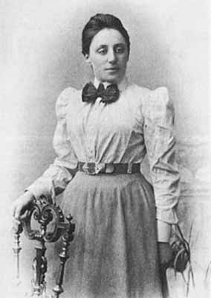
Emmy Noether (1882 -1935)

Slide 131
Life of Noether
Gottingen
  Invariant Theory
  Noether’s theorem
  Algebra
Moscow
Bryn Mawr
  not Princeton "men's university, where nothing female is admitted"

Slide 132
It was she who taught us to think in terms of simple and general algebraic concepts – homomorphic mappings, groups and rings with operators, ideals…
P.S. Alexandrov
For Emmy Noether, relationships among numbers, functions, and operations became transparent, amenable to generalisation, and productive only after they have been dissociated from any particular objects and have been reduced to general conceptual relationships…
B.L. van der Waerden

Slide 133
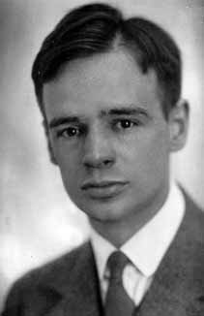
Bartel Leendert van der Waerden
(1903 - 1996)

Slide 135
Noether gcd algorithm
template <EuclideanDomain R>
R gcd(R m, R n) {
while (n != R(0)) {
R t = m % n;
m = n;
n = t;
}
return m;
}

Slide 136
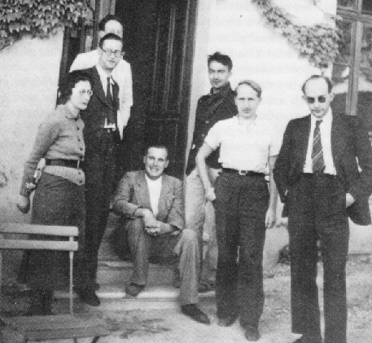
Nicolas Bourbaki

Slide 137
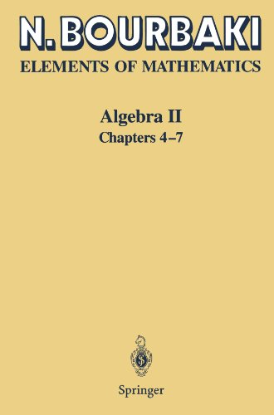

Slide 138
Euclid and Göttingen
Gauss: Non-Euclidean geometry
Dirichlet: Infinity of primes in arithmetic progression
Riemann: Non-Euclidean geometry
Dedekind: Real numbers
Klein: Erlanger program
Hilbert: Foundations of Geometry, Mechanization of mathematics
Minkowski: Space-time

Slide 139
Group
Notes:
~~\\
operations: $x \circ y, ~~x^{-1}$\\
constant: ~~~~$e$ ~(identity)\\\\
axioms:
$$x\circ (y\circ z) = (x \circ y) \circ z~~~~~~~~~~~~~~~~~~~~~~~~~~~~~~~~~~~~~~~~~~~~~~~~~~~~~~~~~~~$$
$$x\circ e = e \circ x = x~~~~~~~~~~~~~~~~~~~~~~~~~~~~~~~~~~~~~~~~~~~~~~~~~~~~~~~~~~~$$
$$x\circ x^{-1} = x^{-1} \circ x = e~~~~~~~~~~~~~~~~~~~~~~~~~~~~~~~~~~~~~~~~~~~~~~~~~~~~~~~~~~~~~$$

Slide 140
Notation for group operation
Mathematicians use circle or star or dot formally.
  They often replace x*y with xy.
They use + for Abelian (commutative) groups.

Slide 141
All groups are transformation groups
Every element a of the group G defines a transformation of G onto itself:
  x ⟶ ax
This transformation is one-to-one because of invertibility:
  y ⟶ a⁻¹x

Slide 142
Group transformations are one-to-one
For any finite set S of elements of group G and any element a of G, a set of elements aS has the same number of elements as S:
Proof:
Notes:
~~\\$S = \{s_1, \ldots, s_n\}$ then $aS = \{as_1, \ldots, as_n\}$.\\ Suppose ~$as_i = as_j$; then $a^{-1}(as_i) = a^{-1}(as_j)$. \\
By associativity, $(a^{-1}a)s_i = (a^{-1}a)s_j$; \\by cancellation, $es_i = es_j$
and by identity, $s_i = s_j$.

Slide 143
Examples of groups
Additive group of integers
  there is no multiplicative group of integers
Multiplicative group of remainders modulo 7
Permutation group of 52 cards
Multiplicative group of invertible matrices with real coefficients
Group of rotations of the plane

Slide 144
Kinds of group
Abelian groups
Finite groups
Finite cyclic group

Slide 145
Notes:
ab = e \implies b = a^{-1}
ab &= e \\ a^{-1}(ab) &= a^{-1}e\\ (a^{-1}a)b &= a^{-1} \\ eb &= a^{-1} \\ b &= a^{-1}

Slide 146
Notes:
(ab)^{-1} = b^{-1}a^{-1}
(ab)(b^{-1}a^{-1}) = a(bb^{-1})a^{-1} = aa^{-1} = e

Slide 147
Notes:
(x^{-1})^n = (x^n)^{-1}
&{\rm By~induction:}\\\\
&{\rm Case}~1:~~~~(x^{-1})^1 = x^{-1} = (x^1)^{-1}\\
\\
&{\rm Case~}n:~~~~~{\rm Assume~that~~~}(x^{-1})^{n-1} = (x^{n-1})^{-1} ~~{\rm then}\\
&~~~~~~~~~~~~~~~~~x^n(x^{-1})^n = (x^{n-1}x)(x^{-1}(x^{-1})^{n-1}) = e {\rm~~~~~~therefore}\\
&~~~~~~~~~~~~~~~~~(x^n)^{-1} = (x^{-1})^n

Slide 148
Problem 148 (very easy)
Prove that any group has at least one element.

Slide 149
Order of a group
If a group has n > 0 elements, n is is called the group’s order.
If n has infinitely many elements, it is of infinite order.

Slide 150
Order of an element
An element a has an order n > 0 if a^{n} = e and for any 0 < k < n, a^{k} ≠ e.
If such n does not exist, a has an infinite order.

Slide 151
Problem 151 (very easy)
What is the order of e?
Prove that e is the only element of such order.

Slide 152
Every element of a finite group has finite order
If n is an order of the group, then for any element a, {a, a², a³, …, a^{n+1}} has at least one repetition a^{i} and a^{j}. Let us assume that i < j and a^{i} is the first repeated element. Then
And j – i > 0 is the order of a.
Notes:
a^j &= a^i\\
a^ja^{-i} &= a^ia^{-i} = e\\
a^{j-i} &= e

Slide 153
Problem 153
Prove that if a is an element of order n, then
Notes:
a^{-1} = a^{n - 1}

Slide 154
Subgroups
A subgroup is a group that is a subset of another group.
Examples
  the additive group of even numbers are a subgroup of the additive group of integers.

Slide 155
Multiplication modulo 7 with inverses
Notes:
~\\
1\times i:~~ &{\bf\color[rgb]{1.000000,0.000000,0.000000}1}, 2, 3, 4, 5, 6 ~~~~~1\\
2\times i:~~ &2, 4, 6, {\bf\color[rgb]{1.000000,0.000000,0.000000}1}, 3, 5 ~~~~~4\\
3\times i:~~ &3, 6, 2, 5, {\bf\color[rgb]{1.000000,0.000000,0.000000}1}, 4 ~~~~~5\\
4\times i:~~ &4, {\bf\color[rgb]{1.000000,0.000000,0.000000}1}, 5, 2, 6, 3 ~~~~~2\\
5\times i:~~ &5, 3, {\bf\color[rgb]{1.000000,0.000000,0.000000}1}, 6, 4, 2 ~~~~~3\\
6\times i:~~ &6, 5, 4, 3, 2, {\bf\color[rgb]{1.000000,0.000000,0.000000}1} ~~~~~6\\

Slide 156
Notes:
Subgroups of $\mathbb{Z}_7$
~~\\
$\{1\}$ is a multiplicative subgroup of $\mathbb{Z}_7$\\\\
$\{1, 6\}$ is a multiplicative subgroup of $\mathbb{Z}_7$\\\\
$\{1, 2, 4\}$ is a multiplicative subgroup of $\mathbb{Z}_7$\\\\
$\{1, 2, 3, 4, 5, 6\}$ is a multiplicative subgroup of $\mathbb{Z}_7$\\\\

Slide 157
Problem 157 (easy)
Find orders of every element of multiplicative group of remainders mod 7.
Find orders of every element of multiplicative group of remainders mod 11.

Slide 158
Cyclic group
A finite group is called cyclic if it has an element a such that for any element b there is an integer n where
Notes:
b = a^n

Slide 159
Cyclic group of an element
Powers of a given element in a finite group form a subgroup.
Powers contain e.
Powers contain inverse.

Slide 160
Example of a cyclic group
Additive group of remainders modulo n.

Slide 161
Problem 161
Prove that any subgroup of a cyclic group is cyclic.

Slide 162
Problem 162 (easy)
Prove that a cyclic group is Abelian.

Slide 163
Cosets
Notes:
~~\\If $G$ is a group, $H \subset G$ its subgroup,
\\then for any $a \in G$ the \emph{(left) coset} of $a$ by $H$ is a set
$$aH= \{g \in G \mid \exists h \in H ~:~ g = ah\}~~~~~~~~~~~~~~~~~~~~~~~~~~~~~~~~~~~~~~~~~~~~~~~~~$$

Slide 164
Examples of cosets
Consider additive group of integers Z and its subgroup, integers divisible by 4, 4Z. It has 4 distinct cosets
4n
4n + 1
4n + 2
4n + 3

Slide 165
Size of cosets
The number of elements in a coset aH is the same as the number of elements in the subgroup H.
Proof:
Follows from one-to-one property of the transformation ax.

Slide 166
Complete coverage by cosets
Every element a of group G belongs to some coset of subgroup H.
Proof:
Notes:
a = ae \implies a \in aH

Slide 167
Cosets are either disjoint or identical
If two cosets aH and bH in a group G have a common element c, then aH = bH.
Proof:
Notes:
c = ah_a ~&\wedge~ c = bh_b\\
ah_a &= bh_b\\
a &= bh_bh_a^{-1}\\
\forall x\in H, ax&=bh_bh_a^{-1}x \in bH\\
aH &\subseteq bH\\
{\rm Similarly,~~}
bH &\subseteq aH,
{\rm ~~and~so~~}
bH = aH\\

Slide 168
Lagrange’s Theorem
The order of a subgroup H of a finite group G divides the order of the group.
Proof:
The group G is covered by cosets of H.
Different cosets are disjoint.
They are of the same size n.
The order of G is nm where m is the number of distinct cosets.

Slide 169
Corollary of Lagrange’s theorem
The order of any element in the finite group divides the order of the group.
Proof:
An order of an element is equal to the order of the cyclic group of its powers.

Slide 170
Second Corollary
G is a group of order n. If a is an element of G then a^{n} = e.
Proof:
If a has an order m, than m divides n,
and n = qm.
a^{m} = e, therefore (a^{m})^{q} = e and a^{n} = e.

Slide 171
New Proof of Little Fermat Theorem
Let us take a multiplicative group of remainders modulo p. Since p - 1 is the order of the group it follows immediately from the second corollary of Lagrange’s Theorem that:

Slide 172
New Proof of Euler Theorem
Let us take a multiplicative group of coprime remainders modulo n. Since φ(n) is by definition the order of the group it follows immediately from the second corollary of Lagrange’s Theorem that:
Notes:
${\rm gcd}(a, n) = 1 \implies a^{\phi(n)} = 1\mod n$

Slide 173
Problem 173 (very easy)
What are subgroups of a group of order 101?

Slide 174
Problem 174
Prove that every group of prime order is cyclic.

Slide 175
Heirs of Pythagoras
Lecture 4

Slide 176
Rings
Notes:
~~\\
operations: $x + y, -x, xy$\\
constant: ~~~~$0_R, 1_R$\\
axioms:
\begin{align*}
x+ (y + z) &= (x + y) + z~~~~~~~~~~~~~~~~~~~~\\
x + 0 = 0 + x = x~~&~~~~~ x + -x = -x + x = 0~~~~~~~~~~~~~~~~~~~~\\
x + y &= y + x~~~~~~~~~~~~~~~~~~~~\\
x(yz) &= (xy)z~~~~~~~~~~~~~~~~~~~~\\
1 \neq 0~~~~~~1x = &~x1 = x~~~~~~~ 0x = x0 = 0~~~~~~~~~~~~~~~~~~~~\\
x(y + z) = xy + xz ~~~&~~~~(y + z)x = yx + zx~~~~~~~~~~~~~~~~~~~~
\end{align*}

Slide 177
Examples of Rings
Integers
n × n matrices with real coefficients
Gaussian integers
Univariate polynomials with integer coefficients

Slide 178
Commutative Rings
A ring is commutative if xy = yx.
non-commutative rings usually come from linear algebra
rings of algebraic integers and polynomial rings commute
Two “branches” of abstract algebra
  Commutative algebra
  Non-commutative algebra
We are dealing with commutative algebra.

Slide 179
Invertible Elements
An element x of a ring is called invertible if there is an element x⁻¹ such that
An invertible element of a ring is called a unit of this ring.
Notes:
xx^{-1} = x^{-1}x = 1

Slide 180
Problem 180 (very easy)
Notes:
~~\\
What are units in the ring ${\mathbb Z}$ of integers?\\
What are units in the ring ${\mathbb Z[\sqrt{-1}}]$ of Gaussian integers?

Slide 181
A product of units
A product of units is a unit.
Proof:
Notes:
If $a$ is a unit and $b$ is a unit then so is $ab$: $$ab(b^{-1}a^{-1}) = 1~~~~~~~~~~~~~~~~~~~~~~~~~~~~~~~~~~~~~~~~~~~~~~~~~~~~~~~~~~~~~$$

Slide 182
Multiplicative group of units
Units are closed under multiplication.
1 is a unit.
Inverse of a unit is a unit.

Slide 183
Integral Domain
An element x of a ring is called a zero divisor if
A commutative ring is an integral domain if it has no zero divisors.
Notes:
1.~~&x \neq 0\\
2.~~&\exists y \neq 0, ~~xy = 0

Slide 184
Examples of Integral Domain
Integers
Gaussian integers
Polynomials over integers
Rational functions over integers
Notes:
\frac{x^2 + 1}{x^3 - 2}

Slide 185
Problem 185 (very easy)
Prove that a zero divisor is not a unit.

Slide 186
Euclidean domain
(Euclidean ring)
E is a Euclidean domain if:
  E is an integral domain
  E has operations quot and rem
  E has a non-negative norm:
Notes:
~~\\
\|x\|: E \rightarrow\mathbb{N} \\{\rm satisfying}: \\
~~~~~\|a\| = 0 \iff a = 0 \\
~~~~~b \ne 0 \implies \|ab\| \ge \|a\|\\
~~~~~b \ne 0 \implies a = {\rm quot}(a, b) \cdot b + {\rm rem}(a, b)\\
~~~~~\|{\rm rem}(a, b)\| < \|b\|

Slide 187
Euclidean Domain gcd
template <EuclideanDomain R>
R gcd(R m, R n) {
while (n != R(0)) {
R t = m % n; // ‖t‖ < ‖n‖
m = n;
n = t;
}
return m;
}

Slide 188
Fields
An integral domain where every non-zero element is invertible is called a field.
Notes:
~~\\
{\em Field}: An integral domain where
$$\forall x \neq 0 ~~\exists x^{-1}:~~ xx^{-1} = 1~~~~~~~~~~~~~~~~~~~~~~~~~~~~~~~~~~~~~~~~~~~~~~$$

Slide 189
Examples of fields
Notes:
~~\\
Rational numbers $\mathbb{Q}$\\
Real numbers $\mathbb{R}$\\
Prime remainder fields $\mathbb{Z}_p$\\
Complex numbers $\mathbb{C}$\\

Slide 190
Kinds of fields
Finite fields
Algebraically closed fields
Non-commutative field of quaternions
Notes:
~~\\
&{\mathbb R}[i, j, k]\\
&i^2 = j^2 = k^2 = -1\\
&ij = k,~ jk = i,~ ki = j\\
ji = -k,~ kj = -i,~ ik = -j

Slide 191
Josef (“Yossi”) Stein (1961)
“I was in the beginning of my PhD thesis, which included using the Racah Algebra. Using "Racah Algebra" meant doing calculations with numbers of the form a/b*sqrt(c), where, a, b, c were integers. I wrote a program for the only available computer in Israel at that time - The WEIZAC at the Weizmann institute. Addition time was 57 microseconds, division took about 900 microseconds. Shift took less than addition. …I had the right conditions for finding that algorithm. Fast GCD meant survival.”

Slide 192
Delayed publication
“Yes, 1961 is the correct year…The reason why I did not publish the algorithm earlier was, that when I told my advisor (G. Racah himself) about my idea, he said: "Yesss” (in Hebrew) in his Italian accent. Somehow this did not sound like an encouragement for publication. In 1966, when I was looking for a post-doc I met another great physicist: John Blatt. He encouraged me to publish it.”
Josef Stein, Computational problems associated with Racah algebra, J. Comput. Phys., (1967) 1, 397-405

Slide 193
Stein’s Mathematics
Notes:
~~\\
{\rm gcd}(n, 0) =
{\rm gcd}(0, n) = n\\\\
{\rm gcd}(n, n) = n\\
{\rm gcd}(2n, 2m) = 2\cdot{\rm gcd}(n, m)\\
{\rm gcd}(2n, 2m + 1) = {\rm gcd}(n, 2m + 1)\\
{\rm gcd}(2n + 1, 2m) = {\rm gcd}(2n + 1, m)\\
{\rm gcd}(2n + 1, 2(n + k) + 1) = {\rm gcd}(2n + 1, k)\\
{\rm gcd}(2(n + k) + 1, 2n + 1) = {\rm gcd}(2n + 1, k)\\
~~\\

Slide 194
196 42
98 21 2
49 21 2
28 21 2
14 21 2
7 21 2
14 7 2
7 7 2
GCD: 7×2 = 14

Slide 195
Stein’s algorithm
(prologue)
template <BinaryInteger I>
I stein_gcd(I m, I n) {
if (m < I(0)) m = -m;
if (n < I(0)) n = -n;
if (m == I(0)) return n;
if (n == I(0)) return m;
//
Notes:
m > 0 \wedge n > 0

Slide 196
Stein’s algorithm
(factoring out power of 2)
int d_m = 0;
while (even(m)) { m >>= 1; ++d_m;}
int d_n = 0;
while (even(n)) { n >>= 1; ++d_n;}
//
Notes:
{\rm odd}(m) \wedge {\rm odd}(n)

Slide 197
Stein’s algorithm
(the main loop)
while (m != n) {
if (n > m) swap(n, m);
m -= n;
do m >>= 1; while (even(m));
}
//

Slide 198
Stein’s algorithm
(epilogue)
return m << min(d_m, d_n);
}

Slide 199
Is it just a hack?
Is Stein’s algorithm only interesting because of slow hardware?
Is it only useful for binary integers?

Slide 200
Every useful algorithm is based on some fundamental mathematical truth.
The discoverer of the algorithm might not see this truth.
There might be a long time between the first discovery of the algorithm and its understanding.
Every useful program is a worthy object of study.

Slide 201
Generalization of Euclid’s gcd
Integers
  Greeks (V BC)
Polynomials
  Stevin (ca. 1600)
Gaussian Integers
  Gauss (ca. 1830)
Algebraic Integers
  Dirichlet, Dedekind (ca. 1860)
Generic Version
  Noether, van der Waerden (ca. 1930)

Slide 202
Stein for polynomials (1969)
Use x as 2 !
x² + x is “even”
x² + x + 1 is “odd”
x² + x “shifts to” x + 1
Notes:
{\mathbb R}[x]

Slide 203
Stein for polynomials over a field
Notes:
~~\\
{\rm gcd}(p, 0) =
{\rm gcd}(0, p) = p\\
{\rm gcd}(p, p) = p\\\\
{\rm gcd}(xp, xq) = x\cdot{\rm gcd}(p, q)\\
{\rm gcd}(xp, xq + c) = {\rm gcd}(p, xq + c)\\
{\rm gcd}(xp + c, xq) = {\rm gcd}(xp + c, q)\\
{\deg}(p) \geq {\deg}(q) \implies {\rm gcd}(xp + c, xq + d) = {\rm gcd}(p - \frac{c}{d}q, xq + d)\\
{\deg}(p) < {\deg}(q) \implies {\rm gcd}(xp + c, xq + d) = {\rm gcd}(xp + c, q - \frac{d}{c}q)\\
~~\\

Slide 204
n m operation
x³ − 3x − 2 x² − 4 n − (0.5x² − 2)
x³ − 0.5x² − 3x x² − 4 shift(n)
x² − 0.5x − 3 x² − 4 n − (0.75x² − 3)
0.25x² − 0.5x x² − 4 normalize(n)
x² − 2x x² − 4 shift(n)
x − 2 x² − 4 m − (2x − 4)
x − 2 x² − 2x shift(m)
x − 2 x − 2 GCD: x − 2

Slide 205
Andre Weilert algorithm for Gaussian Integers (2000)
Use 1+i as 2 !
Andre Weilert, (1+i)-ary GCD Computation in Z[i] as an Analogue of the Binary GCD Algorithm, J. Symbolic Computation (2000) 30, 605-617

Slide 206
Division by 1+i
A Gaussian integer a+bi is divisible by 1+i if and only if a=b (mod 2)
Notes:
\frac{a + bi}{1 + i}=\frac{(a+bi)(1-i)}{(1+i)(1-i)}=\frac{(a+b) - (a - b)i}{2}

Slide 207
Remainder Cancellation
If two Gaussian integers z₁ and z₂ are not divisible by 1+i then z₁+z₂ is divisible by 1+i. Then z₁−z₂, z₁+iz₂ and z₁−iz₂ are also divisible by 1+i.
And,
Notes:
{\rm min}(|z_1+z_2|, |z_1-z_2|, |z_1 + iz_2|, |z_1-iz_2|) < {\rm max}(|z_1|, |z_2|)

Slide 208
Further extension of Stein (2003)
Ivan Bjerre Damgård and Gudmund Skovbjerg Frandsen, Efficient algorithms for GCD and cubic residuosity in the ring of Eisenstein integers, Proceedings of the 14th International Symposium on Fundamentals of Computation Theory, Lecture Notes in Computer Science 2751, Springer-Verlag (2003), 109-117

Slide 209
Damgård and Frandsen Algorithm
Stein algorithm works for Eisenstein integers , i.e. the integers extended with a complex primitive cubic root of 1
In Stein, we use instead of 2.
Notes:
\zeta=\frac{-1 + \sqrt{-3}}{2}

Slide 210
Stein works where Euclid does not!
In 2004 Agarwal and Frandsen demonstrated that there is a ring that is not a Euclidean domain (ring of integers in ) where Stein algorithm works.
Saurabh Agarwal, Gudmund Skovbjerg Frandsen: Binary GCD Like Algorithms for Some Complex Quadratic Rings. ANTS 2004: 57-71
Notes:
{\mathbb Q}(\sqrt{-19})

Slide 211
What is Stein domain?

Slide 212
Fundamental operations on Stein
is_unit(u)
there is a v such that vu = 1
are_associates(m,n)
m = un where u is a unit
is_smallest_prime(p)
Notes:
q \neq 0 \wedge {\rm norm}(q) < {\rm norm}(p) \implies q{\rm~is~a~unit}

Slide 213
Three lemmas for Stein
If a Euclidean ring is not a field it has a smallest prime.
Notes:
$u$ is a unit $\implies \|a\| = \|ua\|$
$p$ is a smallest prime $\implies {\rm rem}(q, p)$ is either a unit or $0$

Slide 214
Conjecture
Every Euclidean domain is a Stein domain

Slide 215
Generalized Stein’s algorithm
(prologue)
template <SteinDomain R>
R stein_gcd(R m, R n) {
if (m == R(0)) return n;
if (n == R(0)) return m;
Notes:
m > 0 \wedge n > 0

Slide 216
Generalized Stein’s algorithm
(factoring out power of smallest prime)
int d_m = 0;
while (divisible_by_smallest_prime(m)) {
m = divide_by_smallest_prime(m);
++d_m;
}
int d_n = 0;
while (divisible_by_smallest_prime(n)) {
n = divide_by_smallest_prime(n);
++d_n;
}
Notes:
{\rm odd}(m) \wedge {\rm odd}(n)

Slide 217
Generalized Stein’s algorithm
(the main loop)
while (!is_associate(m, n)) {
if (norm(n) > norm(m)) swap(n, m);
m = reduce_associate_remainders(n, m);
do {
m = divide_by_smallest_prime(m);
} while (divisible_by_smallest_prime(m));
}

Slide 218
Generalized Stein’s algorithm
(epilogue)
R p = smallest_prime<R>();
return m * power(p, min(d_m, d_n));
}

Slide 219
Lessons of Stein
Even a classical problem studied by great mathematicians may have a new solution.
Performance constraints are good for creativity.
Behind every optimization there is solid mathematics.

Slide 220
Project
Compare the performance of the Stein and Euclid algorithms on random integers from ranges [0, 2¹⁶), [0, 2³²), and [0, 2⁶⁴).

Slide 221
Heirs of Pythagoras
Lecture 5

Slide 222
Bézout's identity
Notes:
\forall a, b ~\exists x, y~:~ xa+yb = {\rm gcd}(a, b)

Slide 223
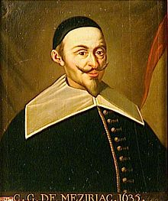
Claude Gaspard Bachet de Méziriac
(1581 – 1638)

Slide 224
Bachet’s work
Diophantus, Arithmetic (1621)
  Bachet’s Diophantus immortalized by Fermat
Problèmes Plaisants (1612, 1624)
  first book on recreational mathematics
    the modern equivalent is Mathematical Recreations and Essays by W. W. Rouse Ball

Slide 225
Ideals
An ideal I is a non-empty subset of a ring R such that
Notes:
~~\\
1.~\forall x, y\in I ~:~ x+y \in I\\
2.~\forall x\in I~\forall a \in R ~:~ax\in I

Slide 226
Examples of Ideals
Even numbers
Univariate polynomials with root 5
Polynomials with x and y with free coefficient 0
  x² + 3y² + xy + x

Slide 227
Subrings that are not ideals

Slide 228
Problem 228
1. Prove that an ideal I is closed under subtraction:
2. Prove that I contains 0.
Notes:
~~\\
\forall x, y \in I ~:~ x+y \in I\\

Slide 229
Linear combination ideal
In a ring, for any two elements a and b, the set of all elements {xa + yb} forms an ideal.
Proof:
closed under addition:
(x₁a + y₁b) + (x₂a + y₂b) = (x₁ + x₂)a + (y₁ + y₂)b
closed under multiplication by an arbitrary element:
z(xa + yb) = (zx)a + (zy)b

Slide 230
Problem 230
Prove that all the elements of a linear combination ideal are divisible by any of the common divisors of a and b.

Slide 231
Ideals in Euclidean Domains
Any ideal in an Euclidean domain is closed under remainder operation and under Euclidean gcd.
Proof:
Closed under remainder:
  rem(a, b) = a – quot(a, b)⋅b
Closed under gcd :
  Immediately follows from 1.

Slide 232
Principal Ideals
Notes:
~~\\An ideal $I$ of the ring $R$ is called a \emph{principal ideal}\\
if there is an element $a \in R$ called the \emph{principal element}\\
such that
$$x\in I \iff \exists y \in R ~:~ x = ay~~~~~~~~~~~~~~~~~~~~~~~~~~~~~~~~~~~~~~~~~~~~~~~~~~~~~~~~~~~~~~$$

Slide 233
Examples of Principal Ideals
Even numbers
Polynomials with root 5

Slide 234
An ideal that is not principal
Polynomials with x and y with free coefficient 0
  x² + 3y² + xy + x
  Couldn’t be generated by x – would not contain y; and vice versa.

Slide 235
Problem 235
Prove that any element in a principal ideal is divisible by the principal element.

Slide 236
Principal Ideal Domain
An integral domain is called a principal ideal domain (PID) if every ideal in it is a principal ideal.

Slide 237
Notes:
ED \implies PID
~~\\
Every Euclidean domain is a principal ideal domain.\\\\
Proof:\\
Any ideal $I$ contains an element $m$ with a minimal\\ positive norm.
Then $\forall a \in I ~:~a = qm$.\\ Otherwise, $a = qm + r$ where $0<\|r\|<\|m\|$.\\
Contradiction. Therefore $m$ is the principal\\
element of $I$ and $I$ is a principal ideal.

Slide 238
Bachet theorem
A linear combination ideal I = {хa + yb} of a Euclidean domain contains gcd(a, b).
Proof:
Notes:
a\in I ~\wedge~ b\in I \implies {\rm gcd}(a, b) \in I

Slide 239
Invertibility lemma
Notes:
~~\\
$\forall a, n \in {\mathbb Z} ~:~ {\rm gcd}(a, n) = 1 \implies
\\~~~~~~~~~~~ \exists b \in {\mathbb Z}_n ~:~ab = 1 \mod n $\\
Proof:\\
By Bachet theorem, $$\exists b, d \in {\mathbb Z} ~:~ ba + dn = 1
~~~~~~~~~~~~~~~~~~~~~~~~~~~~~~~~~~~~~~~~~~~~~~~~~~~~~~~~~~~~~~~~~~~~~~~~~~$$
Therefore, $~ab = 1 - dn$
and $$~ab = 1 \mod n
~~~~~~~~~~~~~~~~~~~~~~~~~~~~~~~~~~~~~~~~~~~~~~~~~~~~~~~~~~~~~~~~~~~~~~~~~~~~~~~~~~~~~~~~~~~$$

Slide 240
Problem 240
Using Bachet’s theorem prove that if p is prime, then any 0 < a < p has a multiplicative inverse modulo p.

Slide 241
Non-constructive proofs
We know that inverses exist, but have no idea how to find them.
This situation is unsatisfactory.
The philosophy of mathematics that rejects non-constructive proofs is called constructivism.
  Intuitionism is historically most important variety of constructivism.

Slide 242
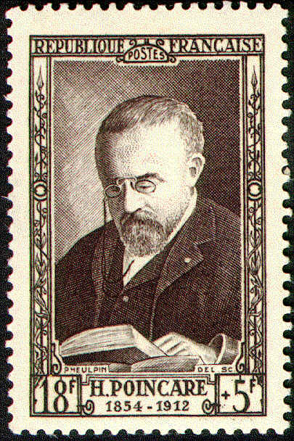
Henri Poincaré

Slide 243
Poincaré’s Contributions
Almost every branch of mathematics
  originating several (algebraic topology…)
Special relativity theory
Criticism of set theory and the formalist (Hilbert) agenda
A major tragedy of XX century science was the rejection of Poincare’s legacy by Bourbaki and Bourbaki’s epigones.

Slide 244
Poincaré’s Books
Poincaré was a brilliant writer. In 1909 he was elected a member of Académie française. His books on philosophy of science are very important
  Science and Hypothesis
  Value of Science
  Science and Method

Slide 245
Poincaré on Science
“Science has had marvelous applications, but a science that would only have applications in mind would not be science anymore, it would be only cookery.”

Slide 246
Bachet’s algorithm
There is a constructive way to find x and y such that
  xa + yb = gcd(a, b)

Slide 247
Trace of Euclidean Algorithm
Notes:
~~\\
a &= b \cdot q_1 + r_1\\
b &= r_1 \cdot q_2 + r_2\\
&\cdots\\
r_{n-2} &= r_{n-1} \cdot q_{n} + r_n\\
r_{n-1} &= r_n \cdot q_{n+1}

Slide 248
Remainder trace
Notes:
~~\\
r_1 &= a - b\cdot q_1\\
r_2 &= b - r_1 \cdot q_2\\
&\cdots\\
r_{i+2} &= r_{i} - r_{i+1} \cdot q_{i+2}\\
&\cdots\\

Slide 249
First steps of Bachet’s algorithm
Notes:
~~\\
a &= 1 \cdot a + 0\cdot b\\
b &= 0 \cdot a + 1\cdot b\\
r_1 &= 1 \cdot a - q_1 \cdot b\\
r_2&= b - (a - b \cdot q_1) \cdot q_2 \\&= -q_2 \cdot a + (1 + q_1 \cdot q_2)\cdot b\\

Slide 250
Iterative recurrence for Bachet
Notes:
~~\\
{\rm Assume~that~~~~}\\
r_i &= x_i \cdot a + y_i \cdot b\\
r_{i+1} &= x_{i+1} \cdot a + y_{i+1} \cdot b\\
{\rm Then~~~~~~~~~~~~~~~~~~}\\
r_{i+2} &= r_{i} - r_{i+1} \cdot q_{i+2}\\
&= x_i \cdot a + y_i \cdot b - (x_{i+1} \cdot a + y_{i+1} \cdot b) \cdot q_{i+2}\\
&= (x_i - x_{i+1} \cdot q_{i+2}) \cdot a + (y_i - y_{i+1} \cdot q_{i+2}) \cdot b\\
{\rm In~other~words}\\
x_{i+2} &= x_i - x_{i+1} \cdot q_{i+2}\\
y_{i+2} &= y_i - y_{i+1} \cdot q_{i+2}

Slide 251
We do not need y!
If b ≠ 0 we can compute x and gcd and get y using the formula
y = quot(gcd(a, b) – ax, b)

Slide 252
Problem 252
What are x and y if b = 0?

Slide 253
Extended gcd
template <EuclideanDomain R>
pair<R, R> extended_gcd(R a, R b) {
R x0(1);
R x1(0);
while (b != R(0)) {
// compute new r and x
pair<R, R> p = quotient_remainder(a, b);
R x2 = x1 – p.first * x0;
// shift r and x
x0 = x1; x1 = x2;
a = b; b = p.second;
}
return make_pair(x0, a);
}

Slide 254
Project 254
Develop a version of extended gcd based on Stein’s algorithm.

Slide 255
Applications of gcd
Cryptography
Rational arithmetic
Symbolic integration
std::rotate

Slide 256
Permutations
Permutation is a function from a sequence of n objects onto itself.
Notation:
Shorthand:
Example: (2 4 1 3): {a, b, c, d} = {c, a, d, b}
Notes:
\begin{pmatrix}
1 & 2 & 3 & 4 \\
2 & 4 & 1 & 3
\end{pmatrix}

Slide 257
Symmetric Groups
A set of all permutations on n elements constitutes a group called the symmetric group S_{n}.
  group operation: composition
    function composition is associative
  identity element: identity permutation
  inverse: inverse permutation

Slide 258
Problem 258
What is the order of S_{n}?

Slide 259
Transpositions
A transposition (i j) is a permutation that exchanges the ith and jth elements (i ≠ j) leaving the rest in place.
(2 3): {a, b, c, d} = {a, c, b, d}
(In C++, we call it swap.)

Slide 260
Transposition Lemma
Any permutation is a product of transpositions.
Proof:
One transposition can put one element into its final destination. Therefore, n − 1 transpositions will put all elements into their final destinations.

Slide 261
Problem 261
Prove that if n > 2, S_{n} is not Abelian.

Slide 262
Cycles in the permutations
Every permutation can be decomposed into cycles. For example, (2 3 5 6 1 4) contains two cycles:
It is written (2 3 5 6 1 4) = (1 2 3 5)(4 6)
1
2
3
5
4
6

Slide 263
Cycles are disjoint
If you are at a position in a cycle, you can get to all other positions in that cycle. Therefore, if two cycles share a position, they share all the positions.

Slide 264
Trivial cycle
A cycle containing one element is called a trivial cycle.

Slide 265
Problem 265
How many non-trivial cycles could a permutation of n elements contain?

Slide 266
Number of assignments
The number of assignments needed to perform a permutation in place is n – u + v, where n is the number of elements, u is the number of trivial cycles and v is the number of non-trivial cycles.
Proof:
Every non-trivial cycle of length k requires
k + 1 assignments. The number of elements in non-trivial cycles is equal n – u and v is added for all non-trivial cycles.

Slide 267
Problem 267
Design an in-place reverse algorithm for forward iterators; that is, it should work for singly-linked lists without modifying the links.
An algorithm is in-place if for an input of length n it uses O(p(log n)) additional space where p is a polynomial. (Such algorithms are also called polylog space algorithms.)

Slide 268
Heirs of Pythagoras
Lecture 6

Slide 269
Lessons from Mathematics
Abstracting from specific types to generalized theories
Breaking the reasoning discourse into a sequence of small self-contained lemmas

Slide 270
Swapping ranges
while (condition) swap(*f0++, *f1++);

Slide 271
Ranges
semi-open closed
Bounded: two iterators [i, j) [i, j]
Counted: iterator and integer [i, n) [i, n]

Slide 272
Swapping an explicit range with an implicit range
template <ForwardIterator I0,
ForwardIterator I1>
I1 swap_ranges(I0 f0, I0 l0, I1 f1) {
while (f0 != l0) swap(*f0++, *f1++);
return f1;
}

Slide 273
The Law of Useful Return
A procedure should return all the potentially useful information it computed.
  this does not imply doing unneeded extra
  computations.
  this does not imply returning useless information.

Slide 274
The Law of Separating Types
Do not assume that two types are the same when they may be different.
template <ForwardIterator I0,
ForwardIterator I1>
I1 swap_ranges(I0 f0, I0 l0, I1 f1);
not
template <ForwardIterator I>
I swap_ranges(I f0, I l0, I f1);

Slide 275
Swapping explicit ranges
template <ForwardIterator I0,
ForwardIterator I1>
pair<I0, I1> swap_ranges(I0 f0, I0 l0,
I1 f1, I1 l1) {
while (f0 != l0 && f1 != l1) {
swap(*f0++, *f1++);
}
return pair<I0, I1>(f0, f1);
}

Slide 276
The Law of Completeness
When designing an interface, consider all the related procedures.

Slide 277
Swapping counted ranges
template <ForwardIterator I0,
ForwardIterator I1,
Integer N>
pair<I0, I1> swap_ranges_n(I0 f0,
I1 f1,
N n) {
while (n != N(0)) {
swap(*f0++, *f1++);
--n;
}
return pair<I0, I1>(f0, f1);
}

Slide 278
Problem 278
Why don’t we provide
pair<I0, I1> swap_ranges_n(I0 f0,
I1 f1,
N0 n0,
N1 n1)

Slide 279
Indexing
While mathematical texts index sequences from 1, the computer science convention of indexing from 0 is more natural.
  For a sequence with n elements the indices are in the range [0, n) and any iteration is bounded by the length.
  rotating n elements to the right by k transforms an index i to the index i + k mod n.

Slide 280
Rotation
A permutation of n elements by k
where k ≥ 0:
(k mod n, k + 1 mod n, …, k + n – 2 mod n, k + n – 1 mod n)
is called an n by k rotation.
(We index permutations from 0.)

Slide 281
rotate
rotate is the most important algorithmic primitive of which you never heard.
We are going to see its uses throughout the next Journey.

Slide 282
Designing Interfaces
We can design a useful interface only after we figure out its multiple future uses.
The design is a multi-pass activity.

Slide 283
Interface to rotate
Experience shows that it is convenient to define rotation with three iterators: f, m and l where [f, m) and [m, l) are valid ranges. Rotation then interchanges ranges [f, m) and [m, l).

Slide 284
An example of rotate
0 1 2 3 4 5 6
f m l
Produces:
2 3 4 5 6 0 1

Slide 285
Problem 285
Prove that if we do rotate(f, m, l) then it performs distance(f, l) by distance(m, l) rotation.

Slide 286
Gries-Mills algorithm
template <ForwardIterator I>
void gries_mills_rotate(I f, I m, I l) {
// u = distance(f, m) && v = distance(m, l)
if (f == m || m == l) return; // u == 0 || v == 0
pair<I, I> p = swap_ranges(f, m, m, l);
while(p.first != m || p.second != l) {
if (p.first == m) { // u < v
f = m; m = p.second; // v = v - u
} else { // v < u
f = p.first; // u = u - v
}
p = swap_ranges(f, m, m, l);
}
return; // u == v
}

Slide 287
Problem 287
If you inline swap_ranges you see that the algorithm does unnecessary iterator comparisons. Re-write the algorithm so that no unnecessary iterator comparisons are done.

Slide 288
The number of swaps during the last swap_range
The number of swaps during the last swap_range is gcd(n, k) where
n = distance(f, l)
k = distance(m, l)

Slide 289
Number of cycles in the rotate
Every swap_range moves elements along their cycles.
The number of cycles is gcd(n, k)
For a formal proof see EoP pages 178-179

Slide 290
Complexity of Gries-Mills
During the call to all the swap_range except the last one, every swap puts one element into the final destination.
During the last swap_range every swap puts two elements into the final destination.
The total number of swaps n – gcd(n, k)
The total number of assignments 3(n – gcd(n, k))

Slide 291
Trace of Gries-Mills
0 1 2 3 4 5 6
f m l
2 3 0 1 4 5 6
f m l
2 3 4 5 0 1 6
f m l
2 3 4 5 6 1 0
f m l
2 3 4 5 6 0 1
f m
l

Slide 292
The return value of rotate
Many applications benefit if rotate returns a new middle: a position where the first element moved.
Observe, that
rotate(f, rotate(f, m, l), l)
is an identity permutation.
The task is to find a way to return the desired value without doing any extra work.

Slide 293
An auxiliary rotate
template <ForwardIterator I>
I rotate_unguarded(I f, I m, I l, I m1) {
// assert(f != m && m != l)
pair<I, I> p = swap_ranges(f, m, m, l);
while (p.first != m || p.second != l) {
f = p.first;
if (m == f) m = p.second;
p = swap_ranges(f, m, m, l);
}
return m1;
}

Slide 294
Final rotate for forward iterators
template <ForwardIterator I>
I rotate(I f, I m, I l, forward_iterator_tag) {
if (f == m) return l;
if (m == l) return f;
pair<I, I> p = swap_ranges(f, m, m, l);
while (p.first != m || p.second != l) {
if (p.second == l)
return rotate_unguarded(p.first, m, l, p.first);
f = m;
m = p.second;
p = swap_ranges(f, m, m, l);
}
return m;
}

Slide 295
In search of faster algorithm
We know that we can do a permutation without trivial cycles with n + c assignments where n is the size of permutation and c is the number of cycles.
Such an algorithm requires stronger requirements on the iterators.
And we need to go through cycles in reverse order!

Slide 296
cycle_from
template <ForwardIterator I,
Transformation F>
void cycle_from(I i, F from) {
typedef typename iterator_traits<I>::value_type V;
V tmp = *i;
I start = i;
for (I j = from(i); j != start; j = from(j)) {
*i = *j;
i = j;
}
*i = tmp;
}

Slide 297
transformation for rotate
template <RandomAccessIterator I>
struct rotate_transform {
typedef typename iterator_traits<I>::difference_type N;
N plus;
N minus;
I m1;
rotate_transform(I f, I m, I l) :
plus(m – f), minus(m – l), m1(f + (l – m)){}
I operator()(I i) const {
return i + ((i < m1) ? plus : minus);
}
};

Slide 298
Modified Fletcher-Silver algorithm
template <RandomAccessIterator I>
I rotate(I f, I m, I l,
random_access_iterator_tag) {
if (f == m) return l;
if (m == l) return f;
typedef iterator_traits<I>::difference_type N;
N d = gcd(m - f, l - m);
rotate_transform<I> rotator(f, m, l);
while (d-- > 0) cycle_from(f + d, rotator);
return rotator.m1;
}

Slide 299
3-reverse rotate
template <BidirectionalIterator I>
void three_reverse_rotate(I f, I m, I l) {
reverse(f, m);
reverse(m, l);
reverse(f, l);
}

Slide 300
Problem 300
How many assignments does 3-reverse rotate perform?

Slide 301
reverse_until
template <BidirectionalIterator I>
pair<I, I> reverse_until(I f, I m, I l) {
while (f != m && m != l) swap(*f++, *--l);
return pair<I, I>(f, l);
}

Slide 302
Bidirectional rotate
template <BidirectionalIterator I>
I rotate(I f, I m, I l,
bidirectional_iterator_tag) {
reverse(f, m);
reverse(m, l);
pair<I, I> p = reverse_until(f, m, l);
reverse(p.first, p.second);
if (m == p.first) return p.second;
return p.first;
}

Slide 303
Iterator category dispatch
template <ForwardIterator I>
inline
I rotate(I f, I m, I l) {
typename iterator_traits<I>::iterator_category c;
return rotate(f, m, l, c);
}

Slide 304
Bidirectional reverse
template <BidirectionalIterator I>
void reverse(I f, I l,
bidirectional_iterator_tag) {
while (f != l && f != --l) swap(*f++, *l);
}

Slide 305
Returning from reverse
It might appear that according to the law of useful return we should return
pair<I, I>(f, l)
However, there is no evidence that it is useful; therefore the law does not apply.

Slide 306
reverse_n
template <BidirectionalIterator I,
Integer N>
void reverse_n(I f, I l, N n) {
n >>= 1;
while (n-- > N(0)) {
swap(*f++, *--l);
}
}

Slide 307
Problem 307
Unroll the loop of reverse_n 4 times.
(Read about Duff’s device.)

Slide 308
Random Access reverse
template <RandomAccessIterator I>
void reverse(I f, I l,
random_access_iterator_tag) {
reverse_n(f, l, l - f);
}

Slide 309
Recursive reverse
template <ForwardIterator I,
BinaryInteger N>
I reverse_recursive(I f, N n) {
if (n == 0) return f;
if (n == 1) return ++f;
N h = n >> 1;
I m = reverse_recursive(f, h);
advance(m, n & 1);
I l = reverse_recursive(m, h);
swap_ranges_n(f, m, h);
return l;
}

Slide 310
Forward Iterator reverse
template <ForwardIterator I>
void reverse(I f, I l,
forward_iterator_tag) {
reverse_recursive(f, distance(f, l));
}

Slide 311
Generic reverse
template <ForwardIterator I>
inline
void reverse(I f, I l) {
typename iterator_traits<I>::iterator_category c;
reverse(f, l, c);
}

Slide 312
Complexity of computation
Time complexity
  Hartmanis and Stearns
  time hierarchy theorem
Space complexity
  Lewis, Stearns and Hartmanis

Slide 313
Space complexity in concrete algorithmics
In-place
  An algorithm is in-place if for an input of length n it uses O(p(log n)) additional space where p is a polynomial. (Such algorithms are also called polylog space algorithms.)
Not in-place
  usually means that you can create a copy of your data

Slide 314
reverse with buffer
template <ForwardIterator I,
Integer n,
BidirectionalIterator B>
I reverse_n_with_buffer(I f, N n, B buffer) {
return reverse_copy(buffer,
copy_n(f, n, buffer),
f);
}

Slide 315
reverse_copy
template <BidirectionalIterator I,
OutputIterator O>
O reverse_copy(I f, I l, O r) {
while (f ! = l) *r++ = *--l;
return r;
}

Slide 316
Memory-adaptive algorithms
In practice, the dichotomy of in-place and not in-place algorithms is not very useful.
While the assumption of unlimited memory is not realistic, neither is the assumption of only polylog extra memory.
Usually 25%, 10%, 5% or at least 1% of extra memory is available.
Algorithms need to adapt to however much is available.

Slide 317
Adaptive reverse
template <ForwardIterator I, Integer n,
BidirectionalIterator B>
I reverse_n_adaptive(I f, N n,
B b, N b_n) {
if (n == N(0)) return f;
if (n == N(1)) return ++f;
if (n <= b_n) return reverse_n_with_buffer(f, n, b);
N h = n >> 1;
I m = reverse_n_adaptive(f, h, b, b_n);
advance(m, n & 1);
I l = reverse_n_adaptive(m, h, b, b_n);
swap_ranges_n(f, m, h);
return l;
}

Slide 318
The sad story of get_temporary_buffer
get_temporary_buffer takes a size and should return the largest available buffer not greater than the size that fits into physical memory.
There is a bogus implementation – using malloc till it returns something.
No vendor provides the correct implementation.

Slide 319
Words of wisdom
Whose heirs are we?

