Slide 1
Four Journeys
Alexander Stepanov

Slide 2
Four Journeys: Journey One
Lecture 1
Alexander Stepanov

Slide 3
Ἀεὶ ὁ θεὸς γεωμετρεῖ.
Πλάτων
ἀλλὰ πάντα μέτρῳ καὶ ἀριθμῷ καὶ σταθμῷ διέταξας.
Σοφία Σολομώντος
...impossibile est res huius mundi sciri nisi sciatur mathematica.
Rogerius Baco

Slide 4
Objectives
To show deep connections between Programming and Mathematics.
To recognize well-known mathematical abstractions in regular programming tasks.
To write reusable, efficient algorithms defined on these abstractions.
To use a small number of algorithms in a variety of applications.

Slide 5
Approach
The course traces four fundamental algorithmic ideas and shows how they led to discoveries in both computing and mathematics and how they can be applied to a variety of problems.

Slide 6
Historical Approach
To understand something we need to know its history.
“Great Men, taken up in any way, are profitable company.”
  Thomas Carlyle

Slide 7
Programming Aesthetics
Sense of beauty is important for building large systems and controlling complexity.
Study of mathematics develops this sense.

Slide 8
Lincoln and Jefferson
Lincoln
  “He studied and nearly mastered the Six-books of Euclid, since he was a member of Congress.”
  “…to improve his logic and language.”
  Use of Euclid in Lincoln-Douglas debates.
Jefferson
  “I have given up newspapers in exchange for Tacitus and Thucydides, for Newton and Euclid; and I find myself much the happier.”
  A thorough knowledge of Euclid should be the admission requirement to the University of Virginia.
Notes:
The quote is from Lincoln’s Autobiographical Note written in the third person.

Slide 9
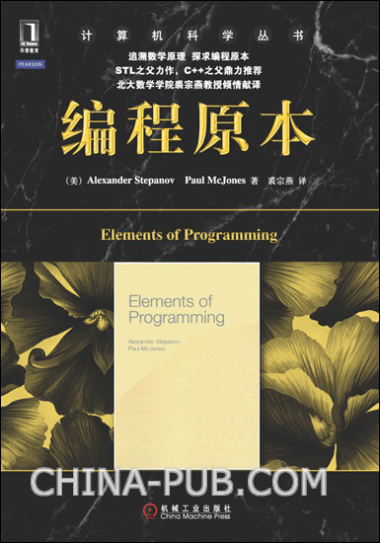
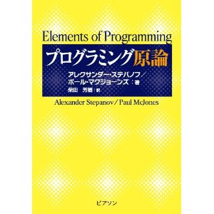
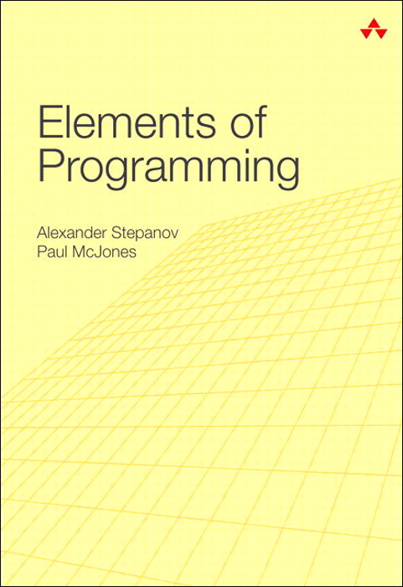
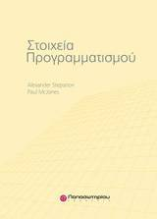
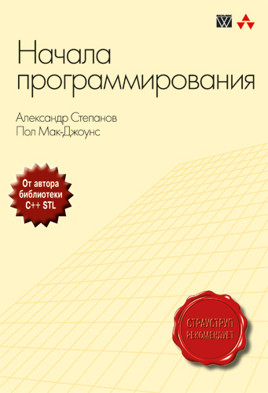
The Auxiliary Text: EoP
Notes:
It

Slide 10
Deductive vs. Historical Approach
EoP presents facts.
Four Journeys presents the intuition behind the facts.
They complement each other.
  It is not necessary to read EoP.
  But it might be really helpful for some.

Slide 11
First Journey:
The Spoils of the Egyptians
How elementary properties of commutativity and associativity of addition and multiplication led to fundamental algorithmic and mathematical discoveries

Slide 12
Self-evident propositions
Notes:
Commutativity and associativity
%\slide{Self-evident propositions}
\hspace{0.5in}From time immemorial people knew that
addition obeys:
\begin{align*}
a + b &= b + a \\
(a + b) + c &= a + (b + c)
\end{align*}
\hspace{0.5in}
and multiplication obeys:
\begin{align*}
ab &= ba \\
(ab)c &= a(bc)
\end{align*}

Slide 13
Are proofs important?

Slide 14
Geometric Proofs
For millennia mathematicians relied on geometric proofs
They appeal to our innate intuition of space
  Innate?
Notes:
Kant

Slide 15
a
a
b
b

Slide 16
Commutativity of addition

Slide 17
Associativity of addition

Slide 18
Commutativity of multiplication

Slide 19
Associativity of multiplication
A
C
B
Notes:
A(BC) = B(AC)
(actually, we show that a(bc) = c(ab), but since we already established commutativity, it is the same.
[Had to add opaque white squares for lower left figure, so that layer behind wouldn’t show. May need a bit more work.]

Slide 21
Problem 21
Design geometric proofs
Notes:
(a - b)^2 &= a^2 - 2ab + b^2 \\
a^2 - b^2 &= (a + b)(a - b) \\
(a + b)^3 &= a^3 + 3a^2b + 3ab^2 + b^3 \\
(a - b)^3 &= a^3 - 3a^2b + 3ab^2 - b^3 \\

Slide 22
Problem 22
Using geometry find formulas for
  Sum of the first positive integers
  Sum of the first positive odd integers
Find geometric upper bound for π.

Slide 23
What is a proof?
A proof of a proposition is
an argument
accepted by the mathematical community
to establish the proposition as valid
What is a valid proof today, might not be a valid proof three hundred years from now.
Notes:
Many proofs that were viewed as valid by Euler – the greatest XVIII century mathematician – are frowned upon today.

Slide 24
Reading 24
Richard A. De Millo, Richard J. Lipton, Alan J. Perlis (1979), “Social processes and proofs of theorems and programs”, Communications of the ACM, Volume 22, Issue 5

Slide 25
Number systems
All civilizations developed number systems
Fundamental requirement for
  Collecting taxes
  Calendar computation to determine cultivation dates

Slide 26
Common Source?
    How could they all discover Pythogorean triples?
Van der Waerden conjecture
  Common Neolithic source (3000 BC)
  Spreads through
    Babylonia: Plimpton 322
    China: Nine Chapters
      (九章算術 Jiǔzhāng Suànshù)
    India: Baudha-yana’s Sulvasutra
Notes:
I do not believe it!

Slide 27
Parallel Evolution
Many similar mathematical concepts have been (re-)discovered independently
That shows their fundamental nature

Slide 28
Geographical origins
India and China had early mathematical traditions
  Liu Hui (劉徽)
    on inability to find volume of the sphere.
  Aryabhata (आर्यभट)
European mathematical tradition (which included Arabs) is the one from which Computer Science came

Slide 29
“Egyptians we take to be the most ancient of men”
…the mathematical arts were founded in Egypt...
Aristotle, Metaphysics, A 981b23-2
[Moses] speedily learned arithmetic, and geometry... This knowledge he derived from the Egyptians, who study mathematics above all things...
  Philo, De Vita Mosis, I, 23-24
Notes:
Title from Aristotle Meteorology 252b21
Quid ergo Athenis et Hierosolymis? – Tertullian, De Praescriptione Haereticorum, VII, 9
What indeed has Athens to do with Jerusalem?

Slide 30
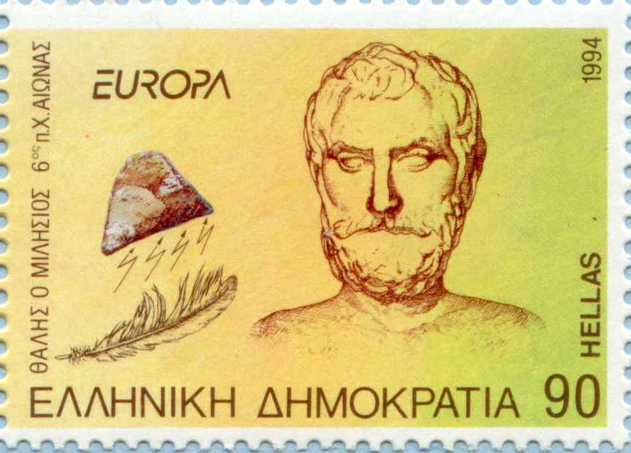
Thales of Miletus (635BC – 545BC)
Notes:
First of the Greeks to learn from Egyptians.
Oil presses
Bull sacrifice when he discovered his theorem.
Father of Western philosophy – Bertrand Russell
γνῶθι σεαυτόν
nosce te ipsum

Slide 31
Thales Theorem:
AC is diameter => ∠ABC = 90˚
B
A
C
Notes:
&\angle DAB = \angle DBA\\
&\angle DCB = \angle DBC\\
&\angle DAB + \angle DCB = \angle DBA + \angle DBC\\
&\angle DAB + \angle DCB + \angle DBA + \angle DBC = 180^\circ\\
&(\angle DBA + \angle DBC) + (\angle DBA + \angle DBC) = 180^\circ\\
&\angle DBA + \angle DBC = 90^\circ\\
&\angle CBA = 90^\circ

Slide 32
The Proof of Thales Theorem
B
A
D
C
Notes:
&\angle DAB = \angle DBA\\
&\angle DCB = \angle DBC\\
&\angle DAB + \angle DCB = \angle DBA + \angle DBC\\
&\angle DAB + \angle DCB + \angle DBA + \angle DBC = 180^\circ\\
&(\angle DBA + \angle DBC) + (\angle DBA + \angle DBC) = 180^\circ\\
&\angle DBA + \angle DBC = 90^\circ\\
&\angle CBA = 90^\circ

Slide 33
Surviving Egyptian Mathematics
Rhind papyrus
  Written by the scribe Ahmes
  1650BC (copy of a much older text ≈1850BC)
  Fast multiplication algorithm
    Greeks knew it as Egyptian multiplication
    Russian Peasant Algorithm
  Fast division algorithm
    We will meet it during the next journey
Notes:
“I have been told that there is a method in use to-day (some say in Russia, but I have not been able to verify this) ...” Sir Thomas Heath, History of Greek Mathematics

Slide 34
Distributivity
Every multiplication algorithm depends on:
It allows us to reduce the problem

Slide 35
The Inductive Base
Could we prove it?

Slide 36
Inductive Step
Depends on distributivity?
Notes:
“Theorem soup”

Slide 37
Slow Multiply Algorithm
int multiply0(int n, int a) {
if (n == 1) return a;
return multiply0(n – 1, a) + a;
}
Both a and n are positive
Notes:
Historical precondition

Slide 38
The Algorithmic Insight
Notes:
Associativity!
And we need to compute a + a only once reducing the number of additions
4a &= ((a + a) + a) + a\\
&= (a + a) + (a + a)

Slide 39
Ahmes Algorithm: 41 × 59
1 | ✓ | 59
2 |  | 118
4 |  | 236
8 | ✓ | 472
16 |  | 944
32 | ✓ | 1888
Notes:
Instead of reconstructing code from Ahmes, let us use simple algebra (anachronism).

Slide 40
Halving
Notes:
\begin{align*}
even(n) &\implies n = \frac{n}{2} + \frac{n}{2}\\
\\
odd(n) &\implies n = \frac{n-1}{2} + \frac{n-1}{2} + 1\\
\end{align*}

Slide 41
Fast Multiply Algorithm
int multiply1(int n, int a) {
if (n == 1) return a;
int result = multiply1(half(n), a + a);
if (odd(n)) result = result + a;
return result;
}
requirement for half:
Notes:
\mathit{odd}(n) \implies \mathit{half}(n) = \mathit{half}(n – 1)

Slide 42
Problem 42
Implement an iterative version of fast multiply.

Slide 43
Number of additions
Notes:
\#_+(n) = \color[rgb]{0.000,0.000,1.000}\lfloor \log n \rfloor \color[rgb]{0.000,0.000,0.000}+ \color[rgb]{1.000,0.000,0.000} \nu(n) – 1
\flushleft
where $\nu(n)$ is the number of $1$s in the \\
binary representation of $n$ \\
(the \emph{population count} or \emph{popcount})

Slide 44
Is it optimal?

Slide 45
multiply_by_15
int multiply_by_15(int a) {
int b = (a + a) + a; // b == 3*a
int c = b + b; // c == 6*a
return (c + c) + b; // 12*a + 3*a
}
5 additions!
We discovered an optimal addition chain for 15.

Slide 46
Problem 46
Optimal Addition Chains
Find optimal addition chains for n < 100.

Slide 47
Further Reading 47
Donald Knuth, The Art of Computer Programming, Volume 2: Seminumerical Algorithms, pages 465-481.
Notes:
Knuth is a treasure trove.
It is like a chest in your grandfather attic: you never know what you can find in it.
It is a good thing to acquire a habit of browsing it.
Read answers to the exercises.

Slide 48
Four Journeys: Journey One
Lecture 2
Alexander Stepanov

Slide 49
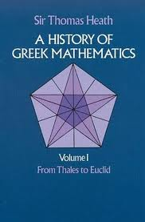
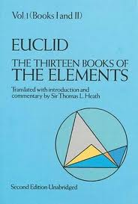
Dover Treasures

Slide 50
Fast Multiply Algorithm
int multiply1(int n, int a) {
if (n == 1) return a;
int result = multiply1(half(n), a + a);
if (odd(n)) result = result + a;
return result;
}
requirement for half:
Notes:
\mathit{odd}(n) \implies \mathit{half}(n) = \mathit{half}(n – 1)

Slide 51
Program transformations
The code of multiply1 is a good implementation of Egyptian Multiplication as far as the number of additions
It also does recursive calls
  function call is much more expensive than plus

Slide 52
multiply-accumulate
It is often easier to do more than less

Slide 53
mult_acc0
int mult_acc0(int r, int n, int a) {
if (n == 1) return r + a;
if (odd(n)) {
return mult_acc0(r + a, half(n), a + a);
} else {
return mult_acc0(r, half(n), a + a);
}
}
Invariant:
Notes:
Define tail recursion for those who forgot it.
We can unify two recursive calls – they are only differ on the first argument.
I assume that you know how to implement half and odd.
We will see the implementation later.

Slide 54
mult_acc1
int mult_acc1(int r, int n, int a) {
if (n == 1) return r + a;
if (odd(n)) r = r + a;
return mult_acc1(r, half(n), a + a);
}
n is usually not 1.
if n is even, it is not 1.
We can reduce the number of comparisons with 1 by a factor of 2.

Slide 55
mult_acc2
int mult_acc2(int r, int n, int a) {
if (odd(n)) {
r = r + a;
if (n == 1) return r;
}
return mult_acc2(r, half(n), a + a);
}
A strict tail-recursive procedure is one in which all the tail-recursive calls are done with the formal parameters of the procedure being the corresponding arguments.

Slide 56
mult_acc3
int mult_acc3(int r, int n, int a) {
if (odd(n)) {
r = r + a;
if (n == 1) return r;
}
n = half(n);
a = a + a;
return mult_acc3(r, n, a);
}
Now it is easy to make it iterative.

Slide 57
mult_acc4
int mult_acc4(int r, int n, int a) {
while (true) {
if (odd(n)) {
r = r + a;
if (n == 1) return r;
}
n = half(n);
a = a + a;
}
}
Notes:
And now back to multiply

Slide 58
multiply2
int multiply2(int n, int a) {
if (n == 1) return a;
return mult_acc4(a, n - 1, a);
}
When n is 16, it does 7 addition instead of 4.
We do not want to subtract 1 from an even number.
Let us make it odd!
Notes:
We shall see later that saving one addition might be a big deal if “addition” is expensive.

Slide 59
multiply3
int multiply3(int n, int a) {
while (!odd(n)) {
a = a + a;
n = half(n);
}
if (n == 1) return a;
return mult_acc4(a, n - 1, a);
}
mult_acc4 does an unnecessary test for 1.

Slide 60
multiply4
int multiply4(int n, int a) {
while (!odd(n)) {
a = a + a;
n = half(n);
}
if (n == 1) return a;
// even(n - 1) => n - 1 != 1
return mult_acc4(a, half(n), a + a);
}

Slide 61
Coloring mult_acc4
int mult_acc4(int r, int n, int a) {
while (true) {
if (odd(n)) {
r = r + a;
if (n == 1) return r;
}
n = half(n);
a = a + a;
}
}
Notes:
blue and red parts are disjoint. They can be different types!

Slide 62
Syntactically generalized multiply_accumulate
template <typename A, typename N>
A multiply_accumulate(A r, N n, A a) {
while (true) {
if (odd(n)) {
r = r + a;
if (n == 1) return r;
}
n = half(n);
a = a + a;
}
}
Notes:
What are A and N?

Slide 63
Syntactic Requirements on A
a + b
  operator+
can be passed by value
  copy constructor
assignment
  operator=

Slide 64
A semantic requirement on A:
Associativity of +
Notes:
A(T) \implies \forall a, b, c \in T: a + (b + c) = (a + b) + c
Explain quanitfiers!
We need to explain that A is an equational theory.

Slide 65
In computer + may be partial
We often deal with operations that are partially defined.
We require axioms to hold inside the domain of definition.
Much research work is needed to extend axioms to computer models of real numbers.
  approximate associativity

Slide 66
Implicit syntactic requirements induced by intended semantics
Equality
  operator==
Inequality
  operator!=

Slide 67
Equational Reasoning
Equality on type T should satisfy our expectations.
  inequality is negation of equality
  equality is reflexive, symmetric and transitive
  Substitutability
Notes:
\\a = a
\\a = b \implies b = a
\\a = b \wedge b = c \implies a = c
\forall\mathbb{P}, a, b: a = b \implies \mathbb{P}(a) = \mathbb{P}(b)

Slide 68
Regular types:
Connection between construction, assignment and equality:
T a = b; assert(a == b);
a = b; assert(a == b);
T a = b; <=> T a; a = b;
“normal” destructor

Slide 69
Regularity is the default
  All the types in this course will be regular unless stated otherwise.

Slide 70
Problem 70
It seems that all of the C/C++ built-in types are regular. Unfortunately, one of the most important logical axioms is sometimes violated: the law of excluded middle. Sometimes the following is false:
Find the case; analyze it and propose a solution.
Notes:
a = b \vee a\neq b

Slide 71
Problem 71
There is a sizable body of work on constructive real numbers: the real numbers that can be computed with arbitrary precision. Apparently, the classes that implement them are not regular. Why?
If you are interested to learn more
Hans-Juergen Boehm: Constructive real interpretation of numerical programs. PLDI 1987: 214-221
or use his calculator
  http://www.hpl.hp.com/personal/Hans_Boehm/crcalc/
Notes:
a = b \vee a\neq b

Slide 72
Requirements on A
Regular type
Associative +
A is an additive semigroup:
  semigroup: a set with an associative binary operation
  additive: binary operation is +
    but by convention, + commutes
Notes:
uint32 has many semigroups

Slide 73
Rules for overloading +
If a set has one binary operation and it is associative and commutative, call it .
If a set has one binary operation and it is associative and not commutative, call it .
Kleene uses to denote string concatenation (in mathematics is elided).

Slide 74
Overloading Dilemma
We can drop commutativity requirement
  Allows people to use multiply with strings
    The algorithm is used by Hans Boehm in his implementation of ropes
      http://www.sgi.com/tech/stl/Rope.html
We can try to enforce an established mathematical terminology

Slide 75
Language as a tool of thought
If there is an established term, use it.
Do not use an established term inconsistently with its accepted meaning.
Notes:
posting list vs. doc vectors
Story about “vector” in STL.
rule 3: if there are conflicting usages the much more established one wins

Slide 76
Problem 76
What would be a better name for std::vector?

Slide 77
Solution: Explicit Weakening
We do not want to change the meaning of an established mathematical concept Additive Semigroup.
We want our algorithm to work with strings.
We weaken Additive Semigroup into Noncommutative Additive Semigroup.
We require commutativity of + unless otherwise specified.

Slide 78
Examples of Additive Semigroups
Positive even numbers
Negative integers
Planar vectors
Boolean functions
  what is +?
Line segments
  what is +?

Slide 79
Non-requirement is not a requirement
If an algorithm requires Noncommutative Semigroup, it will work on Commutative Semigroup.
Noncommutative only means that it is not required to be Commutative.

Slide 80
Syntactically generalized multiply_accumulate
template <NonCommutativeAdditiveSemigroup A,
typename N>
A multiply_accumulate(A r, N n, A a) {
while (true) {
if (odd(n)) {
r = r + a;
if (n == 1) return r;
}
n = half(n);
a = a + a;
}
}
Notes:
What are A and N?

Slide 81
Syntactic Requirements on N
Regular type with
  half
  odd
  == 1
  copy constructor
  assignment

Slide 82
Semantic Requirements on N
even(n) => half(n) + half(n) == n
odd(n) => even(n – 1)
odd(n) => half(n – 1) == half(n)
axiom:
n == 1 || half(n) == 1 ||
half(half(n)) == 1 || ...
What kind of a mathematical concept is N?

Slide 83
Disjunctive Requirements
Sometimes we define requirements not through axioms but by defining a set of intended models – types on which we want our algorithm to work.
N = {uint8_t, int8_t, ..., uint64_t, int64_t, ...}
We will call N Integer.
At the end of the course we will be able to define it axiomatically.
Notes:
In some sense, the course could be renamed “What are Integers,”
but for the fact that someone far greater than me already wrote
“Was sind und was sollen die Zahlen?”

Slide 84
Auxiliary procedures
// poor man’s concepts:
#define Integer typename
template <Integer N>
N half(N n) { return n >> 1; }
template <Integer N>
bool odd(N n) { return n & 1; }

Slide 85
multiply_accumulate for Additive Semigroup
template
<NoncommutativeAdditiveSemigroup A, Integer N>
A multiply_accumulate_semigroup(A r, N n, A a) {
precondition(n >= 0);
if (n == 0) return r;
while (true) {
if (odd(n)) {
r = r + a;
if (n == 1) return r;
}
n = half(n);
a = a + a;
}
}

Slide 86
multiply for Additive Semigroup
template
<NoncommutativeAdditiveSemigroup A, Integer N>
A multiply_semigroup(N n, A a) {
precondition(n > 0);
while (!odd(n)) {
a = a + a;
n = half(n);
}
if (n == 1) return a;
return multiply_accumulate_semigroup(a, half(n),
a + a);
}

Slide 87
Why n > 0 not n >= 0?
is the right additive identity
is the left additive identity
is the additive identity, a zero
A semigroup might not have an identity
Notes:
Give an example of an additive semigroup that does not have zero.

Slide 88
Monoids
Monoid is a semigroup that contains an identity element id:
Additive monoid is an additive semigroup where the identity element is 0:

Slide 89
Monoid multiply
template <NoncommutativeAdditiveMonoid A, Integer N>
A multiply_monoid(N n, A a) {
precondition(n >= 0);
if (n == 0) return A(0);
return multiply_semigroup(n, a);
}

Slide 90
Groups
Group is a monoid with inverse operation
Additive group is an additive monoid with unary – (minus) such that

Slide 91
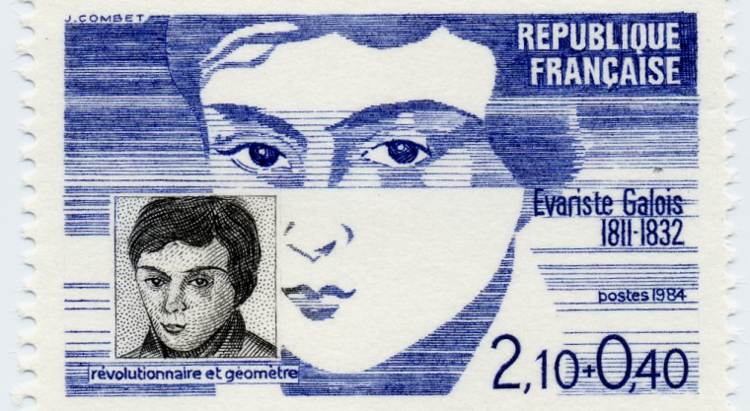
“А new star of unimaginable brightness in the heavens of pure mathematics”
Notes:
Um 1830 herum [leuchtet] in Frankreich ein neuer Stern von ungeahntem Glanz am Himmel der reinen Mathematik auf ..., um freilich einem Meteor gleich, sehr bald zu verlöschen: Évarite Galois.
Felix Klein: Mathematik im 19. Jahrhundert. Berlin, 1926, S. 88

Slide 92
Group multiply
template <AdditiveGroup A, SignedInteger N>
A multiply_group(N n, A a) {
if (n < 0) {
n = -n;
a = -a;
}
return multiply_monoid(n, a);
}
Notes:
No more preconditions.
Explain why SignedInteger.

Slide 93
From multiply to power
If we replace + with * we compute
instead of .
  replace doubling with squaring

Slide 94
power_accumulate for Multiplicative Semigroup
template <MultiplicativeSemigroup A, Integer N>
A power_accumulate_semigroup(A r, A a, N n) {
precondition(n >= 0);
if (n == 0) return r;
while (true) {
if (odd(n)) {
r = r * a;
if (n == 1) return r;
}
n = half(n);
a = a * a;
}
} we compute
Notes:
na, but a^n: we change the order to accommodate the convention.

Slide 95
power for Multiplicative Semigroup
template <MultiplicativeSemigroup A, Integer N>
A power_semigroup(A a, N n) {
precondition(n > 0);
while (!odd(n)) {
a = a * a;
n = half(n);
}
if (n == 1) return a;
return power_accumulate_semigroup(a, a * a,
half(n));
}

Slide 96
power for Multiplicative Monoid
template <MultiplicativeMonoid A, Integer N>
A power_monoid(A a, N n) {
precondition(n >= 0);
if (n == 0) return A(1);
return power_semigroup(a, n);
}

Slide 97
power for Multiplicative Group
template <MultiplicativeGroup A>
A multiplicative_inverse(A a) {
return A(1) / a;
}
template <MultiplicativeGroup A, Integer N>
A power_group(A a, N n) {
if (n < 0) {
n = -n;
a = multiplicative_inverse(a);
}
return power_monoid(a, n);
}
Notes:
There could be a specialization of multiplicative inverse.
we say power_group because there is no overloading on concepts.

Slide 98
Multiple semigroups on T
There could be multiple associative operations on the same type T
  additive
  multiplicative
  …
We often need to pass an operation to an algorithm

Slide 99
accumulate for an arbitrary semigroup
template <Regular A, Integer N, SemigroupOperation Op>
requires (Domain<Op, A>) // parens will go away
A power_accumulate_semigroup(A r, A a, N n, Op op) {
precondition(n >= 0);
if (n == 0) return r;
while (true) {
if (odd(n)) {
r = op(r, a);
if (n == 1) return r;
}
n = half(n);
a = op(a, a);
}
}
Notes:
domain of the operation is A

Slide 100
power for an arbitrary semigroup
template <Regular A, Integer N, SemigroupOperation Op>
requires(Domain<Op, A>)
A power_semigroup(A a, N n, Op op) {
precondition(n > 0);
while (!odd(n)) {
a = op(a, a);
n = half(n);
}
if (n == 1) return a;
return power_accumulate_semigroup(a, op(a, a),
half(n), op);
}

Slide 101
power for an arbitrary monoid
template <Regular A, Integer N, MonoidOperation Op>
requires(Domain<Op, A>)
A power_monoid(A a, N n, Op op) {
precondition(n >= 0);
if (n == 0) return identity_element(op);
return power_semigroup(a, n, op);
}
Notes:
Tricky question: why identity_element(op), not Op::identity_element

Slide 102
identity_element examples
template <NoncommutativeAdditiveMonoid T>
T identity_element(std::plus<T>) {
return T(0);
}
template <MultiplicativeMonoid T>
T identity_element(std::multiplies<T>) {
return T(1);
}

Slide 103
power for an arbitrary group
template <Regular A, Integer N, GroupOperation Op>
requires(Domain<Op, A>)
A power_group(A a, N n, Op op) {
if (n < 0) {
n = -n;
a = inverse_operation(op)(a);
}
return power_monoid(a, n, op);
}

Slide 104
examples of inverse_operation
template <AdditiveGroup T>
std::negate<T> inverse_operation(std::plus<T>) {
return std::negate<T>();
}
template <MultiplicativeGroup T>
reciprocal<T> inverse_operation(std::multiplies<T>) {
return reciprocal<T>();
}

Slide 105
reciprocal
template <MultiplicativeGroup T>
struct reciprocal
: public std::unary_function<T, T> {
T operator()(const T& x) const {
return T(1) / x;
}
};
Notes:
Should have been in the standard but I fell asleep while typing.
Fixing oversights is hard.

Slide 106
Algorithms defined on abstract concepts
An ancient algorithm can be used on an abstract mathematical concept and then applied to a myriad of different situations.

Slide 107
Even more important algorithm on semigroups
Additive semigroup
Multiplicative semigroup
Arbitrary semigroup
  reduction
Notes:
Associativity is central

Slide 108
Reduction
APL (Ken Iverson – 1962) (reduce)
  + / 1 2 3
FP (John Backus – 1973) (insert)
  (/ +): <1, 2, 3>
Tecton (Kapur et al – 1981)
  semigroups, monoids, parallel reduction
MapReduce (Dean et al – 2004)
  commutativity
Notes:
We will study reduction during Journey 3.

Slide 109
Problem 109
Using our work on multiply and power design a library version of reduction algorithm.

Slide 110
Reading 110
Kenneth Iverson, Notation as a Tool of Thought, CACM, Vol. 23(8), Aug. 1980
John Backus, Can programming be liberated from the von Neumann style?, CACM, Vol. 21(8), Aug. 1978
Deepak Kapur et al, Operators and Algebraic Structures, Proceedings FPCA 1981
Jeffrey Dean et al, MapReduce: simplified data processing on large clusters, Proceedings OSDI 2004

Slide 111
Four Journeys: Journey One
Lecture 3
Alexander Stepanov

Slide 112
Fibonacci Numbers
0, 1, 1, 2, 3, 5, 8, 13, 21, 34, 55, 89, 144, 233, 377, 610, 987, 1597, 2584, 4181, 6765, 10946, 17711, 28657, 46368, 75025, 121393, 196418, 317811, 514229, 832040, 1346269, 2178309, 3524578, 5702887, 9227465, 14930352, 24157817, 39088169,…

Slide 113
Computation of Fibonacci numbers
Notes:
We will encounter Fibonacci during the Third Journey.

Slide 114
“Obvious” Implementation
int fib0(int n) {
if (n == 0) return 0;
if (n == 1) return 1;
return fib0(n – 1) + fib0(n – 2);
}

Slide 115
fib0(5)
Notes:
\\
F_5 =\\
F_4 + F_3 =\\
(F_3 + F_2) + (F_2 + F_1) =\\
((F_2 + F_1) + (F_1 + F_0)) + ((F_1 + F_0) + F_1) =\\
(((F_1 + F_0) + F_1) + (F_1 + F_0)) + ((F_1 + F_0) + F_1)\\

Slide 116
Problem 116
How many additions are needed to compute fib0(n)?

Slide 117
Iterative Fibonacci
int fibonacci_iterative(int n) {
if (n == 0) return 0;
std::pair<int, int> v(0, 1);
for (int i = 1; i < n; ++i)
v = std::make_pair(v.second,
v.first + v.second);
return v.second;
}

Slide 118
Fibonacci transformation

Slide 119
nth Fibonacci vector
Notes:
\begin{bmatrix}v_{n} \\ v_{n-1}\end{bmatrix} = \begin{bmatrix}1 & 1\\ 1 & 0\end{bmatrix}^{n-1}\begin{bmatrix}1 \\ 0\end{bmatrix}

Slide 120
Matrix multiplication is associative
We use power algorithm to get nth Fibonacci number.
Notes:
First published by Gries and Levin in 1980 (IPL).

Slide 121
Problem 121
Implement computing Fibonacci numbers using power.

Slide 122
Reading 122
EoP (pages 45 – 46) shows how to reduce the number of operations needed to multiply two Fibonacci matrices.

Slide 123
Linear Recurrences
A linear recurrence function of order k is a function f such that
A linear recurrence sequence is a sequence generated by such function from initial k values.
Notes:
f(y_0, \dots, y_{k-1}) = \sum_{i=0}^{k-1}a_iy_i

Slide 124
Linear Recurrence via power
Notes:
\begin{bmatrix}x_n \\ x_{n-1} \\ x_{n-2} \\ \vdots \\ x_{n - k +1} \end{bmatrix}=
\begin{bmatrix}a_0 & a_1 & a_2 & \dots & a_{k-2} & a_{k-1}\\
1 & 0 & 0 & \dots & 0 & 0\\
0 & 1 & 0 & \dots & 0 & 0\\
\vdots & \vdots & \vdots & & \vdots & \vdots\\
0 & 0 & 0 & \dots & 1 & 0\\
\end{bmatrix}^{n-k+1}
\begin{bmatrix}x_{k-1} \\ x_{k-2} \\ x_{k-3} \\ \vdots \\ x_{0} \end{bmatrix}

Slide 125
Further Reading 125
Reducing number of operations
Charles M. Fiduccia: An Efficient Formula for Linear Recurrences. SIAM J. Comput. 14(1): 106-112 (1985)

Slide 126
Matrices
We combine power with matrix multiplication to compute linear recurrences.
It is possible to use this technique for many other algorithms if we use more general notion of matrix multiplication.

Slide 127
Inner Product
Notes:
\vec{x}\cdot\vec{y} =
\sum_{i=1}^{n}x_iy_i

Slide 128
Matrix-vector Product
Notes:
\vec{w} &= \begin{bmatrix}x_{ij}\end{bmatrix}\vec{v}
\\
w_i &=
\sum_{j=1}^{n}x_{ij}v_j

Slide 129
Matrix-matrix Product
Notes:
\begin{bmatrix}z_{ij}\end{bmatrix} &=
\begin{bmatrix}x_{ij}\end{bmatrix}\begin{bmatrix}y_{ij}\end{bmatrix}\\
z_{ij} &=
\sum_{k=1}^{n}x_{ik}y_{kj}

Slide 130
General setting for matrix multiplication
Where do coefficients come from?
Semiring
  two operations
    ⊕ - associative and commutative
    ⊗ - associative
  distributivity
Notes:
a \otimes (b \oplus c) &= a\otimes b \oplus a \otimes c\\
(b \oplus c) \otimes a &= b\otimes a \oplus c \otimes a

Slide 131
Transitive closure of a relation
Take an n×n matrix with Boolean values.
Use matrix multiplication generated by Boolean or {∨, ∧}-semiring.
Raise it to n-1 power.
Notes:
Give a few examples.

Slide 132
Shortest path
Take an n×n matrix with edge length values.
  a_{ij} is the distance from node i to node j
Use matrix multiplication generated by Tropical or {min, +} semiring
Raise the matrix to n-1 power.

Slide 133
Problem 133
Implement power-based shortest path algorithm.
Modify it to return not just the shortest distance but the shortest path (a sequence of edges).

Slide 134
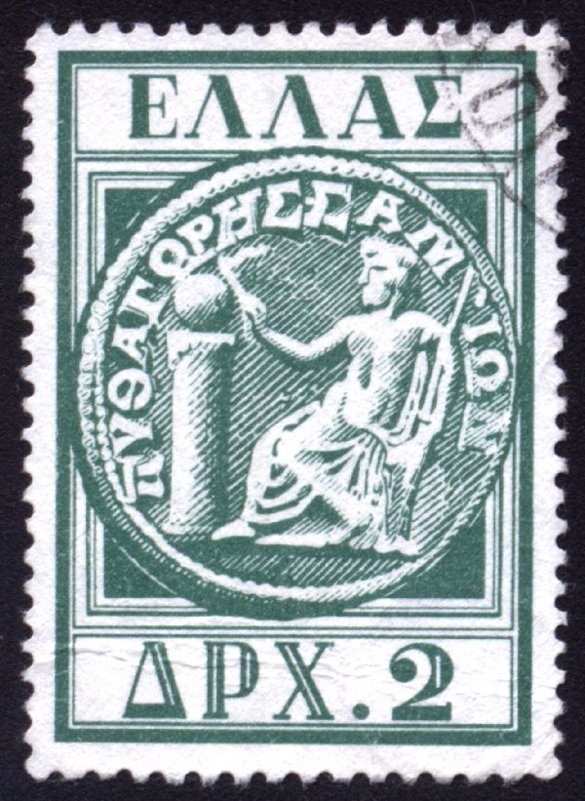
Pythagoras (570BC - 490BC)

Slide 135
Life of Pythagoras
Samos
  Polycrates, his tunnel and his ring.
Travels
  Miletus, Egypt, Babylon, (India?), Croton
Pythagorean brotherhood
  Discipline
  Program of study (μάθημα)
  Political influence

Slide 136
He maintained that “the principles of mathematics are principles of all existing things.”
Aristotle

Slide 137
Pythagorean Quadrivium
ASTRONOMY
GEOMETRY
NUMBER THEORY
MUSIC
Notes:
Quadrivium

Slide 138
Pythagorean Arithmetic
“He attached supreme importance to the study of arithmetic, which he advanced and took out of the region of commercial utility.”
Aristoxenus

Slide 139
Nicomachus of Gerasa
Introduction to Arithmetic
Ἀριθμητικὴ εἰσαγωγή

Slide 140
Triangular numbers
α | α αα | α αα ααα | α αα ααα αααα | α αα ααα αααα ααααα | α αα ααα αααα ααααα αααααα
1 | 3 | 6 | 10 | 15 | 21

Slide 141
Triangular numbers
α | α αα | α αα ααα | α αα ααα αααα | α αα ααα αααα ααααα | α αα ααα αααα ααααα αααααα
1 | 3 | 6 | 10 | 15 | 21
Notes:
\triangle_n = \sum_{i=1}^ni = \frac{n(n+1)}{2}

Slide 142
Oblong numbers
α α | αα αα αα | ααα ααα ααα ααα | αααα αααα αααα αααα αααα | ααααα ααααα ααααα ααααα ααααα ααααα | αααααα αααααα αααααα αααααα αααααα αααααα αααααα
2 | 6 | 12 | 20 | 30 | 42
Notes:
\APLbox_n = 2\triangle_n = 2\sum_{i=1}^ni = n(n+1)

Slide 143
Gnomons
α | αα α | ααα α α | αααα α α α | ααααα α α α α | αααααα α α α α α
1 | 3 | 5 | 7 | 9 | 11
Notes:
nth odd number

Slide 144
Square numbers
α | αα αα | ααα ααα ααα | αααα αααα αααα αααα | ααααα ααααα ααααα ααααα ααααα | αααααα αααααα αααααα αααααα αααααα αααααα
1 | 4 | 9 | 16 | 25 | 36
Notes:
\Box_n = \sum_{i=1}^n(2i-1) = n^2

Slide 145
Problem 145
Find a geometric proof of the following:
Take any triangular number, multiply it by 8 and add 1. The result is a square number.
Plutarch, Platonic Questions

Slide 146
Prime numbers
Numbers that are not products of smaller numbers.
2, 3, 5, 7, 11, 13 …

Slide 147
Euclid VII, 32
Any number is either prime or divisible by some prime.
If not, “an infinite sequence of numbers will divide the number, each of which is less than the other; and this is impossible.”
Notes:
We will have to wait till the fourth journey for further discussion of the induction.

Slide 148
Euclid, IX, 20
For any sequence of primes
there is a prime not in the sequence.
Consider the number .
It is not divisible by any . Its smallest prime factor is the desired .
Therefore, there are infinitely many primes.
Notes:
q = 1 + \prod_{i=1}^np_i
Prime number theorem
You need to go ln(n)/4 steps to on the average to find a prime after n.

Slide 149
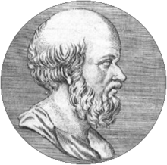
Eratosthenes (284BC – 195BC)
Notes:
Beta and his measuring the Earth

Slide 150
Life of Eratosthenes
Born in Cyrene (Κυρήνη), Libya
Studied in Athens (with Zeno?)
Around 244BC Ptolemy Euergetes invites him to Alexandria as a tutor.
  Duplication of the cube, column and poem
Measuring the Earth (within 2%!).
A friend of Archimedes.
Still just a beta…

Slide 151
Sieve (κόσκινον) of Eratosthenes
0 1 2 3 4 5 6 7 8 9 10 11 12 13 14 15 16 17 18 19 20 21 22 23 24 25
3 5 7 9 11 13 15 17 19 21 23 25 27 29 31 33 35 37 39 41 43 45 47 49 51 53
step 3
3 5 7 9 11 13 15 17 19 21 23 25 27 29 31 33 35 37 39 41 43 45 47 49 51 53
step 5
3 5 7 9 11 13 15 17 19 21 23 25 27 29 31 33 35 37 39 41 43 45 47 49 51 53
step 7
3 5 7 9 11 13 15 17 19 21 23 25 27 29 31 33 35 37 39 41 43 45 47 49 51 53

Slide 152
mark_sieve
template <RandomAccessIterator I,
Integer N>
void mark_sieve(I first, I last, N step) {
*first = false;
while (last - first > step) {
first = first + step;
*first = false;
}
}

Slide 153
Sifting lemmas
The square of the smallest prime factor of a composite number n is less or equal than n.
Any composite number less than p² is sifted by a prime less than p.
When sifting by p, start marking at p².
If the table is of size m, stop sifting when p² ≥ m.
Notes:
lemmata?

Slide 154
Sifting formulas
Notes:
{\rm value~at~position~}i:~{\rm val}(i) &= 3 + 2i = 2i + 3\\
{\rm position~of~value~}v:~{\rm idx}(v) &= \frac{v - 3}{2}\\
{\rm step~between~multiples~of}~p:~{\rm step}(i) &= {\rm idx}((n+2)p) - {\rm idx}(np)\\
&= \frac{np + 2p - 3}{2} - \frac{np - 3}{2} \\&= p = 2i + 3\\
\\
{\rm position~of~square~of~value~at}~i:~{\rm idx}({\rm val}^2(i)) &= \frac{(2i + 3)^2 - 3}{2} \\
&= \frac{4i^2 + 12i + 9 - 3}{2} \\
&= 2i^2 + 6i + 3

Slide 155
sift0
template <RandomAccessIterator I, Integer N>
void sift0(I first, N n) {
std::fill(first, first + n, true);
N i(0);
N square(3);
while (square < n) {
// invariant: square = 2i² + 6i + 3
if (first[i]) {
mark_sieve(first + square,
first + n, // last
i + i + 3); // step
}
++i;
square = 3 + 2*i*(i + 3);
}
}

Slide 156
sift1
template <RandomAccessIterator I, Integer N>
void sift1(I first, N n) {
I last = first + n;
std::fill(first, last, true);
N i(0);
N square(3);
N step(3);
while (square < n) {
// invariant: square = 2i² + 6i + 3, step = 2i + 3
if (first[i]) mark_sieve(first + square, last, step);
++i;
step = i + i + 3;
square = 3 + 2*i*(i + 3);
}
}

Slide 157
Strength reduction
From Wikipedia, the free encyclopedia
Strength reduction is a compiler optimization where expensive operations are replaced with equivalent but less expensive operations. The classic example of strength reduction converts "strong" multiplications inside a loop into "weaker" additions – something that frequently occurs in array addressing.
Examples of strength reduction include:
replacing a multiplication within a loop with an addition
replacing an exponentiation within a loop with a multiplication
Notes:
If compilers can do it, so should we.
(Non-trivial cases need to be done by hand.)

Slide 158
Increment computation
Replace
step = i + i + 3;
square = 3 + 2*i*(i + 3);
with
step += δ_{step};
square += δ_{square};

Slide 159
δ computations
Notes:
\delta_{step}:~~&(2(i+1) + 3) - (2i + 3) = 2 \\
\\
\delta_{square}:~~&(2(i+1)^2 + 6(i+1) + 3) -(2i^2 + 6i + 3)
\\&= 4i + 8 = (2i + 3) + (2i + 2 + 3)
\\&= (2i+3) + (2(i + 1) + 3)
\\&= {\rm step}(i) + {\rm step}(i + 1)
A friend remarks: This decomposition is something that would never occur to me in a million years. Unfortunately, that's a skill I don't think can be taught. The result is that I can't generalize this learning to my own work.
Explain why he is wrong.

Slide 160
sift
template <RandomAccessIterator I, Integer N>
void sift(I first, N n) {
I last = first + n;
std::fill(first, last, true);
N i(0);
N square(3);
N step(3);
while (square < n) {
// invariant: square = 2i² + 6i + 3, step = 2i + 3
if (first[i]) mark_sieve(first + square, last, step);
++i;
square += step;
step += N(2);
square += step;
}
}

Slide 161
Problem 161
Time the sieve using different data sizes:
  bool (use std::vector<bool>)
  uint8_t
  uint16_t
  uint32_t
  uint64_t

Slide 162
Problem 162
Using the sieve, graph the function
π(n) = the number of primes < n
for n up to 10⁷ and find its analytic approximation.

Slide 163
Palindromic Primes
2 3 5 7 11 13 17 19 23 29 31 37 41 43 47 53 59 61 67 71 73 79 83 89 97 101 103 107 109 113 127 131 137 139 149 151 157 163 167 173 179 181 191 193 197 199 211 223 227 229 233 239 241 251 257 263 269 271 277 281 283 293 307 311 313 317 331 337 347 349 353 359 367 373 379 383 389 397 401 409 419 421 431 433 439 443 449 457 461 463 467 479 487 491 499 503 509 521 523 541 547 557 563 569 571 577 587 593 599 601 607 613 617 619 631 641 643 647 653 659 661 673 677 683 691 701 709 719 727 733 739 743 751 757 761 769 773 787 797 809 811 821 823 827 829 839 853 857 859 863 877 881 883 887 907 911 919 929 937 941 947 953 967 971 977 983 991 997

Slide 164
No Palindromic Primes ?!
1009 1013 1019 1021 1031 1033 1039 1049 1051 1061 1063 1069 1087 1091 1093 1097 1103 1109 1117 1123 1129 1151 1153 1163 1171 1181 1187 1193 1201 1213 1217 1223 1229 1231 1237 1249 1259 1277 1279 1283 1289 1291 1297 1301 1303 1307 1319 1321 1327 1361 1367 1373 1381 1399 1409 1423 1427 1429 1433 1439 1447 1451 1453 1459 1471 1481 1483 1487 1489 1493 1499 1511 1523 1531 1543 1549 1553 1559 1567 1571 1579 1583 1597 1601 1607 1609 1613 1619 1621 1627 1637 1657 1663 1667 1669 1693 1697 1699 1709 1721 1723 1733 1741 1747 1753 1759 1777 1783 1787 1789 1801 1811 1823 1831 1847 1861 1867 1871 1873 1877 1879 1889 1901 1907 1913 1931 1933 1949 1951 1973 1979 1987 1993 1997 1999

Slide 165
Problem 165
Are there palindromic primes > 1000?
What is the reason for the lack of them in the interval [1000, 2000]?
What happens if we change our base to 16? To an arbitrary n?

Slide 166
Four Journeys: Journey One
Lecture 4
Alexander Stepanov

Slide 167
Perfect numbers
An aliquot part of a positive integer is a proper divisor of the integer.
The aliquot sum of a positive integer is the sum of its aliquot parts.
A positive integer is perfect if it is equal to its aliquot sum.

Slide 168
Perfect numbers known to the Greeks
Notes:
6 &= 1 + 2 + 3 \\
28 &= 1 + 2 + 4 + 7 + 14 \\
496 &= 1 + 2 + 4 + 8 + 16 + 31 + 62 + 124 + 248\\
8128 &= 1 + 2 + 4 + 8 + 16 + 32 + 64 + 127\\ &\hspace{1.9em} + 254 + 508 + 1016 + 2032 + 4064
Νικόμαχος
47 are known today

Slide 169
Their prime factorization

Slide 170
Further decomposition
Notes:
6 = 2\cdot 3 &= 2^1\cdot(2^2 - 1)\\
28 = 4\cdot 7 &= 2^2\cdot(2^3 - 1)\\
496 = 16 \cdot 31 &= 2^4\cdot(2^5 - 1)\\
8128 = 64 \cdot 127 &= 2^6\cdot(2^7 - 1)

Slide 171
Other powers of 2
Notes:
6 = 2\cdot 3 &= 2^1\cdot(2^2 - 1)\\
28 = 4\cdot 7 &= 2^2\cdot(2^3 - 1)\\
120 = 8\cdot {\color[rgb]{1.000000,0.000000,0.000000}15} &= 2^3\cdot(2^4 - 1) {\rm ~not~perfect}\\
496 = 16 \cdot 31 &= 2^4\cdot(2^5 - 1)\\
2016 = 32 \cdot {\color[rgb]{1.000000,0.000000,0.000000}63} &= 2^5\cdot(2^6 - 1) {\rm ~not~perfect}\\
8128 = 64 \cdot 127 &= 2^6\cdot(2^7 - 1)

Slide 172
Euclid, Elements,
Book IX, Proposition 36
If is prime then is perfect.
Notes:
What is the sum equal to?
\sum_{i=0}^n2^i

Slide 173
Difference of powers
Notes:
x^2 - y^2 &= (x-y)(x +y)\\
x^3 - y^3 &= (x-y)(x^2 + xy + y^2)\\
\vdots\\
x^{n + 1} - y^{n + 1} &= (x-y)(x^n + x^{n-1}y + \dots + xy^{n-1} + y^n)\\
\\
\\
x(x^n + x^{n-1}y + \dots + xy^{n-1} + y^n) &= x^{n+1} + x^ny + x^{n-1}y^2+\dots + xy^n\\
y(x^n + x^{n-1}y + \dots + xy^{n-1} + y^n) &= \hspace{3.3em} x^ny + x^{n-1}y^2 +\dots + xy^n + y^{n+1}\\

Slide 174
Sum of odd powers
Notes:
x^{2n+1} + y^{2n+1} &= x^{2n+1} - -y^{2n+1} \\&= x^{2n+1} - (-y)^{2n+1}
\\&= (x - (-y))(x^{2n} + x^{2n -1}(-y) + \cdots + (-y)^{2n}) \\&=
(x + y)(x^{2n} - x^{2n -1}y + \cdots - xy^{2n-1}+ y^{2n})

Slide 175
Restatement of Euclid’s theorem
If is prime then is perfect.
Notes:
\\(2-1)(2^{n-1}+2^{n-2} +\dots + 2 + 1) =
\sum_{i=0}^{n-1}2^i = 2^n-1

Slide 176
σ(n) - sum of the divisors
Notes:
\\n =~&p^{a_1}_1 p^{a_2}_2\dots p^{a_m}_m\\
\\
\sigma(n) &=
\prod_{i=1}^m(1 + p_i + p_i^2 + \dots + p_i^{a_i})\\
&=\prod_{i=1}^m\frac{p_i^{a_i+1}-1}{p_i - 1}

Slide 177
Problem 177
Prove that if n and m are co-prime (have no common prime factors) then
σ(nm) = σ(n)σ(m)

Slide 178
α(n) - aliquot sum
α(n) = σ(n) - n

Slide 179
Proof of Euclid, IX, 36
Notes:
Q &= 2^{n-1}(2^n-1)\\
m &= 2, ~p_1 = 2, ~a_1= n-1, ~p_2=2^n-1, ~a_2 = 1\\
\sigma(Q) &= \frac{2^{(n-1) + 1} -1}{1}\cdot\frac{(2^n-1)^2 -1}{(2^n-1) -1}\\
&=(2^n -1)((2^n -1) +1) \\
&=2^n(2^n -1) = 2 \cdot 2^{n-1}(2^n-1)=2Q\\
\alpha(Q) &= \sigma(Q) - Q = Q

Slide 180
The inverse of IX, 36
In XVIII century Leonard Euler proved that every even perfect number is of the form
Odd perfect numbers?

Slide 181
Problem 181
Prove that every even perfect number is a triangular number.

Slide 182
Problem 182
Prove that the sum of the reciprocals of the divisors of a perfect number is always 2.

Slide 183
Practical years
In 212 BC the study of Mathematics in the Latin West takes a long break.
In the third journey we will see how it comes back around 1200 AD.
Notes:
Marcellus takes the machines as his personal loot…

Slide 184
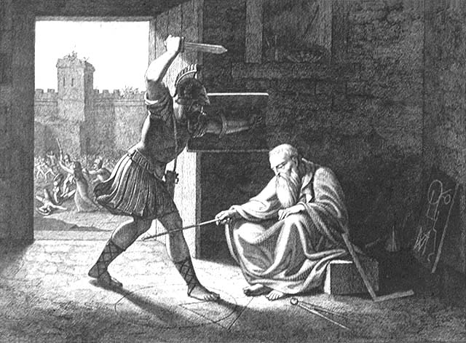
  Noli turbare circulos meos!

Slide 185
An admission of a practical fellow
In summo apud illos honore geometria fuit, itaque nihil mathematicis inlustrius; at nos metiendi ratiocinandique utilitate huius artis terminavimus modum.
Among the Greeks geometry was held in highest honor; nothing could outshine mathematics. But we have limited the usefulness of this art to measuring and calculating.
Marcus Tullius Cicero,Tusculan Disputations
The tomb of Archimedes.

Slide 186
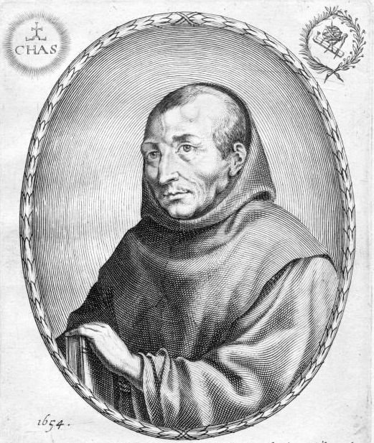
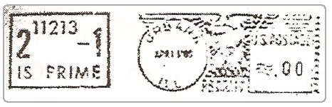
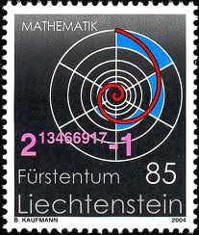
Marin Mersenne (1588 – 1648)
“walking scientific journal”
Notes:
quote from Victor J. Katz “A History of Mathematics” page 436

Slide 187
Wikipedia on Mersenne
His most important contribution to the advance of learning was his extensive correspondence with mathematicians and other scientists in many countries. At a time when the scientific journal had not yet come into being, Mersenne was the center of a network for exchange of information.

Slide 188
A few of Mersenne’s friends
Galileo Galilei
René Descartes
Pierre de Fermat
Blaise Pascal

Slide 189
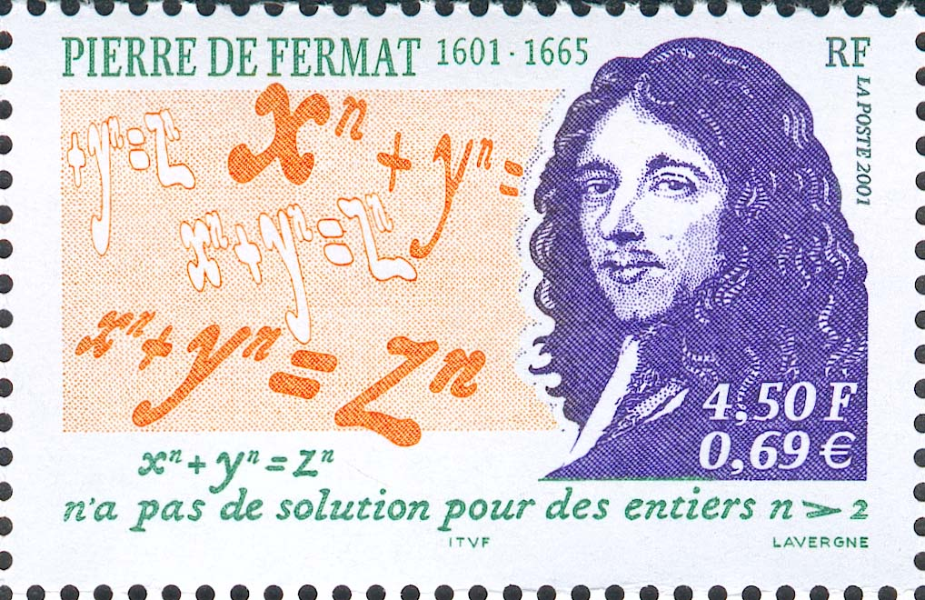

Slide 190
When is 2^{n} − 1 prime?
Greeks: true for n = 2, 3, 5, 7, 13
Hudalricus Regius (1536): false for n = 11
  2¹¹ − 1 = 2047 = 23×89
Pietro Cataldi (1603): true for n = 17, 19
true for n = 23, 29, 31, 37
Fermat discovered that
Notes:
2^{23} -1 &= 8388607= 47 \times 178481 \\
2^{37} -1 &= 137438953471 = 223 \times 61631877
233 * 1103 * 2089 = 536870911 = ( 2 ^ 29 ) – 1 (Euler)

Slide 191
Mersenne primes
In 1644 in his book Cogitata Physico Mathematica, Mersenne states that if n ≤ 257 then 2^{n}-1 is prime if and only if n =
2, 3, 5, 7, 13, 17, 19, 31, 67, 127, 257
67 might be a misprint for 61.
Mersenne missed: 89, 107

Slide 192
Letter from Fermat to Mersenne
In June 1640 Fermat states that his factorization of 2³⁷ − 1 depends on the following three discoveries:
If n is not a prime, 2^{n} − 1 is not a prime.
If n is a prime, 2^{n} − 2 is a multiple of 2n.
If n is a prime, and p is a prime divisor of 2^{n} − 1, then p − 1 is a multiple of n.
Notes:
Andre Weil, Number Theory, page 55

Slide 193
Factoring 2³⁷ − 1
It has a prime factor p.
p − 1 is divisible by 37.
p = 37n + 1
p is odd
p = 74m + 1
m = 1, but 75 is not a prime
m = 2, 149 is prime, but does not divide
m = 3, 223 is prime and does divide!

Slide 194
If is prime then is prime
Notes:
\hspace{10em}Proof:~~ Suppose $n$ is not prime. Then,
$$n = uv, \hspace{1em}u > 1, v> 1$$
\begin{align*}
\hspace{12.5em}2^n - 1 &= 2^{uv} -1 \\
&= (2^u)^v -1 \\
&=(2^u -1)((2^u)^{v-1} + (2^u)^{v-2}+ \dots + (2^u) + 1)\\
\end{align*}
$$u > 1 \implies 1<2^u -1$$
$$\hspace{7em}1<(2^u)^{v-1} + (2^u)^{v-2}+ \dots + (2^u) + 1$$
\hspace{11.5em}Contradiction!

Slide 195
Fermat’s discoveries 2 and 3
“… he would send [the proof] if he did not fear being too long.”
Fermat to Frenicle

Slide 196
Little Fermat Theorem
If p is prime, a^{p−1} − 1 is divisible by p for any 0 < a < p.

Slide 197
Delayed proof
Fermat claimed to have the proof in 1640.
Leibnitz discovered the proof some time between 1676 an 1680, but did not publish.
Euler published two different proofs in 1742 and 1750.

Slide 198
Another Conjecture by Fermat
Notes:
2^{n} + 1 {\rm ~is~prime} \iff n = 2^i

Slide 199
Notes:
$2^n + 1$ is prime $\implies n = 2^i$
~~\\Proof:\\\\
If $n \neq 2^i$ then $n$ has an odd factor $2q + 1 > 1$ and $n = m(2q + 1)$.
\\\\ Using the formula for sum of odd powers, we factor $2^n+1$:
\begin{align*}
2^n + 1 &= (2^m)^{2q+1} + 1^{2q+1}
\\&= (2^m + 1)((2^m)^{2q} - (2^m)^{2q - 1} + \cdots + 1)
\end{align*}

Slide 200
Fermat states that 3, 5, 17, 257, 65537, 4294967297 and 18446744073709551617 are primes.
Fermat conjectured that so are they all.
In 1732 Euler shows that
2³² +1 = 4294967297 = 641 × 6700417
For 5 ≤ i ≤ 32 they are composite.
Are there any more Fermat primes?

Slide 201
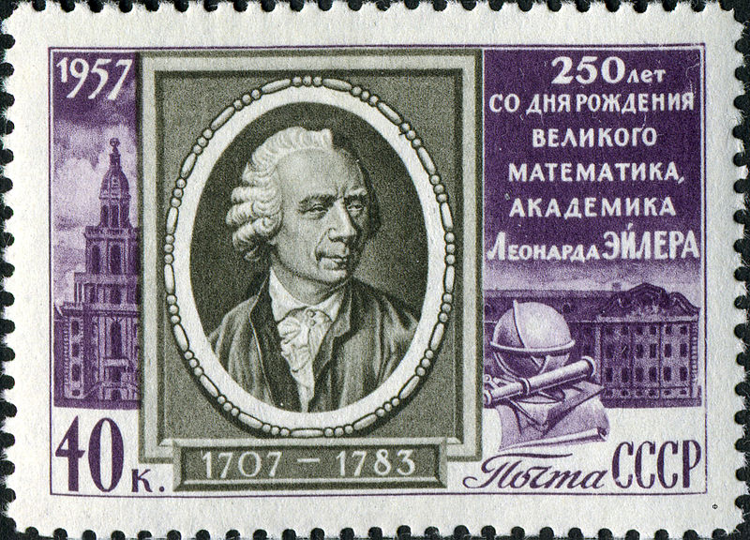
Leonhard Euler, c'est notre maître à tous
Notes:
Pierre-Simon marquis de Laplace: Lisez Euler, lisez Euler, c'est notre maître à tous.

Slide 202
Euclid, VII, 30
The product of two integers smaller than a prime p is not divisible by p.

Slide 203
The proof of VII, 30
Notes:
$$ p{\rm ~is~prime~} \wedge~ 0<a, b < p \implies ab = mp + r \wedge 0 < r < p$$
Proof:\\ \\
Assume the contrary. Then for a given $a$
let $b$ be the smallest integer
\\such that
$ab = mp$. Then since $p$ is prime
$$p = bu + v \wedge 0 < v < b$$
$$ap = abu + av$$
$$ap - mpu = av$$
$$av=(a - mu)p \wedge v < b$$
Contradiction!

Slide 204
Notational convention
For the rest of the journey, p is always assumed to be prime.

Slide 205
Permutation of Remainders Lemma
Notes:
~\\
For any $0 <a < p$,
\begin{align*}
a\cdot\{1,~ \ldots, ~p-1\} &= \{a, ~\ldots, ~a(p-1)\}\\
&= \{q_1p+r_1,~\ldots, ~q_{p-1}p+r_{p-1}\}
\end{align*}
where $0<r_i<p \wedge i \neq j \implies r_i \neq r_j$.\\\\
Proof:
Suppose $r_i = r_j$ and $i < j$
\begin{align*}
(q_jp + r_j) - (q_ip + r_i) &= (q_j - q_i)p = aj - ai = a(j -i)
\end{align*}
Contradicts VII, 30

Slide 206
Cancellation Law
Notes:
~\\
For any $0 <a < p$
there is $0 <b < p$ such that $ab = mp + 1$.\\\\
Proof:\\\\By the Permutation of Remainders Lemma we know that one of $$a\cdot\{1,~ \ldots, ~p-1\} $$
maps to 1.

Slide 207
Self-cancelling elements
1 and p−1 cancel themselves.

Slide 208
Self-cancelling Lemma
Notes:
~\\
For any $0 <a < p$,~
$a^2= mp + 1 \implies a = 1 \vee a = p-1$
\\Proof:
$$a \neq 1 \wedge a \neq p-1 \implies 1 < a < p-1$$
$$a^2 - 1 = (a - 1)(a + 1) = mp$$
And, since $0 < a-1,a+1 < p$, ~contradiction with VII, 30.

Slide 209
Wilson Theorem
Was introduced by Waring who (incorrectly) attributes it to Wilson.
Waring stated that he cannot prove it since he did not have the right notation.
Gauss remarks: ”One needs notion, not notation.”
  At nostro quidem iudicio huiusmodi veritates ex notionibus potius quam ex notationibus hauriri debebant.

Slide 210
Wilson’s Theorem
Proof:
Every number except 1 and p−1 is cancelled by its inverse.
Notes:
$$(p-1)!= (p-1) + mp$$
NOT !=

Slide 211
Problem 211
Notes:
~\\Prove that if $n > 4$ is composite\\ then $(n-1)!$ is a multiple of $n$.

Slide 212
The proof of Little Fermat
Notes:
~\\By Wilson Theorem:
$$\prod_{i=1}^{p-1}ai = a^{p-1}\prod_{i=1}^{p-1}i=a^{p-1}((p-1) + up) = a^{p-1}(1 + u)p - a^{p-1}$$
by the Permutation of Remainders Lemma:
$$\prod_{i=1}^{p-1}ai = \prod_{i=1}^{p-1}(q_ip + r_i) = vp + \prod_{i=1}^{p-1}r_i = (p-1) + vp = -1 + (v+1)p$$
$$ (a^{p-1} + u)p - a^{p-1} = -1 + (v+1)p$$
$$a^{p-1} = 1 + np$$

Slide 213
Multiplicative inverse modulo n
Notes:
~\\
For integer $n > 1$ and integer $u > 0$,
\\we call $v$ a {\em multiplicative inverse modulo $n$}
\\ if there is an integer $q$ such that
\\ $uv = 1 + qn$.

Slide 214
a^{p−2} is an inverse of a
Trivial.

Slide 215
Non-invertibility Lemma
Notes:
~\\
If $n = uv \wedge 1 < u, v$ then $u$ is not invertible modulo $n$.
~\\\\
Proof:
~\\\\
Let $uv = n$ and $w$ be an inverse of $u$. Then
$$wn = wuv = (1 + mn)v = v + mvn$$
and
$$(w - mv)n =zn= v$$
Contradiction.

Slide 216
Converse of Little Fermat
Notes:
~\\
If for all $a$ in ~$0 < a < n$,~~$a^{n-1} = 1 + q_an$ \\then $n$ is prime.
~\\\\
Proof:
~\\\\
If $n = uv$ then $u$ is not invertible.
\\But $u^{n -2}u = u^{n-1} = 1 + q_un$.~~~Contradiction.

Slide 217
“Useful” mathematics
The search for (so far) useless perfect numbers led to the discovery of one of the most practically useful theorems in all of mathematics.
In particular, this theorem helps us to find large primes used daily in e-commerce.

Slide 218
Four Journeys: Journey One
Lecture 5
Alexander Stepanov

Slide 219
Multiplication Table modulo 7
Notes:
~\\
1\times i: 1,2,3,4,5,6 &= 1, 2, 3, 4, 5, 6\\
2\times i: 2, 4, 6, 1 + 1\times 7, 3+ 1\times 7, 5+ 1\times 7 &= 2, 4, 6, 1, 3, 5\\
3\times i: 3, 6, 2 + 1\times 7, 5+ 1\times 7, 1 + 2\times 7, 4+ 2\times 7 &= 3, 6, 2, 5, 1, 4\\
4\times i: 4, 1 + 1\times 7, 5 + 1\times 7, 2+ 2\times 7, 6 + 2\times 7, 3+ 2\times 7 &= 4, 1, 5, 2, 6, 3\\
5\times i: 5, 3 + 1\times 7, 1 + 2\times 7, 6+ 2\times 7, 4 + 3\times 7, 2+ 4\times 7 &= 5, 3, 1, 6, 4, 2\\
6\times i: 6, 5 + 1\times 7, 4 + 2\times 7, 3+ 3\times 7, 2 + 4\times 7, 1 + 5\times 7 &= 6, 5, 4, 3, 2, 1\\

Slide 220
Multiplication modulo 7 with inverses
Notes:
~\\
1\times i:~~ &{\bf\color[rgb]{1.000000,0.000000,0.000000}1}, 2, 3, 4, 5, 6 ~~~~~1\\
2\times i:~~ &2, 4, 6, {\bf\color[rgb]{1.000000,0.000000,0.000000}1}, 3, 5 ~~~~~4\\
3\times i:~~ &3, 6, 2, 5, {\bf\color[rgb]{1.000000,0.000000,0.000000}1}, 4 ~~~~~5\\
4\times i:~~ &4, {\bf\color[rgb]{1.000000,0.000000,0.000000}1}, 5, 2, 6, 3 ~~~~~2\\
5\times i:~~ &5, 3, {\bf\color[rgb]{1.000000,0.000000,0.000000}1}, 6, 4, 2 ~~~~~3\\
6\times i:~~ &6, 5, 4, 3, 2, {\bf\color[rgb]{1.000000,0.000000,0.000000}1} ~~~~~6\\

Slide 221
Wilson’s Theorem modulo 7
Notes:
{\bf\color[rgb]{1.000000,0.000000,0.000000}6!} &= 1\times (2 \times 4) \times (3 \times 5) \times 6
\\&= 1\times (1 + 1\times 7) \times (1 + 2 \times 7) \times 6
\\&= (1 + 1\times 7) \times (1 + 2 \times 7) \times 6
\\&= (1 + 2\times 7 + 1\times 7 + 2 \times 7 \times 7) \times 6
\\&= (1 + 17\times 7) \times 6
\\&= 6 + (17 \times 6) \times 7
\\&= {\bf\color[rgb]{1.000000,0.000000,0.000000}6} + 102 \times 7

Slide 222
Wilson modulo 7
Notes:
{\bf\color[rgb]{1.000000,0.000000,0.000000}6!} &= 1\times (2 \times 4) \times (3 \times 5) \times 6
\\&= 1\times (1 + 1\times 7) \times (1 + 2 \times 7) \times 6
\\&= {\bf\color[rgb]{1.000000,0.000000,0.000000}6} + 102 \times 7

Slide 223
Fermat modulo 7
Notes:
~\\
2^6\times 6! &=
(2\times 1)\times (2\times 2) \times(2\times 3)\times (2 \times 4) \times (2 \times 5) \times (2 \times 6)\\
&=2 \times 4 \times 6\times (1 + 1\times 7)\times (3 + 1\times 7) \times (5+ 1\times 7) \\
&= 6! + 7m
{\rm ~~dropping~factorial~by~Wilson}{\rm ~we~get}\\
2^6\times 6 &= 6 + 7u {\rm ~~~multiplying~both~sides~by~} 6 {\rm ~we~get}\\
2^6 &= 1 + 7v

Slide 224
Multiplication modulo 10 with inverses
Notes:
~\\
1\times i:~~ &1, 2, 3, 4, 5, 6, 7, 8, 9 ~~~~~~1\\
2\times i:~~ &2, 4, 6, 8, 0, 2, 4, 6, 8 ~~~~\\
3\times i:~~ &3, 6, 9, 2, 5, 8, 1, 4, 7 ~~~~~~7\\
4\times i:~~ &4, 8, 2, 6, 0, 4, 8, 2, 6 ~~~~~~\\
5\times i:~~ &5, 0, 5, 0, 5, 0, 5, 0, 5 ~~~~~~\\
6\times i:~~ &6, 2, 8, 4, 0, 6, 2, 8, 4 ~~~~~~\\
7\times i:~~ &7, 4, 1, 8, 5, 2, 9, 6, 3 ~~~~~~3\\
8\times i:~~ &8, 6, 4, 2, 0, 8, 6, 4, 2 ~~~~~~\\
9\times i:~~ &9, 8, 7, 6, 5, 4, 3, 2, 1 ~~~~~~9\\

Slide 225
Reducing the Multiplication Table
Notes:
~\\
{\color[rgb]{1.000000,0.000000,0.000000}1}\times i:~~ &{\color[rgb]{1.000000,0.000000,0.000000}1}, 2, {\color[rgb]{1.000000,0.000000,0.000000}3}, 4, 5, 6, {\color[rgb]{1.000000,0.000000,0.000000}7}, 8, {\color[rgb]{1.000000,0.000000,0.000000}9} ~~~~~~{\color[rgb]{1.000000,0.000000,0.000000}1}\\
2\times i:~~ &2, 4, 6, 8, 0, 2, 4, 6, 8 ~~~~\\
{\color[rgb]{1.000000,0.000000,0.000000}3}\times i:~~ &{\color[rgb]{1.000000,0.000000,0.000000}3}, 6, {\color[rgb]{1.000000,0.000000,0.000000}9}, 2, 5, 8, {\color[rgb]{1.000000,0.000000,0.000000}1}, 4, {\color[rgb]{1.000000,0.000000,0.000000}7} ~~~~~~{\color[rgb]{1.000000,0.000000,0.000000}7}\\
4\times i:~~ &4, 8, 2, 6, 0, 4, 8, 2, 6 ~~~~~~\\
5\times i:~~ &5, 0, 5, 0, 5, 0, 5, 0, 5 ~~~~~~\\
6\times i:~~ &6, 2, 8, 4, 0, 6, 2, 8, 4 ~~~~~~\\
{\color[rgb]{1.000000,0.000000,0.000000}7}\times i:~~ &{\color[rgb]{1.000000,0.000000,0.000000}7}, 4, {\color[rgb]{1.000000,0.000000,0.000000}1}, 8, 5, 2, {\color[rgb]{1.000000,0.000000,0.000000}9}, 6, {\color[rgb]{1.000000,0.000000,0.000000}3} ~~~~~~{\color[rgb]{1.000000,0.000000,0.000000}3}\\
8\times i:~~ &8, 6, 4, 2, 0, 8, 6, 4, 2 ~~~~~~\\
{\color[rgb]{1.000000,0.000000,0.000000}9}\times i:~~ &{\color[rgb]{1.000000,0.000000,0.000000}9}, 8, {\color[rgb]{1.000000,0.000000,0.000000}7}, 6, 5, 4, {\color[rgb]{1.000000,0.000000,0.000000}3}, 2, {\color[rgb]{1.000000,0.000000,0.000000}1} ~~~~~~{\color[rgb]{1.000000,0.000000,0.000000}9}\\

Slide 226
Euler Totient function
Notes:
\phi (n) = |\{0<i<n \wedge {\rm coprime}(i, n)\}|

Slide 227
Totient of prime
Notes:
\phi ( p) = p - 1

Slide 228
Euler’s Theorem

Slide 229
Problem 229
Prove Euler’s theorem by modifying the proof of the Little Fermat Theorem
Steps
  Replace Permutation of Remainders Lemma with Permutation of Coprime Remainders Lemma
  Prove that every coprime remainder has a multiplicative inverse
  Use the product of all coprime remainders where that proof of Little Fermat uses the product of all non-zero remainders.
Notes:
~\\
For $0 < a < n$,\\
coprime $a$ and $n$ $\iff a^{\phi(n)} = 1 + mn$

Slide 230
Abstraction
Generalizing code is like generalizing theorems and their proofs.

Slide 231
Totient of power of prime
Notes:
\phi ( p^m) &= (p^m - 1) - |\{p, 2p, \ldots, p^m - p\}|\\
&= (p^m - 1) - |\{1, 2, \ldots, p^{m-1} - 1\}|\\
&= (p^m -1) - (p^{m-1} - 1)\\
&= p^m - p^{m-1}\\
&= p^m(1 - \frac {1}{p})

Slide 232
Totient of n = p^{u}q^{v}
Notes:
\phi(n) &= (n - 1) - (\frac{n}{p} - 1) - (\frac{n}{q} - 1) + (\frac{n}{pq} - 1)\\
&= n - \frac{n}{p} - \frac{n}{q} + \frac{n}{pq}\\
&= n(1 - \frac{1}{p} - \frac{1}{q} + \frac{1}{pq})\\
&= n((1 - \frac{1}{p}) - \frac{1}{q}(1 - \frac{1}{p}))\\
&= n(1 - \frac{1}{p})(1 - \frac{1}{q}) \\
&= p^u (1 - \frac{1}{p}) q^v (1 - \frac{1}{q}) = \phi(p^u)\phi(q^v)

Slide 233
General case totient formula
Notes:
\phi(n) &= \phi(\prod_{i = 1}^mp_i^{e_i})
\\&= n\prod_{i=1}^m(1 - \frac{1}{p_i})
\\&= \prod_{i=1}^m\phi(p_i^{e_i})

Slide 234
Primality Testing
The problem of distinguishing prime numbers from composite and of resolving the latter into their prime factors is known to be one of the most important and useful in arithmetic.
C.F. Gauss
Disquisitiones Arithmeticae, article 329
Notes:
§329 (page 396)

Slide 235
Divides
template <Integer I>
bool divides(const I& i, const I& n) {
return n % i == I(0);
}

Slide 236
smallest_divisor
template <Integer I>
I smallest_divisor(I n) {
// precondition: n > 0
if (even(n)) return I(2);
for (I i(3); n >= i * i; i += I(2)) {
if (divides(i, n)) return i;
}
return n;
}

Slide 237
is_prime
template <Integer I>
I is_prime(const I& n) {
return n > I(1) &&
smallest_divisor(n) == n;
}
Complexity:
Exponential in number of digits.
Notes:
~\\
O(\sqrt n) = O(2^{(\log n)/2})

Slide 238
Modulo Multiplication
template <Integer I>
struct modulo_multiply {
I modulus;
modulo_multiply(const I& i) : modulus(i) {}
I operator() const (const I& n,
const I& m) {
return (n * m) % modulus;
}
};

Slide 239
Modulo Multiplication Identity
template <Integer I>
I identity_element(const modulo_multiply<I>&) {
return I(1);
}

Slide 240
Multiplicative inverse - Fermat
template <Integer I>
I multiplicative_inverse_fermat(I a, I p) {
// precondition: p is prime & a > 0
modulo_multiply<I> op;
return power_monoid(a, p – 2, op);
}

Slide 241
fermat_test
template <Integer I>
bool fermat_test(I n, I witness) {
// precondition: 0 < witness < n
modulo_multiply<I> op(n);
I exp(power_semigroup(witness,
n - I(1),
op);
return exp == I(1);
}
Why don’t I use power_monoid?

Slide 242
Co-prime
Two integers are co-prime if and only if they do not share a prime divisor.

Slide 243
Carmichael Numbers
A composite number n > 1 is a Carmichael number iff

Slide 244
Problem 244
Implement a function
bool is_carmichael(n)
Find the first seven Carmichael numbers.

Slide 245
template <Integer I>
bool miller_rabin_test(I n, I q, I k, I w) {
modulo_multiply<I> op(n);
I x = power_semigroup(w, q, op);
I i(1);
while (x != I(1) && x != n - I(1)) {
if (i >= k) return false;
++i;
x = op(x, x);
}
return x != I(1) || i == I(1);
}
Notes:
{\rm//invariant}~~ x = w^{2^{i - 1}q}
{\rm// precondition}~~n > 1 ~~\wedge~~ n - 1 = 2^kq ~~\wedge~~ q ~~{\rm is~odd}

Slide 246
template <Integer I>
bool miller_rabin_test(I n, I q, I k, I w) {
modulo_multiply<I> op(n);
I x = power_semigroup(w, q, op);
if (x == I(1) || x == n - I(1)) return true;
for (I i(1); i < k; ++i) {
x = op(x, x);
if (x == n – I(1)) return true;
if (x == I(1)) return false;
}
return false;
}
Notes:
{\rm//invariant}~~ x = w^{2^{i - 1}q}
{\rm// precondition}~~n > 1 ~~\wedge~~ n - 1 = 2^kq ~~\wedge~~ q ~~{\rm is~odd}

Slide 247
Miller-Rabin Guarantee
miller_rabin_test is wrong with probability at most 25% for a random w.
Randomly choosing, say, 100 witnesses makes the probability of error less than 2⁻²⁰⁰
“It is much more likely that our computer has dropped a bit, due […] to cosmic radiations.”
Donald E. Knuth

Slide 248

Primes is in P (2002)
Manindra Agrawal, Neeraj Kayal, and Nitin Saxena

Slide 249
Full treatment of AKS
There is a pdf of Andrew Granville’s expository paper on the wiki. It is very well written, but still quite difficult for a non-specialist.

Slide 250
Cryptology
Cryptography develops ciphers.
Cryptanalysis breaks ciphers.
For a brief history of Cryptology, read my notes on the wiki.

Slide 251
Cryptosystem
plaintext => encryption(key₀) => ciphertext
ciphertext => decryption(key₁) => plaintext
the system is symmetric if key₀ = key₁
the system is asymmetric otherwise

Slide 252
Public Key Cryptosystem
An encryption scheme in which users would have a pair of keys, a public key pub for encrypting, and a private key prv for decrypting.
When Alice wants to send a message to Bob she encrypts with Bob’s public key. Bob uses his private key to decipher her message.

Slide 253
Requirements for a Public Key Cryptosystem
The encryption function needs to be a one-way function: easy to compute with an inverse that is hard to compute.
  hard means exponential in the size of the key
The inverse function has to be easy to compute when you have access to a certain additional piece of information (trapdoor).
A function meeting these two requirements is known as a trapdoor one-way function.
Both encryption and decryption functions are publicly known.

Slide 254
Inventors of Public Key Cryptosystems
Whit Diffie, Martin Hellman, Ralph Merkle
  preceded by James Ellis
Ron Rivest, Adi Shamir and Len Adleman
  preceded by Clifford Cocks
    preceded by unnamed NSA researcher

Slide 255
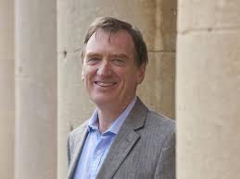
Clifford Cocks (1950 - ) the secret inventor of RSA

Slide 256
RSA key generation
Compute
  random large primes p₁ and p₂
  n = p₁p₂
  φ(p₁p₂) = (p₁ – 1)(p₂ – 1)
  random pub, coprime with φ(p₁p₂)
  prv, the multiplicative inverse of pub modulo φ(p₁p₂)
    wait for the 2nd journey for the algorithm
Destroy: p₁ , p₂
Publish: (pub, n)
  Keep secret: prv

Slide 257
Encoding/decoding
Encode:
power_semigroup(plain_text_block,
pub,
modulo_multiply<I>(n));
Decode:
power_semigroup(cipher_text_block,
prv,
modulo_multiply<I>(n));

Slide 258
Justification of RSA
Notes:
(m^{\rm pub})^{\rm prv} &= m^{{\rm pub} \times {\rm prv}}\\
&= m^{1 + q\phi(p_1p_2)}\\
&= mm^{q\phi(p_1p_2)}\\
&= m({m^{\phi(p_1p_2)}})^q\\
&= m + wn

Slide 259
Presupposition
Factoring is hard and, therefore, computing φ is not feasible.
The presupposition is not true if quantum computers are realizable.

Slide 260
extended_gcd
template <EuclideanDomain I>
std::pair <I, I> extended_gcd(I a , I b) {
if (b == 0) return std::make_pair(I(1), a);
I u(1);
I v(0);
while (true) {
I q = a / b;
a -= q * b; // a = a % b;
if (a == I(0)) return std::make_pair(v, b);
u -= q * v;
q = b / a;
b -= q * a; // b = b % a;
if (b == I(0)) return std::make_pair(u, a);
v -= q * u;
}
}
Notes:
To be explained later.

Slide 261
multiplicative_inverse
template <Integer I>
I multiplicative_inverse(I a, I n) {
std::pair<I, I> p = extended_gcd(a, n);
if (p.second != I(1)) return I(0);
if (p.first < I(0)) return p.first + n;
return p.first;
}
returns multiplicative inverse of a modulo n if it exists or 0 if it does not.

Slide 262
Project 262
Implement RSA key generation library.
Implement RSA message encoder/decoder that takes a string and the key as its arguments.

Slide 263
“Spoils of the Egyptians”?
Let us take from mathematicians what is eternal and beautiful, while leaving behind their passing fads.

