Slide 1
Epilogue
Alex Stepanov

Slide 2
The reason for not doing Journey 4
First three journeys covered three approaches to mathematics.
  Number Theory
  Abstract Algebra
  Logic and Set Theory
The forth journey did not appear to me to have a compelling theme.
  I am not sure that it affects the outcome.

Slide 3
The lessons of the course
Knowledge of Homeric Greek is necessary for a programmer.
You should try to enroll to the University of ‪Göttingen‬ with David Hilbert as your advisor.
You cannot use STL unless you deeply understand the Zermelo-Fraenkel axioms.

Slide 4
au contraire…
And further, by these, my sonne, be admonished: of making many bookes there is no end; and much studie is a wearinesse of the flesh.
Ecclesiastes, 12:12

Slide 5
Canon
A civilization needs a canon to be formed.
The canon must be permanent.
The canon must be small.
The canon must be ancient.

Slide 6
Programming Canon
Elementary algebra
  algebraic manipulations are the basis programming
Euclidian geometry
  provides a large structure that allows one to learn architectural skills

Slide 7
Primary texts on Algebra
George Chrystal, Elementary Algebra, volumes 1 and 2, AMS, 1999
  http://www.amazon.com/Algebra-Elementary-Text-Book-2-set/dp/0821819313/
H.S. Hall and S.R. Knight, Elementary Algebra, Higher Algebra (two separate volumes)
    many reprints, but beware of poor quality
Of historical importance are
  Isaac Todhunter, Algebra for use of Colleges and Schools
  George Peacock, Treatise on Algebra, Vol. 1 and 2

Slide 8
Primary texts in Geometry
Euclid, The Thirteen Books of the Elements, Vol. 1: Books 1-2http://www.amazon.com/The-Thirteen-Books-Elements-Vol/dp/0486600882/
Euclid, The Thirteen Books of the Elements, Vol. 2: Books 3-9 http://www.amazon.com/The-Thirteen-Books-Elements-Vol/dp/0486600890/
Euclid, The Thirteen Books of the Elements, Vol. 3: Books 10-13 http://www.amazon.com/The-Thirteen-Books-Elements-Vol/dp/0486600904/

Slide 9
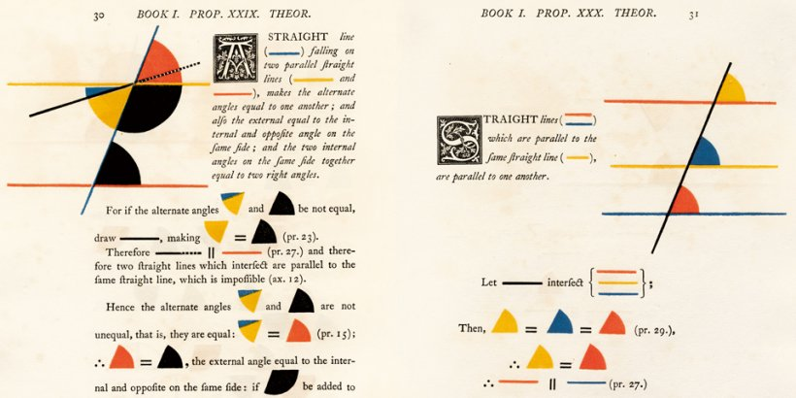
Oliver Byrne’s Edition

Slide 10
Byrne’s Euclid
http://www.amazon.com/Six-Books-Euclid-Werner-Oechslin/dp/3836517752/

Slide 11
How about…
Category theory
Linear logic
Type theory
Fuzzy logic
…

Slide 12
never mind…

Slide 13
Jean Piaget advice
When you are working on something, read nothing in the field; read afterwards only.
Read as much as possible in related fields.
Have a whipping boy.
Notes:
“Conversations with Jean Piaget” pages 126-127

